Slide 1
Competency-Based Assessment of Students in the Clinical Setting

Slide 2
Overview of Session
How to access the form.
Terminology associated with new form (e.g. milestones). It will be key that terms are used consistently.
Explanation and discussion of representative items on the form.
Writing narratives to support the selection of assessment choices and students overall performance.
Conducting the mid-clerkship formative evaluation and the end-of-clerkship summative evaluation with the student

Slide 3
Goals for Session
Increased understanding of:
items on the form.
terminology associated with the form.
importance of narrative comments to support milestones checked as observed and to give guidance to the student.

Slide 4
How Do I Access the New Form?
Accessed same way as old form
Go to FSUCOM web page (http://med.fsu.edu/)
Under “My Resources” (on left column of page) select “E*Value.”
Login with username and password.
Click on FSU, M3 & M4 Clerkships
Click on “your” uncompleted evaluations.

Slide 5
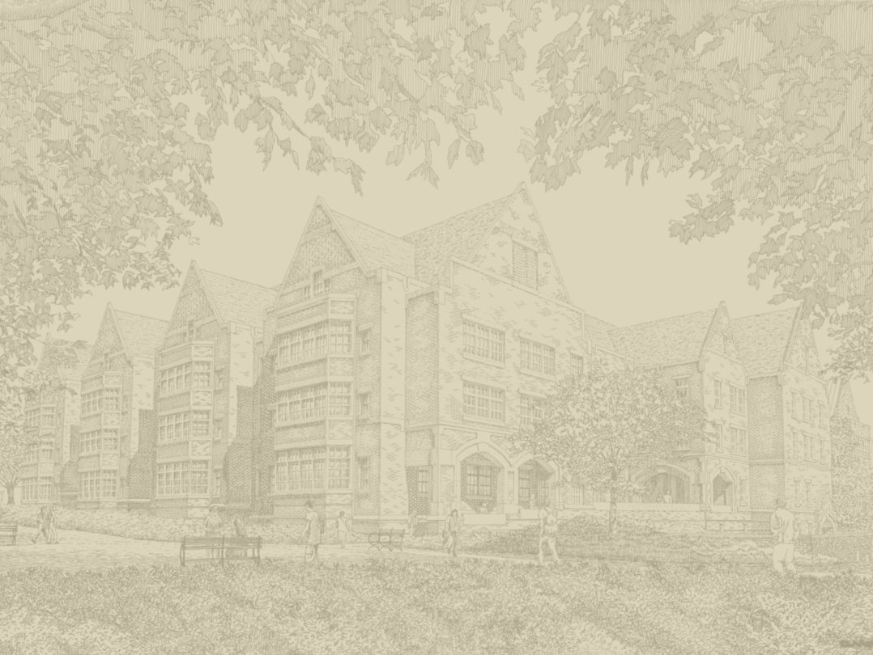
Log in with your med Username and Password

Slide 6
It’s the Same Log in that You’ve been Using for CDCS

Slide 7
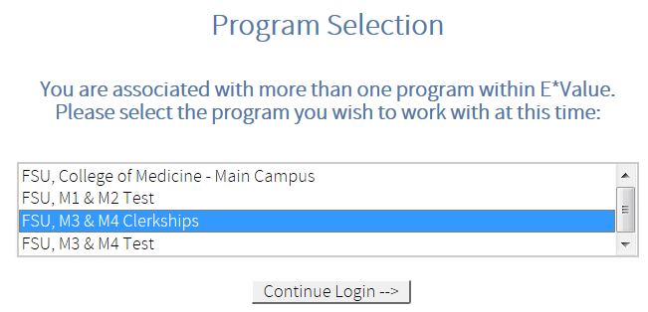
Select the program that you need. You should only choose M3 & M4 Clerkships
ESSENTIAL STEP!!!
Notes:
For right now, you will be practicing in M3 & M4 Test only. We will let you know when the M3 & M4 Clerkships program is ready to go live.

Slide 8
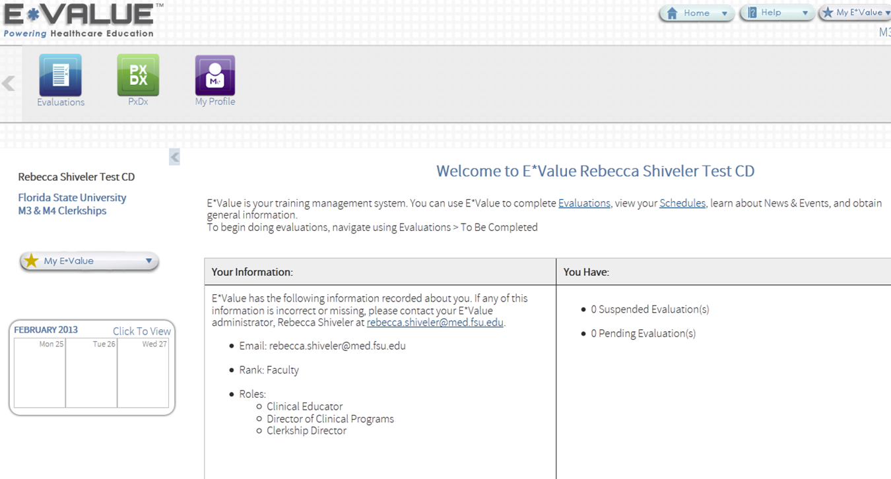
Your next screen will identify you and all of the roles you have in that program.

Slide 9
Rationale for Movement to Competency Based Evaluation
Hallmark of competency-based evaluation is directly observed behaviors
Milestones on new form specify COM expectations as opposed to individual clinical faculty expectations.
Eliminates the need to compare students to each other
Behaviors on new form provide clarity to student and to faculty to increase fairness and ease of use.
Notes:
Regulatory agencies moving in this direction.

Slide 10
Consistent With Residency Training
FSUCOM has adopted the 6 ACGME competency domains plus “Patient Centered Skills and Behaviors” as the foundation for curriculum redesign.
Patient Care
Medical Knowledge
Practice Based Learning and Improvement
Interpersonal and Communication skills
Systems Based Practice
Professionalism
Patient-Centered Skills and Behaviors
Notes:
Regulatory agencies moving in this direction.

Slide 11
Aligns Curriculum and Evaluation
We are developing a curriculum that is developmental, integrated and competency –based
This evaluation tool will be developmental and competency-based as well

Slide 12
Miller’s Pyramid
What you observe the student doing in the context of actual patient care.
Miller’s pyramid. From Academic Medicine 1990;65:S63–7
Notes:
The new assessment instrument is all about what the student does that is observable in the context of actual patient care. George Miller’s Pyramid was published in an article he wrote in Academic Medicine in 1990, entitled, The Assessment of Clinical Skills/Competence/Performance.

Slide 13
Directions on the New Form
Directions: In each of the assessment categories below, a group of “developmental milestones” (progressive performance expectations) for clerkship students has been defined.
For each assessment category, please mark the developmental milestone you observed the student demonstrate during the clerkship.
Notes:
Participants could be referred to the actual paper copy of the form as you show this slide.

Slide 14
Terminology
Competency Domains/Areas
Assessment Categories
Developmental Milestones
Progressive Performance Expectations

Slide 15
PATIENT CARE
1. When performing a physical exam, did the student?
Use appropriate exam techniques? (Quality of exam)
Focus the exam based on the patient history? (examine appropriate organs, systems of body areas)
Distinguish normal from abnormal findings? (Interpreting exam results)
Progressive Development Milestones
Notes:
Comment linked to 3rd box
End of 3rd year on consistent basis.
What is difference between appropriate information vs “only” relevant information (from pattern recognition)

Slide 16
PATIENT CARE
2. In the area of data gathering, the consistency of this student’s performance was:

Slide 17
PATIENT CARE
3. In the area of data gathering, the quality of the student’s performance was:

Slide 18
PATIENT CARE
4. When constructing a differential diagnosis, did the student:
Justify/explain the inclusion (or exclusion) of possible diagnoses?
Prioritize the potential diagnoses based on appropriate consideration of epidemiology, severity and ability to treat?

Slide 19
MEDICAL KNOWLEDGE
5. When discussing patients and their clinical problems/conditions with you, did the student:
Integrate knowledge of foundational (basic) and clinical sciences in creating a differential diagnosis?
Apply knowledge of foundational (basic) and clinical sciences in creating an initial plan of care?
Notes:
How it manifests itself in symptoms and signs
There are three student performance items related to Medical Knowledge for you to assess.
Typical average student in first or second clerkship.
Would you expect that a student comes to you to be able to do 1 and 2.
Ex of developmental

Slide 20
MEDICAL KNOWLEDGE
6. In the area of medical knowledge, the consistency of this student’s performance was:

Slide 21
MEDICAL KNOWLEDGE
7. In the area of medical knowledge, the quality of the student’s performance was:

Slide 22
INTERPERSONAL AND COMMUNICATION SKILLS (Please check all that apply)
8. When giving an oral presentation of the patient, did the student:
Present history and physical exam findings in a logical and organized format?
Recognize and include all of the important data in the presentation (include key facts)?

Slide 23
INTERPERSONAL AND COMMUNICATION SKILLS
9. In the area of interpersonal communications, the consistency of this student’s performance was:

Slide 24
PATIENT-CENTERED SKILLS AND BEHAVIORS (Please check all that apply)
10. When interacting with patients, did the student:
Ask about unique impact of personal, family, cultural , socioeconomic, and spiritual factors that impact the patient?
Incorporate patient preferences into the proposed plan of care?
Negotiate the final plan of care after discussing treatment options and addressing patient questions/concerns?
14. When interacting with patients, did the student:
Identify how the patient’s problem impacts his/her work, leisure or relationships?
Identify patient perceptions about the cause/origin of their problem?
Allow the patient to speak without unnecessary interruptions?
Construct empathetic statements to promote patient rapport?
Notes:
“Student did a nice job collecting the family and cultural issues. She seemed uncomfortable with spiritual issues. I did not hear her negotiate a plan of care with the patients.”

Slide 25
PATIENT-CENTERED SKILLS AND BEHAVIORS
11. In the area of patient-centered skills and behaviors, the consistency of this student’s performance was:

Slide 26
Professionalism
Directions: For each of the four professionalism assessment categories below, please mark either “yes” or “no” based on your observations of the student’s behavior during the clerkship.
Note: Giving a “No” does not constitute a failure. Giving a “No” answer requires an explanation.

Slide 27
PROFESSIONALISM
We expect students to:
Be punctual, reliable and honest;
Show compassion for those in need;
Respect patient rights (confidentiality, autonomy) and demonstrate high ethical standards in all aspects of medical practice and
Strive for excellence, while demonstrating self-awareness

Slide 28
PROFESSIONALISM
12. Did the student meet these professionalism expectations?
Yes
No (A “No” response requires comment below.)

Slide 29
Specialty-Based Additional Questions
Family Medicine and Psychiatry
13. When interacting with patients suffering from psychosocial/emotional disorders, did the student
Identify specific patient behaviors (or responses) that suggest a psychosocial/emotional disorder?
Utilize appropriate clinical screening tools (MMSE, depression screens, CAGE, ADHD screen) to identify patients at risk for psychosocial/emotional disorders?
Utilize accepted diagnostic tools (Mental Status Exam) to confirm the presence of psychosocial/emotional disorders
Utilize DSM-IV (or V) to correctly classify psychosocial/emotional disorders

Slide 30
Surgery and Obstetrics
14. When discussing/performing common procedures, did the student:
Know the indications for a specific procedure?
Know the most common complications of a specific procedure?
Outline the sequence of steps in performing the procedure?
15. When involved with surgical procedures, did the student:
Demonstrate awareness and understanding of sterile technique?
Demonstrate the ability to adequately assist with the procedure?
Demonstrate the ability to perform a minor procedure with coaching?

Slide 31
STAGE OF STUDENT DEVELOPMENT
16. Rate the overall quality of the student’s performance
At or above the level of a first year resident
At the level of a fourth year student
At the level of an experienced third year student
At the level of a new third year student
Below the level of a new third year student

Slide 32
NARRATIVES
Describe the student’s overall performance
Provide specific examples and summary statements
Examples and summary statements may be used in Dean’s Letter for residency application.

Slide 33
Preparing Your Written Comments
Become familiar with the student assessment form for the rotation, its competency domains, and performance descriptions.
Good narrative comments are:
• Constructive
• Concise
• Specific
• Actionable

Slide 34
Consider Modifiers
Time: Consistent, reliable, making progress
Accuracy: Precise, complete, comprehensive
Organization: Organized, systematic, logical
Presentation: Clear, articulate, expressive
Lifelong learning: Insightful, responsive, demonstrating initiative.

Slide 35
What is the learner doing well?
Describe specific skills or behaviors you observed which illustrate that the learner has met competency expectations for the rotation.

Slide 36
What could be improved?
Describe specific skills or behaviors you observed which you feel that the learner should further develop before the next rotation or phase of training.

Slide 37
What to Avoid In Narratives
Avoid vague, global statements, such as “great to work with” or “good student.”

Slide 38
PATIENT CARE
Examples and additional observations about the patient care ability of the student.
History Taking: “She had an excellent grasp of the comorbidities of the common chronic diseases and always included them in her histories.
Student did not seem to understand the adult immunization schedule or cancer screening guidelines. ”
Physical Exam: "I was surprised that the student could correctly identify a pericardial rub at this early stage of training.”
Differential Diagnosis: “Student could create an adequate differential diagnosis list, but she included more “Zebras” than common things. She was fast with her digital searches, but I don’t think she knew very much about the diagnoses that she found.”
Plan of Care: “This was the student’s first rotation. She could explain the tests she ordered, but left out many that should also have been included.”

Slide 39
Examples and additional observations about the student’s medical knowledge.
“Student A “ quickly learned the detailed information required in our speciality. He wrote a handout on Tardive Dyskinesia to help patients make informed decisions about medications that can cause this adverse effect. He also evaluated the research on various strategies for alcohol detoxification, to determine the best strategy supported by the evidence.

Slide 40
Examples and additional observations about the student’s communication skills.
“Student K’s ” interactions with patients was friendly, empathetic, and professional. It was obvious to patients that she was interested and that she was happy to be providing care, which helped patients be comfortable with her. Her explanation of concepts is easy to understand. She developed a power-point presentation on the role of neurotransmitters in Attention Deficit Disorder, and parents appreciated how she answered their questions on what was is issue in the brain with this disorder.

Slide 41
Professionalism
Examples and additional positive and negative comments about the student’s “Professionalism?”
“Student M” demonstrated an exemplary professional manner every day she was with us. Her appearance, dress, and quiet, friendly manner illustrated her respect to patients. Her professionalism was apparent in her helping her fellow students by writing an illustrated quick start guide for future students to quickly access our computer network and medical records.

Slide 42
AREAS FOR IMPROVMENT
22. Examples of areas of student performance needing improvement:
“ Although Student “L” performs complete and thorough patient evaluations, he tends to collect unnecessary or irrelevant data in his HPIs. Efficiency is also an important goal to accomplish in a busy office practice and for him to work on improving.”
“ Student “Y” tends to jump to clinical conclusions without sufficient data to support them, causing him to look at a problem too narrowly. Needs to maintain a broader view in taking patient histories.”

Slide 43
NOTABLE SKILLS AND ATTRIBUTES
23. Example of admirable or notable skills and characteristics that a student possesses:
“Student S” is already becoming an exemplary physician graduate of FSU-COM, one that we point out with pride. She goes the extra mile to provide outstanding evaluations and effective treatment plans. Patients find her to be friendly, interested, professional, and easy to learn from. She gets along well with physicians, staffs, and students, and had outstanding organizational skills. She will be a highly valued and effective member or leader in a treatment team, and will be an outstanding physicians in any residency program. I would be pleased to find “S” providing medical care to me in my geriatric years.

Slide 44
Mid-Clerkship Formative Feedback
The student will be encouraged to self evaluate using the form as a template
Faculty can review the form and student’s evaluation to give formative feedback
Student can use this meeting to create a plan for the remainder of the clerkship
Notes:
Ask for self-assessment
Reinforce
Correct
Help

Slide 45
A Word of Caution
Student meetings with the faculty at mid and end of rotation are evaluative, they are not negotiations for a grade

Slide 46
Questions/Comments
Contact:
Greg Turner, Ed.D, MBA, MPH
Associate Dean for Faculty Development
gregory.turner@med.fsu.edu

