Slide 1
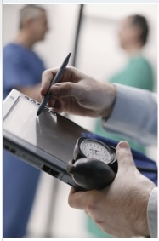
Using an EMR as a Teaching Tool
For Case-based Discussions and Clinical Scenarios as well as Documentation
Nancy Clark, M.Ed.
Director of Medical Informatics Education
FSU College of Medicine
Summer 2011

Slide 2
Objectives
Define current terms in EMR
Describe what students can do legally in preceptor EMRs
Develop cases suitable for EMR
Have hands on experience with cases
Describe logistical issues in using EMR
Teach students to use technology with patients effectively

Slide 3
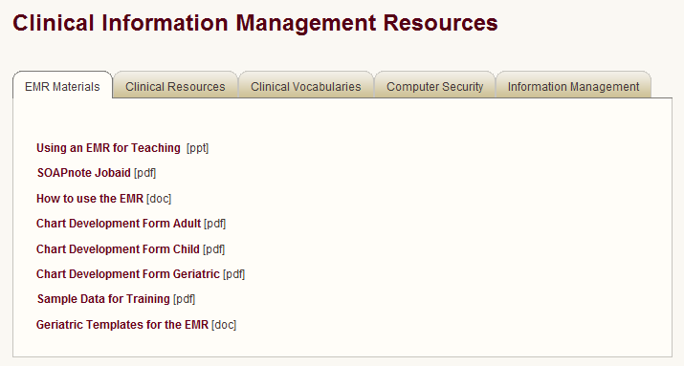
Resources for Workshop
http://med.fsu.edu/informatics

Slide 4
Historical Perspective
Weed, LI. (1968) Medical records that guide and teach. New Eng J of Med. 278(11); 593-657.
Introduced the POMR
Proposed using computers to store medical records
Using a series of screens that prompted good clinical decision making

Slide 5
Technology in medical Practice 2011

Slide 6
Interesting Times
Notes:
You are going to be seeing a lot of changes over the next few years.
Meaningful use checks are coming, and time is running out to get on board http://medicaleconomics.modernmedicine.com/memag/article/articleDetail.jsp?id=726230&sk=f28bfc68fa865f56975f3f228b682149
Publish date: Jun 8, 2011 By: Ken Terry Source: Medical Economics eConsult The Centers for Medicare and Medicaid Services (CMS) on May 19 mailed the first Medicare checks, totaling $75 million, to physicians who had attested that they had achieved meaningful use of their electronic health records (EHRs). Juan Salazar, an internist from McAllen, Texas, and three physicians from the multispecialty West Broadway Clinic of Council Bluffs, Iowa, each received $18,000 in the initial installment of meaningful use payments that can total up to $44,000 for Medicare providers.
Nearly $64,000 is available to each eligible professional from state Medicaid programs, which have dispensed $83 million in incentive payments to hospitals and doctors since January. But Medicaid patients or other “needy individuals” must comprise 30% of a physician’s practice (or 20% of a pediatric practice) for that doctor to be eligible for Medicaid incentives. Far more doctors in private practice are eligible for Medicare bonuses for meaningful use.
What effect will the Medicare payments have on the colleagues of doctors who receive meaningful use checks? Erica Drazen, managing partner, emerging practices, for CSC Consulting, says that the actual arrival of checks from Medicare will encourage more doctors to acquire EHRs and show meaningful use. Until now, she says, some doctors have wondered whether they would really get the promised funds.
“Remember, there was a pay for performance initiative for docs and nobody got much money out of it,” she says. “Then there was an e-prescribing program, and the money was pretty small. So people are skeptical about incentives. Are the thresholds going to be achievable, and is the money really going to be there?”
Now that people are actually getting checks, Drazen says, “It will show that this is achievable. Will this convince somebody who’d decided they weren’t going to implement an EHR? Probably not. But it’s another sign that this is real.”
The first payments to other physicians may encourage some doctors who may have been putting off buying an EHR to move ahead, Drazen says. She adds that physicians can earn $3,000 more if they qualify for the payments in 2011 or 2012 than if they wait until 2013 to file their first application. Also, doctors who don’t do anything face financial penalties, starting in 2015. Their Medicare payments will be lowered by 1% that year, with reductions rising to as much as 5% in subsequent years.
While the meaningful use payments won’t cover the full cost of an EHR, “this is a one-time deal,” Drazen points out. “It’s a substantial chunk of money, and you’re not going to have another chance to get it. So if you figure, ‘I’ve got to get an EHR, it’s going to be the standard of practice and I have to get it done,’ this would be the time to do it.”
The only doctors who probably won’t, Drazen says, are those who plan to retire or sell their practices, or who earn so much they don’t care about the penalties.

Slide 7
Incentives Program
American Recovery and Reinvestment Act (ARRA) $44-64K per physician
CMS EHR Incentive Programs
Meeting meaningful use criteria for CMS EHR Incentives Program
CCHIT (Certification Commission for Health Information Technology) Certifies EMRs
Notes:
Widespread adoption of health information technology (health IT) can foster improvements in quality, safety, efficiency and access – key goals in today’s national dialog on health reform.
In February 2009, Congress acknowledged the value of certification in the language of the American Recovery and Reinvestment Act (ARRA) aimed at stimulating the nation’s economy. The law offers a multi-year series of incentive payments to providers and hospitals for the meaningful use of certified EHR technology. The total amount of payments has been projected by the Congressional Budget Office at $34 billion.
These goals also drive the Certification Commission for Health Information Technology (CCHIT®), a nonprofit, 501(c)3 organization with the public mission of accelerating the adoption of health IT.
A solid foundation for electronic health record technology
Founded in 2004, and certifying electronic health records (EHRs) since 2006, the Commission established the first comprehensive, practical definition of what capabilities were needed in these systems. The certification criteria were developed through a voluntary, consensus-based process engaging diverse stakeholders, and the Certification Commission was officially recognized by the federal government as a certifying body.

Slide 8
Meaningful Use Criteria (briefly)
Use computerized provider order entry (CPOE)
Implement drug-drug and drug-allergy interaction checks.
Maintain an up-to-date problem list of current and active diagnoses.
Generate and transmit permissible prescriptions electronically (eRx).
Maintain active medication list.
Maintain active medication allergy list.
Record all of the following demographics: Preferred language, Gender, Race, Ethnicity, Date of birth.
Record and chart changes in the following vital signs: Height, Weight, Blood pressure, Calculate and display body mass index (BMI).
Notes:
We want to emphasize to you what aspects of the chart that you are seeing that meet meaningful use criteria.

Slide 9
Meaningful Use Criteria (briefly)
Plot and display growth charts for children 2–20 years, including BMI.
Record smoking status for patients 13 years old or older.
Report ambulatory clinical quality measures to CMS
Implement one clinical decision support rule relevant to specialty or high clinical priority along with the ability to track compliance with that rule.
Provide patients with an electronic copy of their health information (including diagnostics test results, problem list, medication lists, medication allergies) upon request.
Provide clinical summaries for patients for each office visit.
Notes:
Because this is more of a simulation than the real thing, you will not get to do all of these. But you should notice when you are at sites if they are using all the meaningful use aspects of an EMR.

Slide 10
HIMSS 2011 Annual Survey
http://www.himss.org/2011Survey/healthcareCIO_final.asp
Healthcare CIOs
#1 IT priority next 2 yrs: achieve Meaningful Use
#1 business issue with impact on healthcare: healthcare reform
#1 area that IT can most impact patient care: improve quality outcomes
Status of adoption of EMRs…
Notes:
On February 17, 2009, President Barack Obama signed the American Recovery and Reinvestment Act (ARRA). Title XIII of ARRA, called the Health IT for Economic and Clinical Health Act (HITECH) allocated $19.2 billion toward health IT. This act seeks to bolster health IT to improve the delivery of healthcare in the United States. With various provisions and regulations, the Act provides assistance, tools, and resources to providers to allow for implementation and utilization of electronic health records.
Without a doubt, ARRA is the driving force in the healthcare industry at this time. When asked to identify the single information technology (IT) priority at this time, half of respondents identified meeting meaningful use criteria, according to the 326 healthcare IT professionals who participated in the 22nd Annual HIMSS Leadership Survey. Two-thirds of respondents reported that their organization has already made additional IT investments to position themselves to qualify for the incentives associated with achieving meaningful use.

Slide 11
Notes:
For the purposes of this research, an EHR is electronically originated and maintained clinical health information for patients, derived from multiple clinical application sources, about an individual’s episode of healthcare at a care delivery organization. It contains all clinical orders and documentation related to a patient’s treatment in electronic format. An EHR is also supported by clinical decision support systems and replaces the paper medical record as the primary source of patient information.
Based on this definition, respondents were asked to identify the current status of the EHR environment at their organization. Slightly more than one-third of respondents (34 percent) indicated they have begun to install this technology in at least one facility in their organization. Another quarter of respondents (26 percent) indicated that they have a fully functional EHR at one facility in their organization. This is consistent with the data captured in the 2010 study. Another 27 percent reported that they have a fully operational EHR system across their entire organization. This represents a continued increase from 22 percent of respondents in 2010 and 17 percent in the 2009 research.

Slide 12
Advantages of EMRs
Consistent, readable, accessible
Single Entry of data populates multiple locations
Structured data across charts enables consistent reporting
Data can be easily graphed
Best for chronic care

Slide 13
Advantages of Connectivity
Shared data across sites of care
SureScripts ePrescription Network connection (send Rx and get refill requests)
Electronic transfer of lab data
Instant Medical History integration
Device Integration: EKG, Holter, Spirometry
Notes:
Because you are not a real physician, we have not connected our SOAPware installations to these added resources, you won’t be able to use these aspects. However, their use can be simulated by putting in the data before sending to students.

Slide 14
Student Use Of Clinic/Hosp EMR
Variable policies adopted by clinics and hospitals that have EMRs
Training to use from none to little
Adoption estimates?
Access to data:
Charts wide open to students
Limited access to sections
Hands off

Slide 15
Student contribution to charts:
Legally limited to the ROS and Past/Family/Social Hx
Attending must document agreement with the student’s findings
HPI, PE, and Medical Decision Making may be documented by a student
but must be performed and REDOCUMENTED by attending
Medicare Transmittal 811; Released January 13, 2006; • Updates Transmittal 1720
Notes:
Medicare Transmittal 811
• Released January 13, 2006
• Updates Transmittal 1720
Definition of a Student
“An individual who participates in an accredited educational program (e.g., a medical school) that is not an approved GME program. A student is never considered to be an intern or a resident. Medicare does not pay for any service furnished by a student”
“Any contribution and participation of a student to the performance of a billable service (other than the review of systems and/or past family/social history which are not separately billable, but are taken as part of an E/M service) must be performed in the physical presence of a teaching physician or physical presence of a resident in a service meeting the requirements set forth in this section for teaching physician billing.”
“Students may document services in the medical record. However, the documentation of an E/M service by a student that may be referred to by the teaching physician is limited to documentation related to the review of systems and/or past family/social history. The teaching physician may not refer to a student’s documentation of physical exam findings or medical decision making in his or her personal note. If the medical student documents E/M services, the teaching physician must verify and redocument the history of present illness as well as perform and redocument the physical exam and medical decision making activities of the service.“

Slide 16
Patient Info on Student Laptops
HIPAA requirements for real patients
No Patient Identifiable Information
Make up names and birthdates
Gender OK, marital status OK
No SSN, address, phone
Applies to any assignments/ documentation stored outside facility
Best used for simulated patients—no HIPAA concerns
Notes:
You have an EMR on your laptop that you are welcome to experiment with. Do not include any patient identifiable information into that EMR or Word document that will be stored on your laptop.

Slide 17
Meet Patients
Beatrix Rodriguez
Baby Girl

Slide 18
Starting SOAPware 2010
Double-click Icon
Username: train
Password: train
Server (if it asks) is localhost

Slide 19
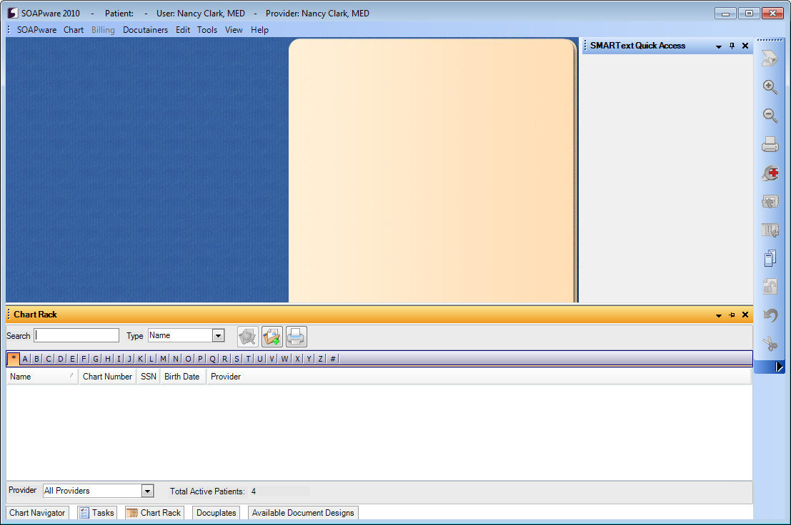
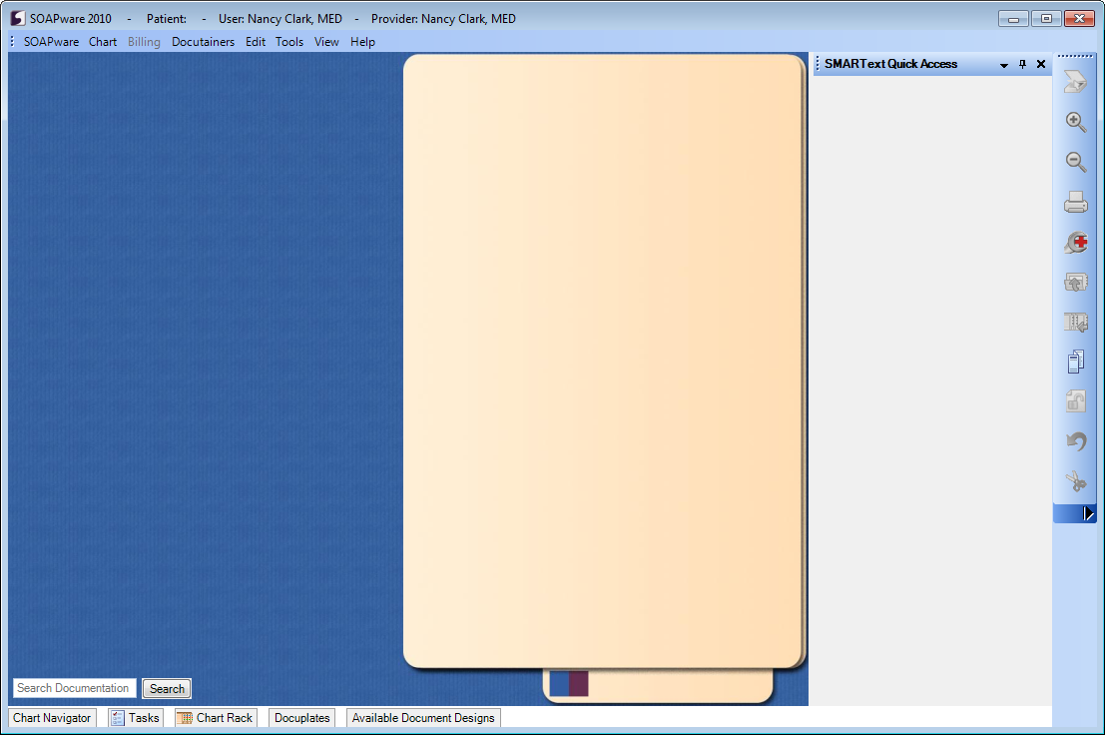
Open a Chart in Chart Rack

Slide 20
Navigating the Chart
Summary Sheet
Vital Signs – Growth Charts
Encounter SOAPnotes
Labs
Flow Sheets
Moving tabs from side to side
Chart Navigation for other sections
Rx Writing, interaction checker
Order Entry

Slide 21
Adding a New Encounter
Click the SOAP Note tab
Click the New Document button
Complete description form and click OK
When the new note opens you will see a blank encounter note
Complete the note.

Slide 22
Optional Exercise
Create a chart from scratch
See Instruction Sheet handout for creating charts

Slide 23
What topics could be taught using Beatrix?
Chronic Dx management
Pharmacology?
Renal physiology?
Patient Education on diet and exercise?
More…

Slide 24
Virtual Clinic Concept
Develop multiple families and individuals to be clinic panel of patients
Various ethnicities, socioeconomic status, age ranges across the development, health insurance coverage/none, education levels
Create complete charts in EMR for all patients/family members
Select a patient from clinic patients/panel to use for any clinical scenario in curriculum across basic science and doctoring

Slide 25
Possibilities
Make some families genetically interesting
Make some families behaviorally interesting
Examples: family violence, substance abuse, LGBT, job loss, bereavement/depression
Insert chronic diseases where appropriate
Hypertension, obesity, diabetes…
Emphasize prevention and health maintenance
Potentially: Build an entire Clinical Foundations curriculum around this panel of patients

Slide 26
Logistics
Getting student access to charts

Slide 27
Developing Patient Chart
Faculty member completes Chart Development Template
Adult
Geriatric
Child
Give to DL or Nancy
We will put into the EMR and make arrangements to get to students

Slide 28
Definitions
Client/Server Configuration
Database of patients on server
Client installed on laptop, accesses server
Server Installation
Database and client on same computer
Remote Desktop
Database of patients on server
Client installed on Terminal Server accessed thru Remote Desktop

Slide 29
Server Installation on Laptop
Student has database and client on their laptop
Patients can be exported from development computer
Chart file posted on central location
Student import charts to their computer

Slide 30
Students Access Charts
From their laptop
Options:
Email or post exported patient on Blackboard
Preload all charts on student laptops
Put chart on server and students access server

Slide 31
Using Technology with Patients
What is wrong with this encounter?
Click on image to bring up video from YouTube
Notes:
All current medical students will use an EMR in their future practice. Assuming that your goal for using an EMR in practice will be to improve safety while having all patient charts in a form that will make them more transportable, reportable, accurate and legible. Also, the EMR should eventually improve your productivity, so that you can complete all your documentation while seeing the patient instead of having to do it after you see the patient. There are a number of impacts that use of technology in the patient encounter can have on communication. What is wrong with this encounter.

Slide 32
CSSC Checklist for Good Patient Communication
Introduce self
Establish rapport
Open ended questions at beginning
Maintain good eye contact
Be supportive and concerned
Used transitional statements
Avoid using medical jargon
Allow patient to speak without interruption
Summarize history
Gave patient a chance to ask questions
Appear poised, professional, confident
How can an
Electronic Medical Record (EMR)
adversely effect patient communication?

Slide 33
Possible Adverse Effects
Computer creates barrier between doctor or student and patient
Poor eye contact
Closed ended questions driven by templates
Missing teaching moments
Pauses while typing/looking for patient education not engaged with patient
What specific actions can we take
to avoid these situations?
Notes:
All of these adverse effects have been identified in the literature. Lets look at one thing– the room arrangement…

Slide 34
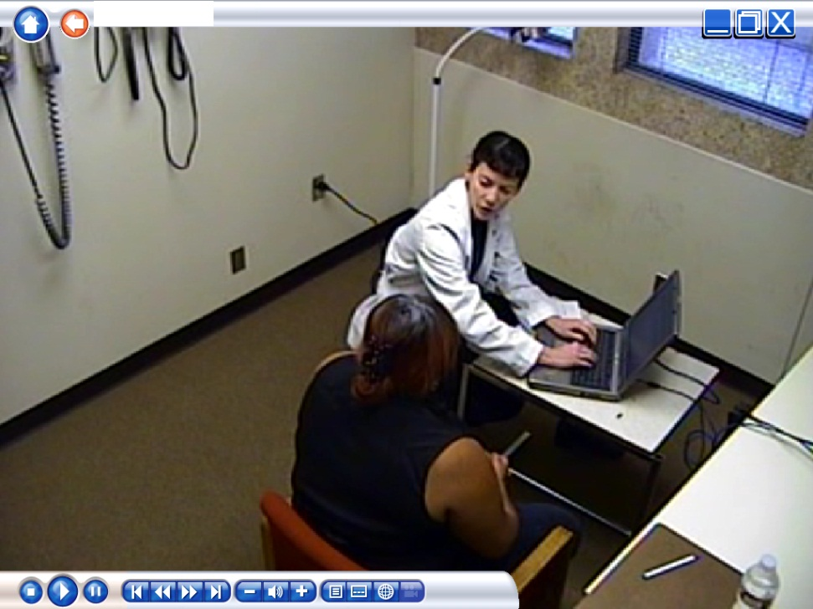
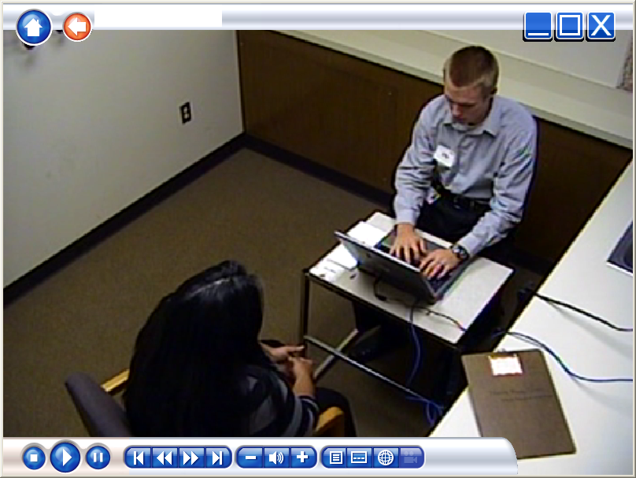
Arranging the Exam Room
Which of these is best? Why?
Notes:
We don’t expect that you will be able to do anything about the room arrangement of your clinical faculty’s clinic. However, in case you do have a say in your own clinic set up, or are using a portable computer,…

Slide 35
5 Tips for Using EMR
Construct a triad with doctor (student), patient and computer
Introduce the computer into the encounter
Adjust screen so patient can see it
Share EMR information on screen with patient
Alert patient verbally “sign posting” when turning to EMR
Notes:
Sign Posting refers to the yellow signs that used to be on the highways that warned the driver of upcoming curves or stop signs. Just as you would alert the patient that you were going to do a certain exam, you should tell the patient that you are going to enter some data or look up the patient’s information in the computer.

Slide 36
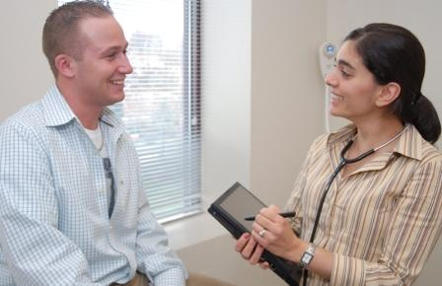
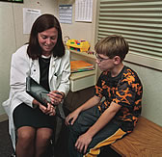
Using Tablet Mode
Advantages? Disadvantages?
Notes:
Have a discussion of what you can do with a tablet.

Slide 37
Ideas for Sharing EMR with Patient
Verify Medication List and Problem List with patient
Show patient his/her vital signs, including weight (gain or loss) and chart
Graph patient’s weight or show flow sheets or show trends about chronic diagnosis
If printer available, ask if patient would like a copy of his/her data
If time allows, access other online patient education materials for patient
Notes:
Summary of ideas,

Slide 38
Major Points for EMR Communication
Introduced self BEFORE turning to computer
Introduced the computer into the doctor/patient/computer triad
If sitting, adjust the chair to be at eye level with patient and so the patient can see screen
Patient should be alerted verbally when turning attention from patient to the computer for longer periods of typing
Notes:
Wrap up

Slide 39
In Summary
These are exciting times in EMR adoption
Student seeing EMRs in preceptor clinics, but getting varied experience
FSU CoM one of few schools to have teaching EMR available instead of clinical EMR only
Student curriculum in EMR use vital to their future and quality of care they deliver

