Slide 1
Using NCBI
Register and get a Username and Password

Slide 2
Why get NCBI Account?
Save searches
Save citations in My Bibliography
Automatically update and e-mail search results from your saved searches
Filter search results
Highlighting search terms

Slide 3
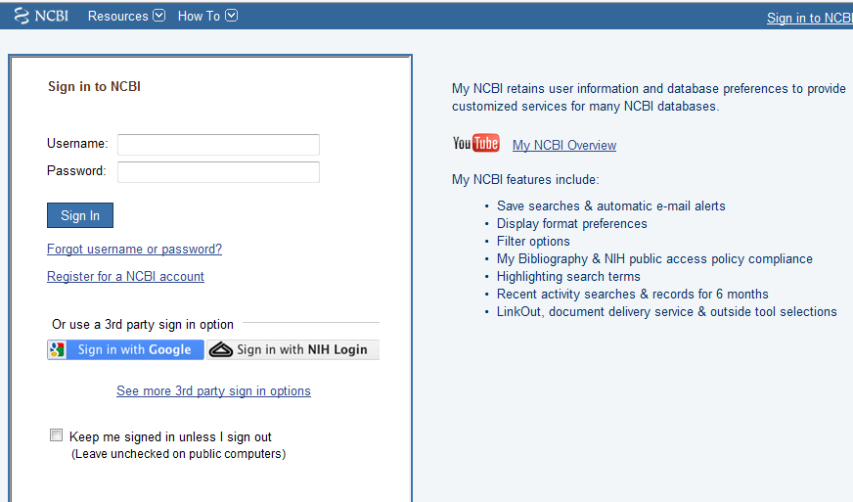
Notes:
To create your account, click on the NCBI in the top right of Pubmed, then Register for a NCBI account.

Slide 4
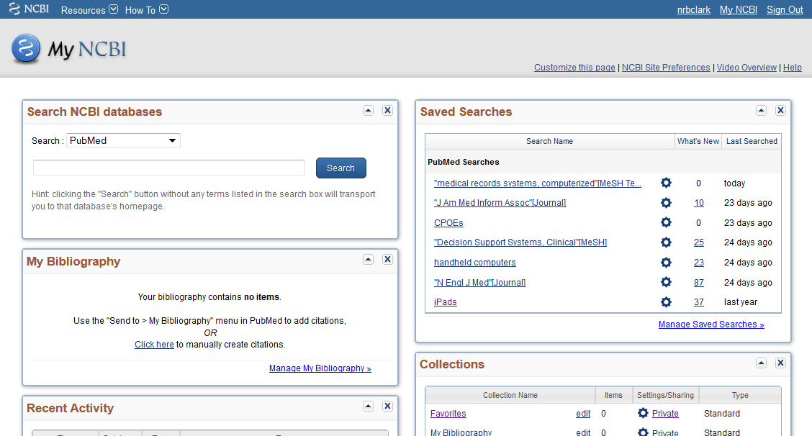
My NCBI
Notes:
Here is what it looks like with several saved searches, collections of articles.

Slide 5
Customize My NCBI
Tutorials: http://www.nlm.nih.gov/bsd/disted/pubmed.html
Saving Searches
Saving References
Customizing the Filters
Highlighting Search Terms
5
Notes:
5

Slide 6
My NCBI – Saving a Search
Develop a search.
Click on ‘Save Search’.
April 29, 2008
Medical Informatics Seminar Session 6
6
Notes:
6
You can modify your search by clicking on it, and modify the email preferences by clicking on ‘Monthly’.

Slide 7
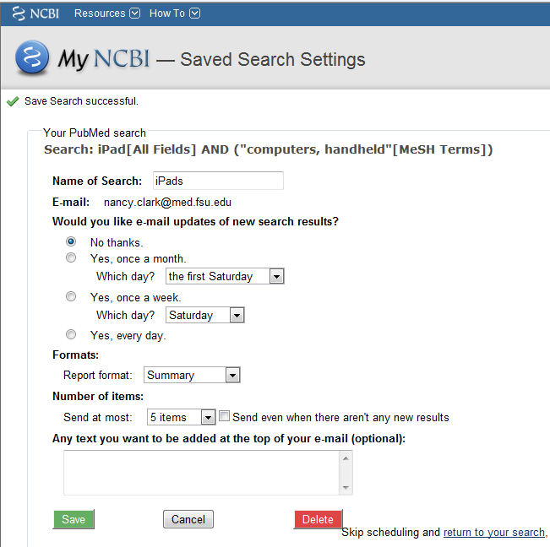
My NCBI – Saving a Search
Give name and Save
Complete form for email notification
‘My NCBI’ puts the search in your list.
Notes:
7
You can modify your search by clicking on it, and modify the email preferences by clicking on ‘Monthly’.

Slide 8
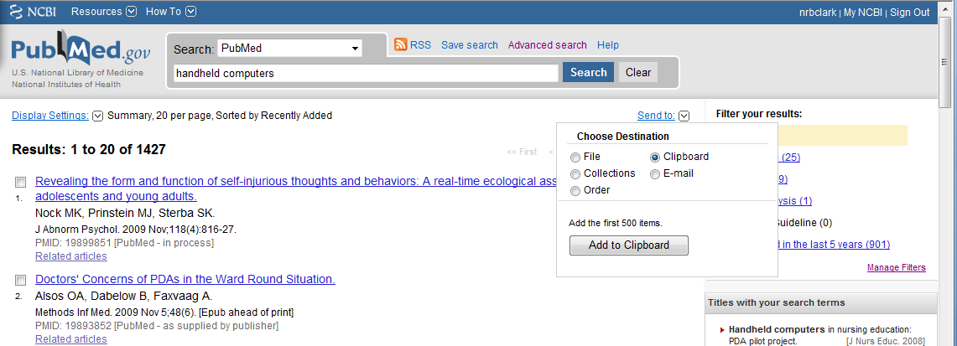
My NCBI – Saving References (1)
Develop a search.
Check the references you want to save.
Click on ‘Send To’ and select ‘Clipboard’.
April 29, 2008
Medical Informatics Seminar Session 6
8
Notes:
8

Slide 9
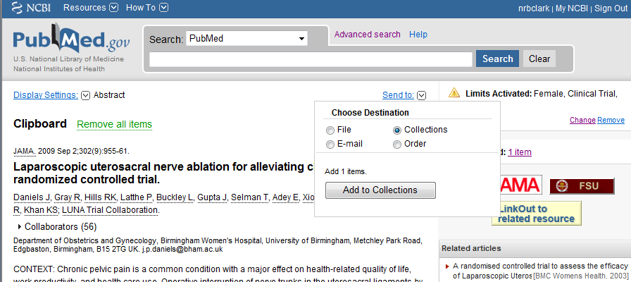
My NCBI – Saving References (2)
Go to the ‘Clipboard’
Click on ‘Send To’ and select Collections.
Notes:
9

Slide 10
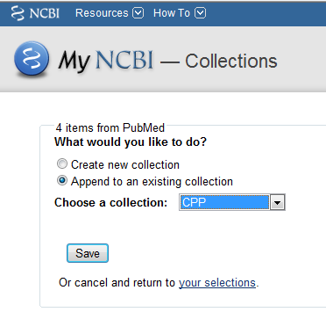
My NCBI – Saving References (3)
Tell My NCBI what to call the collection
Or Append to an existing collection
April 29, 2008
Medical Informatics Seminar Session 6
10
Notes:
10
Again, you can modify your search, or add or delete references from the collection.
Another use for clipboard is to collect references to download to a reference manager such as EndNote or RefWorks.

Slide 11
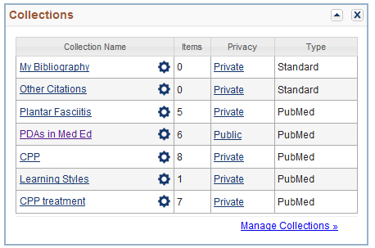
My NCBI – Saving References (4)
To see the collection or saved search, click on ‘My NCBI’ > Collections
Can download collections into a reference manager such as EndNote or RefWorks.
11
Notes:
11
Again, you can modify your search, or add or delete references from the collection.
Another use for clipboard is to collect references to download to a reference manager such as EndNote or RefWorks.

Slide 12
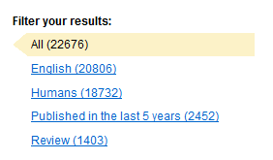
My NCBI – Customizing the Filters
Click on ‘My NCBI’
‘Manage Filters’
Notes:
12
Again, you can modify your search, or add or delete references from the collection.
Another use for clipboard is to collect references to download to a reference manager such as EndNote or RefWorks.
You can also get to filters using the hammer and wrench icon next to the current tabs.

Slide 13
My NCBI – Customizing the Filters
Select from Popular, or Search in Properties.
Create a Custom Query
Notes:
13
Again, you can modify your search, or add or delete references from the collection.
Another use for clipboard is to collect references to download to a reference manager such as EndNote or RefWorks.
You can also get to filters using the hammer and wrench icon next to the current tabs.

Slide 14
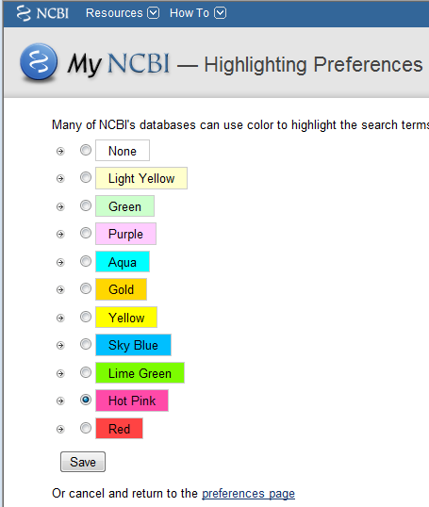
My NCBI – Highlighting Search Terms
Click on ‘NCBI Site Preferences’.
Click on ‘Highlighting’
Pick colors
Notes:
14
Again, you can modify your search, or add or delete references from the collection.
Another use for clipboard is to collect references to download to a reference manager such as EndNote or RefWorks.

Slide 15
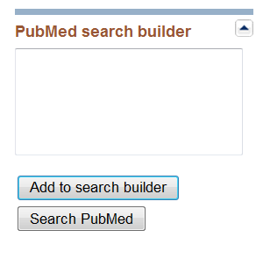
Have Journal Contents Sent (1)
Main Pubmed Page: Journals in NCBI Databases
Enter a general subject term, e.g. “New England Journal”, then ‘Go’.
Click on a journal title to get information about that journal.
Check Journal and Add to Search builder

Slide 16
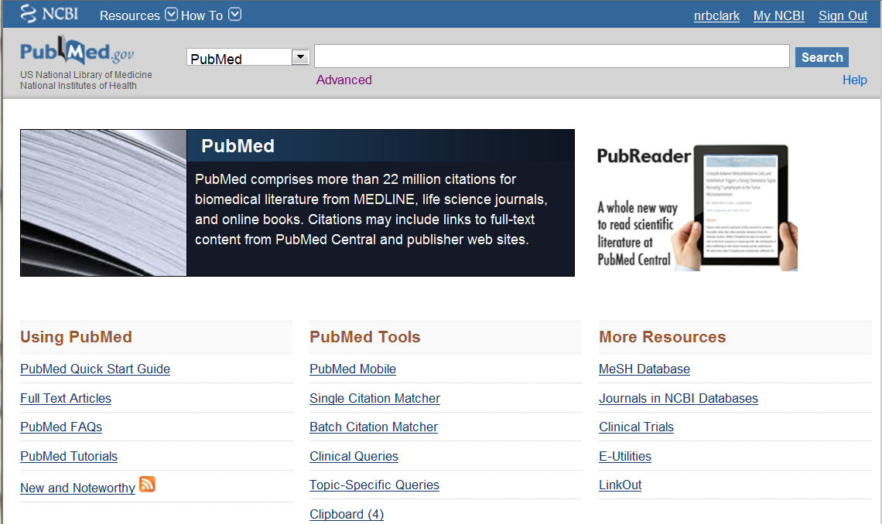
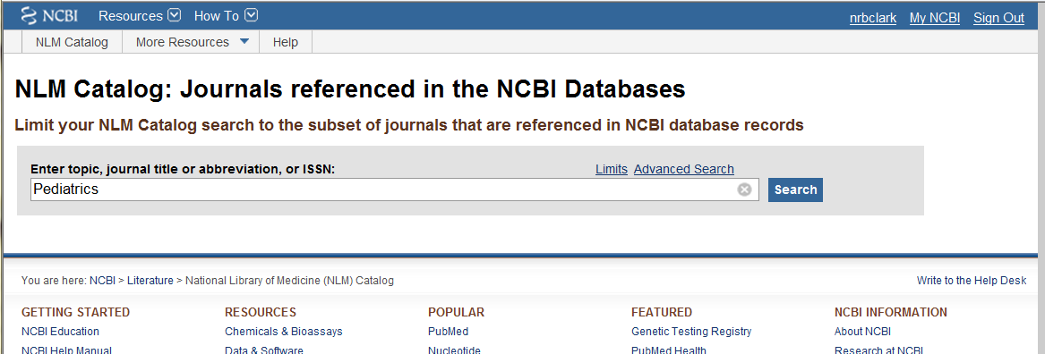

Slide 17
Have Journal Contents Sent (2)
Click on ‘Search PubMed’.
Click on ‘Save Search’, name it, and set up email as earlier.
You will be notified when new articles are published in these journals.
Notes:
17

Slide 18
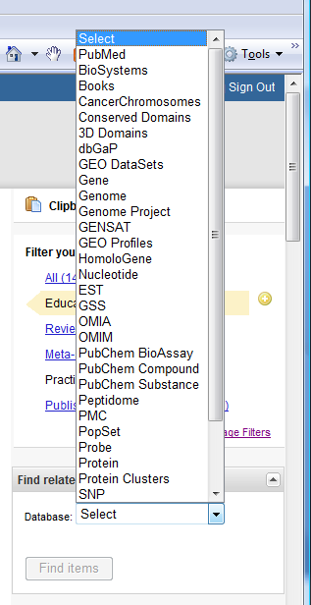
Links to Other NCBI Databases
NCBI has other databases that link to PubMed. (examples: CoreNucleotide, Gene, HomoloGene, Protein, Protein)
18
Notes:
18

Slide 19
Summary
Use Pubmed to Search for Articles on your topics, My NCBI to manage
Link through Dynamed or uCentral MEDLINE search
Use red FSU button to find articles
If no button: Google Scholar > eJournals list > FSU Journals > Interlibrary loan
Any journal article you need, we will get

Slide 20
The End
Practice
Call or e-mail us for individual help
850-644-3883
MedLibrary@med.fsu.edu

