Slide 1
Social Media and Medicine
Warning: this is disruptive technology
Nancy B. Clark, M.Ed., et al
2016
Notes:
The notion of disruptive innovation was popularized by Clayton Christensen [1, 2], and is described as change, usually technological, that causes upheaval of an entire industry sector.
[1] Christensen, C. (1997). The Innovator's Dilemma: When New Technologies Cause Great Firms to Fail. Boston, MA. Harvard Business School Press. [2] Christensen, C. (2012). Disruptive Innovation, in Soegaard, M. and Dam, R., eds. Encyclopedia of Human-Computer Interaction. Aarhus, Denmark. The Interaction-Design.org Foundation. http://www.interaction-design.org/encyclopedia/disruptive_innovation.html.

Slide 2
Thank You
Thanks to all the people who helped put together this workshop:
Martin Wood –Director Medical Library
Mark Strickland – MD (Psychiatry)
Terri Johnson – Medical Informatics Librarian
Debralee LaSeur – Medical Education
Amy Griffith – Branding Expert
Rob Campbell – MD (FM) Asst Dean Student Affairs
Doug Meuser – MD (FM) Orlando FM Clerkship Director
Cynthia Samra – MD (Peds) Sarasota Informatics Director
Robyn Rosasco – Medical Library
Notes:
This presentation was made possible by a social network.

Slide 3
Handouts
PowerPoint
Handout of links to resources
Evaluation
Resources are online at
http://med.fsu.edu/informatics ...Workshop Resources

Slide 4
Objectives for Session
Define social media.
Name the (this week’s) major social media sites and apps and describe their uses and users
List some ways patients use social media and benefits for them
List some medical uses of social media by clinicians
Articulate some strategies to protect your professional reputation
Identify guidelines on the use of social media by physicians
How can we best prepare medical students to practice in the digital age.
Notes:
This workshop was designed as informational. I have been to a number of other SM sessions at luncheons and national conferences. They are mostly evangelical offerings urging everyone to adopt, to go forth and friend, to use in teaching, to pay the company presenting to build a SM presence for marketing.

Slide 5
Disclaimer
No monetary relationship with any of the sites, companies, (except FSU), or people mentioned in this presentation
Ambivalent about some social media sites, uses, etc.
Not an expert
Personal user (Want to see pictures of my grandkids?)
Notes:
I am not trying to sell you on this. As a resident of the 21st century, if for no other reason than in the interest of cultural literacy, you need to know what is happening. Head in the sand is not going to work here, because things are happening in SM that directly affect you, whether you want them to or not.

Slide 6
What is Social Media?
Digital word of mouth
“A group of Internet-based applications that build on the ideological and technological foundations of Web 2.0, and that allow the creation and exchange of user-generated content.“
Electronic communication through which users create online communities to share information, ideas, personal messages, and other content.
Kaplan, Andreas M. and Michael Haenlein . "Users of the world, unite! The challenges and opportunities of social media," Business Horizons, 2010, 53 (1), 59 - 68
Federation of State Medical Boards. Model policy guidelines for the appropriate use of social media and social networking in medical practice. April 2012.
Notes:
Let’s start with some definitions of SM. The key words here are “user generated content” and Communication.
Digital Word of Mouth. This definition comes from Tim McKenna, social media specialist at PAFP

Slide 7
Major Social Media Sites and Uses
Facebook: “I peed.” (social networking)
Youtube: “Look at this pee!” (video)
Twitter: “I need to pee.” (microblog)
Linkedin: “I am good at peeing.” (business networking)
Foursquare: “This is where I peed.” (location)
Fluid and constantly changing based on new technology, websites, etc. All have mobile apps.
Glossary of Social Media Terms: http://www.socialbrite.org/sharing-center/glossary/
Notes:
Here are some of the major sites, with an example of their uses. The lines blur between the sites these days.

Slide 8
How often do you use social media?
Daily
Weekly
Monthly
Seldom or never
Notes:
How often do you use social media?
Daily
weekly
Monthly
Seldom or never
When we say social media/networking, you might find that you probably use or access social media more than you realize.
Do you receive emails from associations with lists of news articles posted on their site?

Slide 9
Personal vs Professional
Physician use social media for personal reasons at the same rate as general public (Pew)
This workshop will focus on uses of SM for professional reasons

Slide 10
Are you an active user of ….
A Blog
Doximity
Facebook
Linked-In
Twitter
YouTube
Other
None
Chose all that apply
Notes:
We have not addressed Pinterest because we debated heatedly if this was actually a pertinent site for medically related communication/information. Won’t go into that now. Those of you who picked other, could you name a few….
Do you use these for personal or professional reasons?

Slide 11
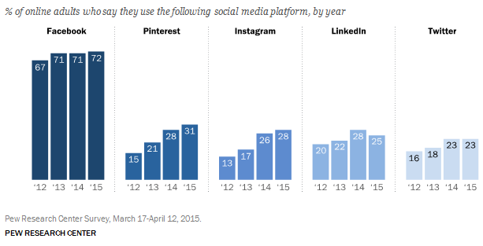
Adult Social Media Use by Site
40% of cell phone owners use social networking via their phone, and 28% do so daily.
Source: Pew Research Center’s Internet & American Life Project Surveys. All surveys of adults 18 and older. Available at http://www.pewinternet.org/2015/08/19/mobile-messaging-and-social-media-2015-main-findings/
Notes:
The 50-64 age group is the fasting growing over the last two years. The number of users is increasing, still, for those of you who predicted 5 years ago that it was a passing fad.

Slide 12
Major Social Media Sites #s
Facebook: 1.55 B+ monthly users (Jun 2015)
YouTube: 1B+ monthly users (YouTube, 2016)
Twitter: 334M+ active users (Jan 2015)
LinkedIn: 313M+ users (LinkedIn, Oct 2014)
Google+: 540M+ monthly users
Pinterest: 100 M active users
http://www.internetlivestats.com/
Notes:
This data changes daily.
Facebook remains the largest, most popular social media site.
Twitter has over 1.6 billion users, tweeting over 500 million tweets per day. 44% of users have never sent a Tweet. But 46% tweet at least once a day.
Stats are difficult to nail down because they change so rapidly.
1 B YouTube videos are viewed per day. 100 hours of video is uploaded to YouTube per minute.
http://www.mediabistro.com/alltwitter/files/2014/06/social-media-statistics-2014.jpg

Slide 13
Privacy Settings Issues
Facebook – set privacy levels, if you know how
YouTube – set some privacy, usually open, allow or block comments
Twitter – set privacy, lock tweets for friends only, block people
Google+ -- put people in circles, set privacy within circles
“We need to be as professional on the Web as we are face-to-face with a patient, and we always need to be aware of HIPAA rules. When you use any form of social media, ask yourself before you hit the send button: if I were in a crowded hospital elevator and I said aloud what I just wrote for a social media network, would that be OK? If the answer no, don’t post it!” Kevin Pho
Notes:
The lesson here is, just don’t post anything on a social media site that you would be embarrassed for the world to see. Nice quote from Kevin Pho, MD who writes the KevinMD blog.

Slide 14
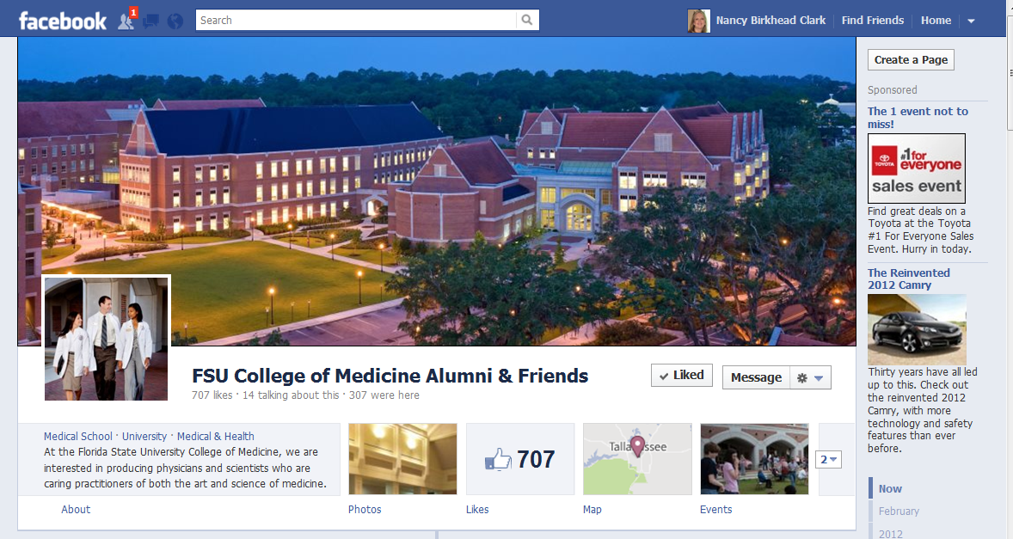
Facebook
Notes:
The largest social media site was set up for individuals. For your clinic, you must have a personal account, then you create a page for your clinic. You don’t friend a Page, and generally, you open the page up to everyone. People can subscribe to the page, and Like the page. People can/may or may not post messages to a page depending on how it is set up, and these can be set up to be moderated or not.

Slide 15
YouTube
http://www.youtube.com/fsumedmedia
Notes:
The second largest social media site allows users to post videos. Viewers can rate and comment on those videos, the creation of curated lists of video clips called Channels. Educational institutions are posting videos to be used in classes. Copyright is out the window here. Youtube tries to purge copyrighted materials posted without permission, like the clip I have used in this workshop in the past, but rely on users to alert them to these postings.

Slide 16
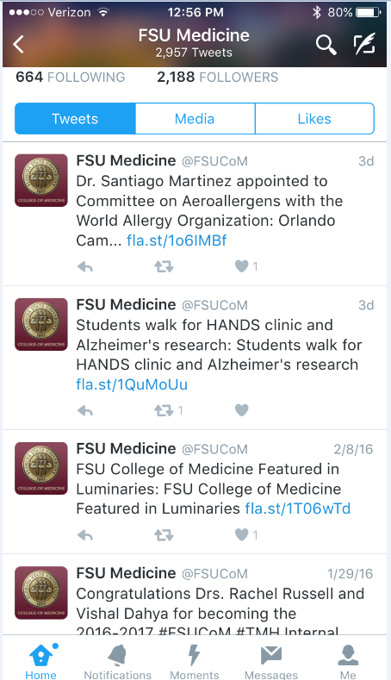
Twitter
Notes:
Microblogging – changing the world. The revolutions in the middle east have been fueled by citizens connected by Twitter. First responders at disasters resort to communicating via Twitter to overcome barriers of communications between agencies/jurisdictions.
Every morning, the news announcers tells me what is trending, and they are referring to Twitter feeds. What are people talking about?

Slide 17
The Anatomy of a Tweet
“Tweet” Members send and read text-based posts of up to 140 characters (Tweet, n or v)
Notes:
I had no idea until compiling this workshop what people were saying in their Tweets, which looked like greek to me.

Slide 18
The Anatomy of a Tweet
"#“ Hashtag. Group posts by topic or type – words or phrases prefixed with a "#" sign. #obesity #Medicine #healthcare #HCSM #Health20 #meded #mHealth http://www.symplur.com/healthcare-hashtags/
"@" sign followed by a username is used for mentioning or replying to other users @MD_chat @HarvardHealth
“Retweet“ To repost a message from another Twitter user, and share it with one's own followers, the retweet function is symbolized by "RT" in the message.
URL shortener – bit.ly tinyurl.com bit.ly/JQKt9L
Tweet Chats: scheduled chats about a subject.
Notes:
For docs interested in learning more about social media, be sure to check out #mdchat @MD_chat, the ‘tweetchat’ founded and principally moderated by @PhilBaumann. Tuesdays at 9 PM, ET
Hashtags are becoming ubiquitous. Now Facebook can be searched using hashtags as well as Twitter. You see these in news reports on all the TV networks.

Slide 19
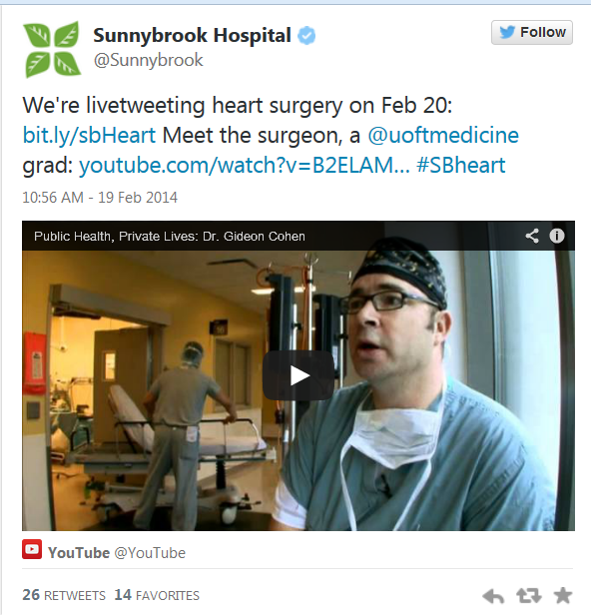
Live Surgical Tweets
Physician’s Guide to Getting Started on Twitter
http://www.slideshare.net/bestdoctors/a-physicians-guide-to-twitter-12776591
Notes:
Live Tweet Surgeries are so commonplace now, it is no longer a novelty.

Slide 20
Does your practice/hospital participate in social media?
Yes
No
Don’t know
Notes:
To promote the clinic, support patients, any medical use of social media?
If so, who manages that SM presence?
Have you participated in your practice/hospital social media and if so, how?

Slide 21
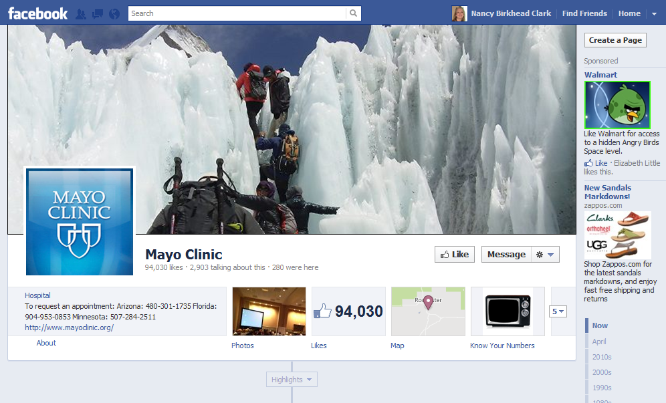
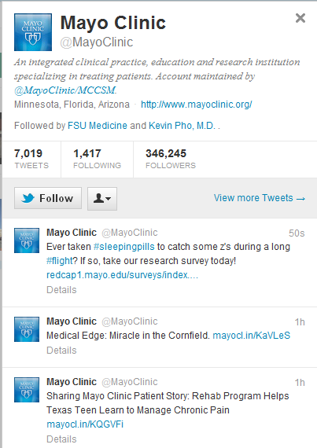
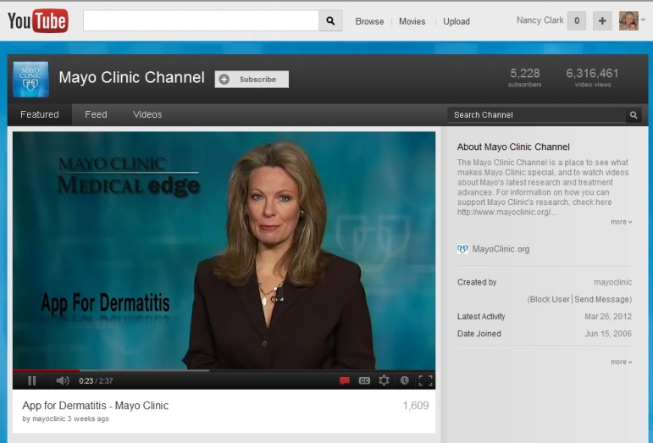
Healthcare Institutions on #HCSM
Notes:
Mayo has not only embraced SM, they have become leaders nationally in the SM movement in healthcare.
A recent study published in the Journal of Medical Internet Research found that nearly 95% of hospitals have a Facebook page, just over half are on Twitter and nearly all hospitals (99.41%) can be found on Yelp. Large, urban, private, not-for-profit and teaching hospitals are among those most likely to use social media, the study found.
Social media platforms are used in a variety of ways:
To create local awareness of hospitals' clinical specialties;
To provide the community with information about events;
To disseminate important health care tips; and
To celebrate awards and achievements.

Slide 22
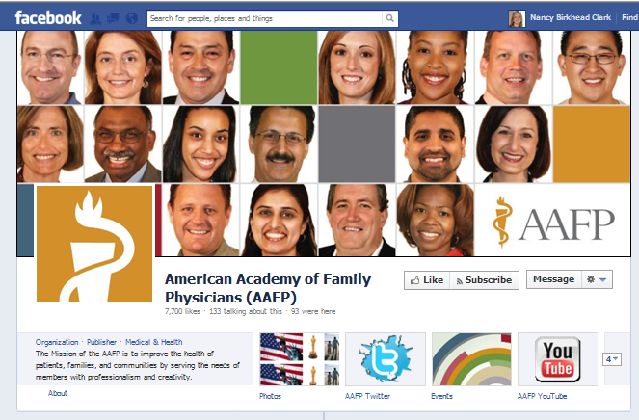
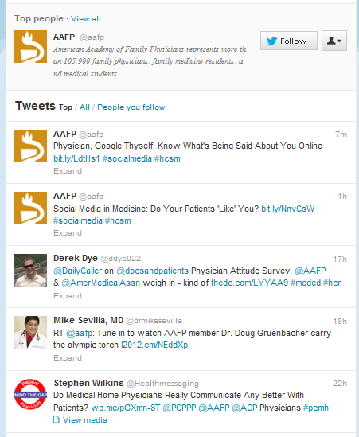
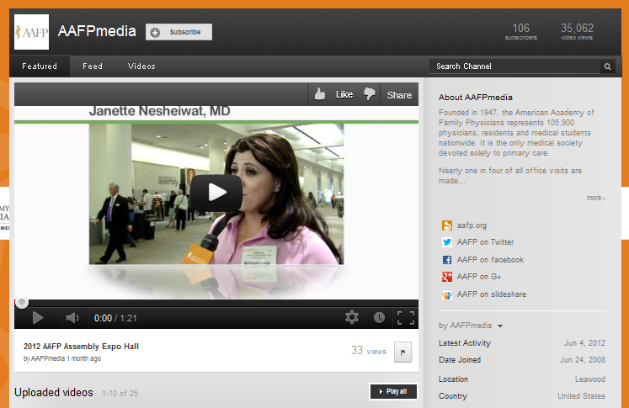
Major Associations on #HCSM
Notes:
Here is another example, of the use of social media by a healthcare organization.

Slide 23
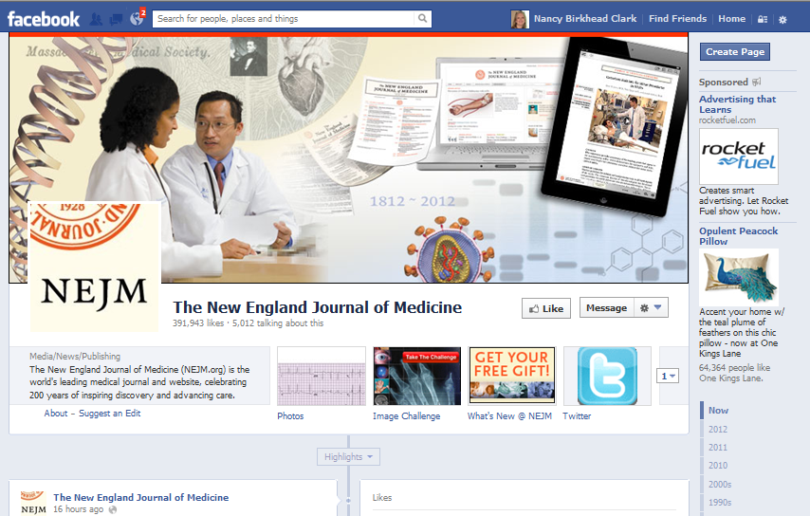
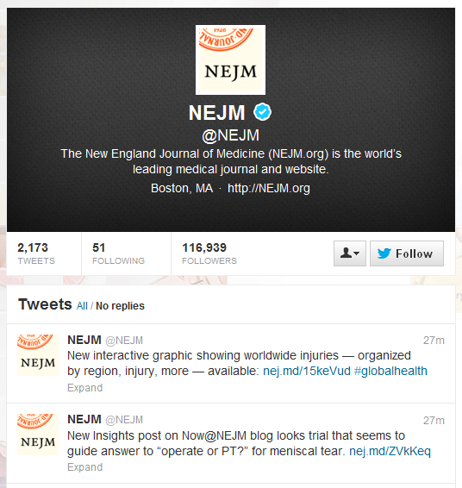
Journals on #HCSM
Notes:
Once you Like a journal, you are shown any posts on their site in your Facebook feed. These include articles as well as quiz of the day questions with images like EKGs and photos, microscopic …. On Twitter, you can follow any of your favorite journals to get news and announcements of articles. On Youtube, they have educational videos. Even an RSS feed can be considered a form of digital/social media.

Slide 24
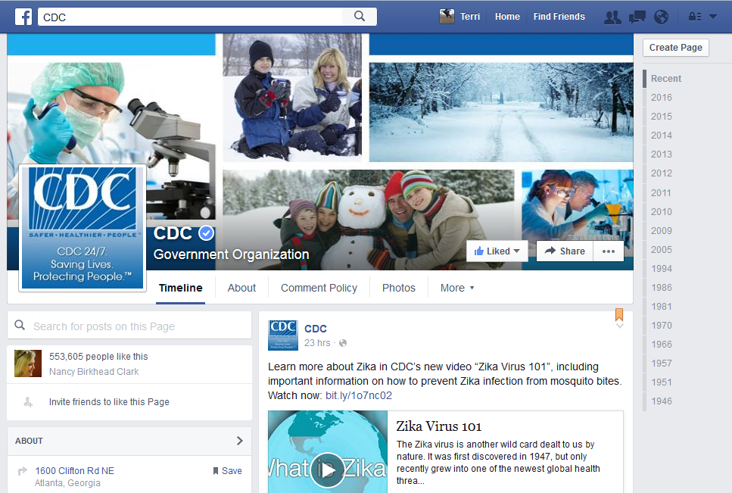
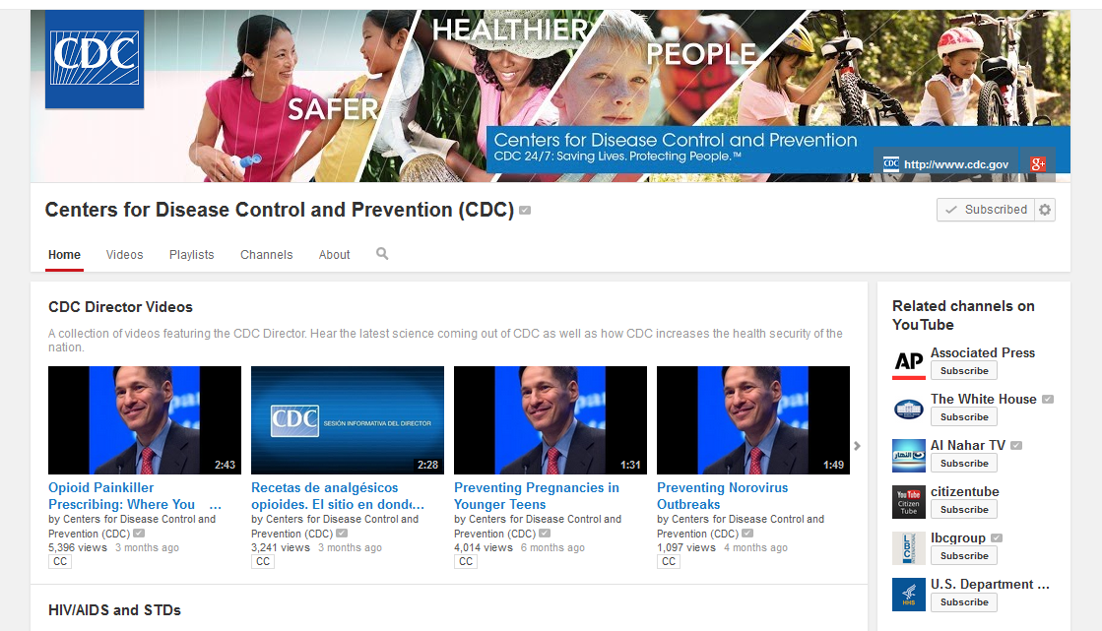
Government Agencies on #HCSM
Notes:
Here are the CDC Facebook, Twitter and YouTube sites. Notice the consistent branding on each. This makes any posting instantly identifiable as the CDCs.

Slide 25
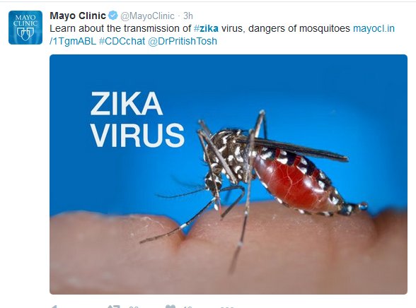
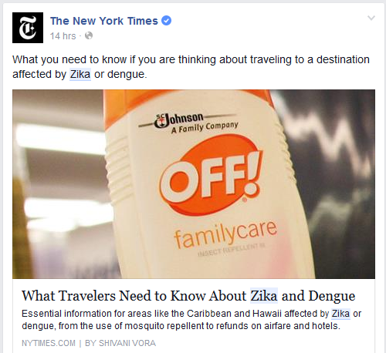
#zika on #HCSM
Twitter
Youtube
Facebook
Notes:
Searching for a condition in any of the social media sites, such as the hashtag Ebola gives you the latest news from multiple sources like the WSJ, Bloomberg, or a physician.

Slide 26
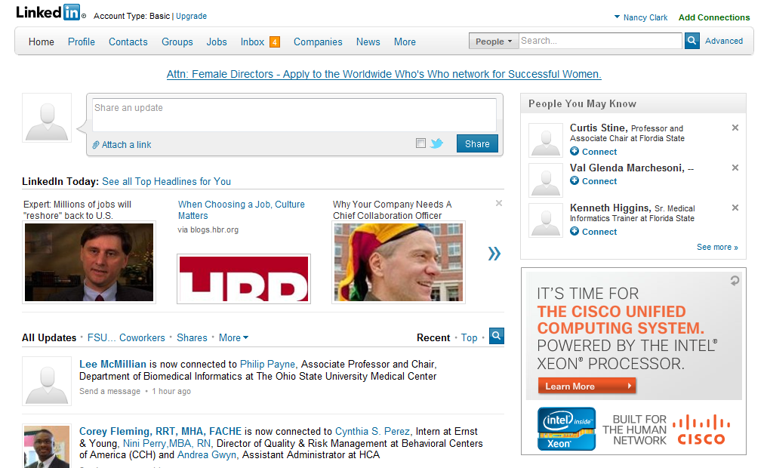
LinkedIn
Notes:
Image is linked to Linkedin.com.
This site is used mostly for professional resume sharing. If you are looking for a job, anticipate changing jobs, or hiring someone with real credentials to fill a job, this is the spot. Groups are starting to form with common interests and are creating discussions. People endorse each others expertise.

Slide 27
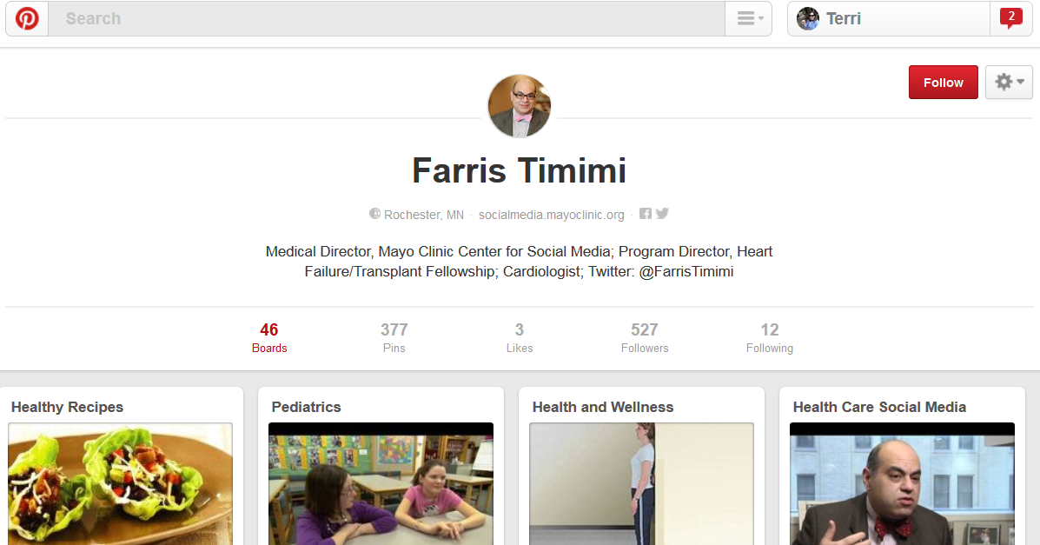
Pinterest
Notes:
{Linked to Farris Timimi’s Pinterest page.}
The popularity of this relatively new site is growing exponentially. It has risen to the 3rd post popular social media site. It seems to have found its purpose, which is to share media/pictures/videos, linked to content elsewhere, grouped by topic called “Boards”, has some use for educations, business, or healthcare. It is morphing as we speak into a content delivery as well as image delivery/sharing site.

Slide 28
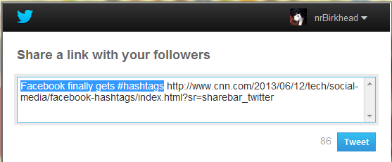
Sharing
“Thank you for sharing” …or not
Notes:
How does this work? Does a good friend of yours email you the latest article he has read on some topic of interest to him, which he assumes you are dying to read? If he was 20 years younger, he might just click on one of these. What do they do? Share on Facebook would add a notice on your page that you read an article. You too could appear to be the most up to date, hipster, geek by posting the latest breaking news to your Twitter or Facebook accounts.
The Share icon shown pulls up a menu of social media sites and other options to pick to share your reading or visiting this page on.

Slide 29
Physician’s Guide to Using FB, Twitter, LI
Pennsylvania Academy of Family Physicians
Guide to Social Media
Advanced Guide now available. Includes setting up a Blog at Wordpress.com
http://bit.ly/1yDwkIv
Notes:
This is an excellent “getting started” resource.

Slide 30
Medical Student’s Use of SM
Class of 2018 incoming survey:
86% have a active account at Facebook, Twitter or LinkedIn
96% upload images to Flickr or Facebook
78% upload videos to YouTube
65% contribute to a wiki or blog
97% Uses Skype or FaceTime to do video/voice communications
N=119
Notes:
Many medical students report that they used to do social media much more before they started medical school, but have become too busy to stay active as they once were.

Slide 31
How would you handle/have you handled a request from a student inviting you to be their Facebook ‘friend’?”
Accept
Decline/Decline until student graduates
Ignore the request
Other
Metzger, AH, et al. Pharmacy faculty members’ perspective on the student/faculty relationship in online social networks. Am J Pharm Educ. 2010. 74(10); 188.
Notes:
I have been asked to discourage any faculty member who might be in a position of power over a medical student, to refrain from accepting or initiating friend requests from students until after they have graduated.
One strategy to decline gracefully is to send the requesting student an email thanking them for the friend request, then saying that you have a personal policy to not friend students until they graduate.

Slide 32
Student Social Media Professionalism
Emphasized from first day
Dr. Campbell’s curriculum during orientation
Students mostly use for personal reasons
Cautioned that residency directors look at FB pages
Warned of permanence of posted media
Cautioned to protect professional reputation – live it
Defines “inappropriate behavior” posted online
Urged to use privacy settings to limit access
Notes:
We try to address social media from the professionalism angle from day 1 of medical school. Social media is mentioned as a source of patient education in the D2 curriculum

Slide 33
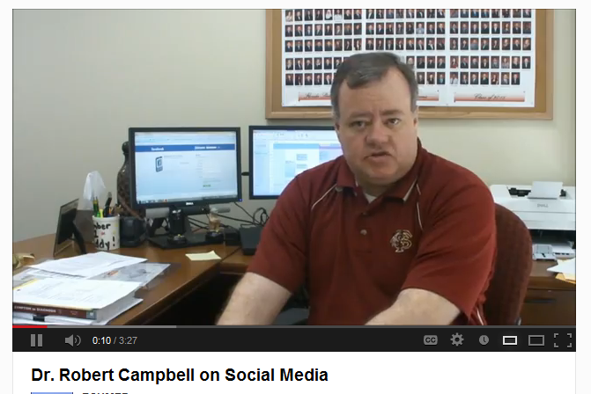
Dr. Campbell on Social Media
http://www.youtube.com/watch?v=hqz3cvVkcMQ
Rob Campbell, MD, Assistant Dean for Student Affairs, FSU CoM

Slide 34
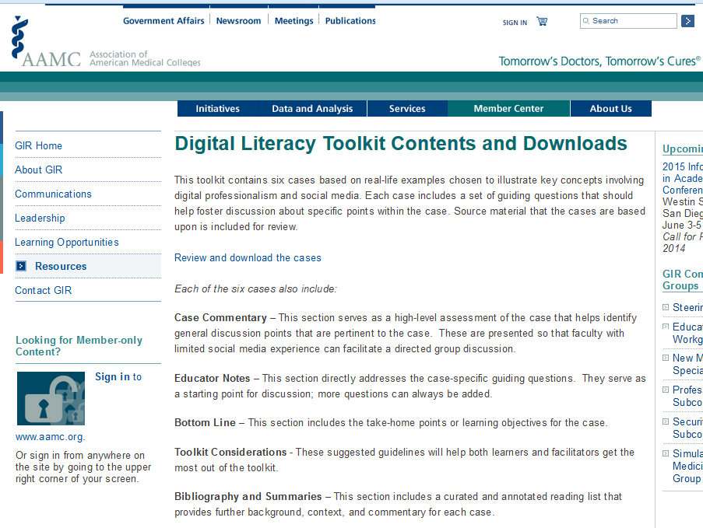
AAMC Digital Literacy Initiative
https://www.aamc.org/members/gir/resources/359492/digitalliteracytoolkit.html
Notes:
Vartabedian said that because social media “now represents the modern means of both sharing information and communicating,” tomorrow’s physicians need specific training that can help them be professional in their use of digital tools.
The AAMC Group on Information Resources developed a digital literacy toolkit for educators and learners. Available online through the AAMC, the toolkit includes case studies and guidelines on the use of social media, educator notes, and other resources.
“The concept behind the toolkit was to put together a set of materials that any faculty member, from the most junior faculty member to a dean, can use to host a meaningful discussion about social media, digital literacy, and digital professionalism,” Wiechmann said. “You don’t need to have an expert on campus or in a program to be able to have these discussions.”

Slide 35
Patient Medical Use of SM
SM is the new word-of-mouth for picking a doctor
Find a local doctor, read and write reviews of doctors, practice, hospitals
Find health information
Find support groups for chronic disease and other health issues
Notes:
Patients use what can be considered social networking sites to find doctors as well as health information and others with their same condition. By insuring that the information that appears about you in free review websites such as Healthgrades, Vitals, and even Angie’s List, you can help maximize your website rankings and ultimately the number of patients visiting your web site and selecting you as their physician.

Slide 36
Are your patients using social media?
Many
Few
None
Don’t know
Notes:
What evidence do you have that your patients are using social media?
Did they listed something like Healthgrades as how they found you?
Give some examples of how you are aware they use social media?

Slide 37
Social Media and Informal Support Groups
Chronic Disease support groups
Awareness, support, education
Community of bloggers
Lifestyle and health maintenance support
Diet plans, track exercise …
Caregiver social support groups
Caregivers for elderly, family members with chronic disease
Notes:
For patients, the relationships that they build online are often as genuine as relationships that they build in real life.
Identifying with a community of people with like health issues builds trust and community, be it online or in real life.
The online patient community is available 24/7/365, and is utilized in all social media vehicles.

Slide 38
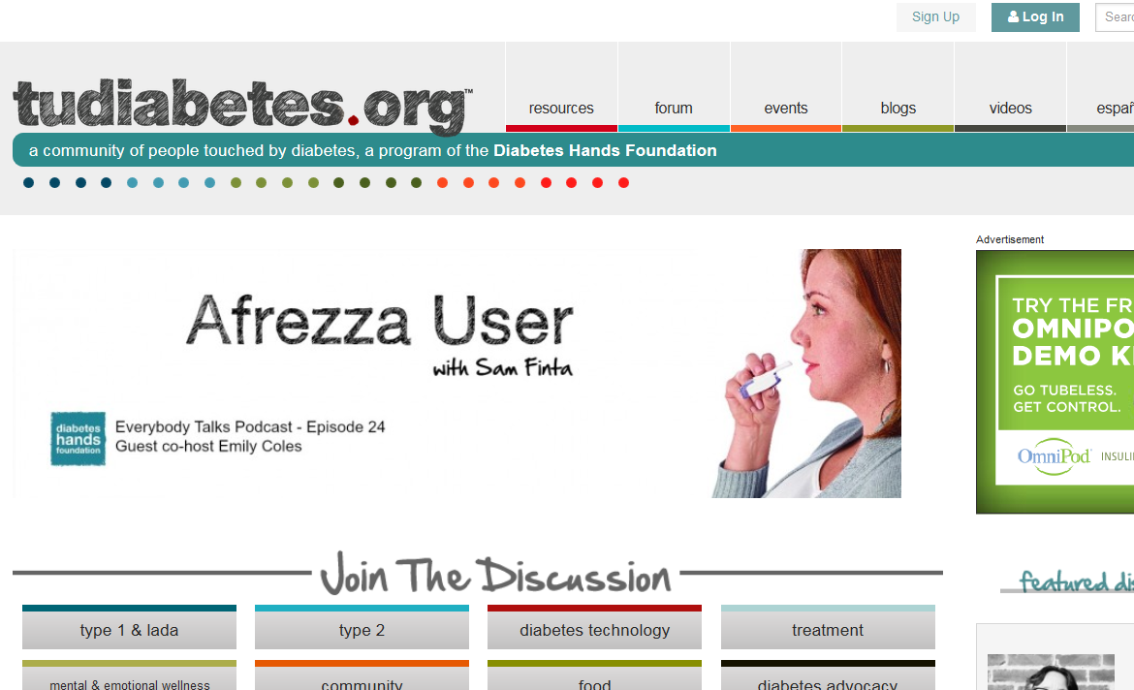
Diabetes, as an Example
Social Media for Chronic disease
Awareness
Support
Education
Diabetes Hands Foundation. http://www.tudiabetes.org
Notes:
Using Diabetes as an example, there are multiple sites, and communities within the major social media sites that promote awareness, support and educational materials.
From Diabetes Social Media Advocacy…
“The virtual community is one of the first and largest to champion social media for chronic disease awareness, support, and education. The Diabetes Online Community provides places online for people affected by diabetes to communicate with others who understand the mental, physical, and emotional challenges of this chronic condition. The community also helps people find ways to embrace their condition and spread diabetes awareness. Diabetes/Patient bloggers are the foundation of the DOC. They share their personal experiences of living with diabetes, including health insurance issues, depression, motivation, mishaps, relationships, and much more. Diabetes/Patient bloggers make us laugh, cry, smile, and think, “I remember when that happened to me,” and “It’s good to know I’m not alone.” You need not be a blogger (nor a person living with diabetes) to participate in the Diabetes Online Community and DSMA. A computer with internet access or a smartphone is the only requirement.

Slide 39
Some Examples of Sites
Cancer Survivors Network – www.csn.cancer.org
Fibromyalgia – www.LivingWithFibro.org
Multiple Sclerosis – www.msconnection.org
Cancer – www.whatnext.com
Type 1 Diabetes – www.typeonenation.org
Leonard, K, et al. “Moderated Social Media Support Groups for Patients,” Journal of Consumer Health on the Internet. 2015.
http://dx.doi.org/10.1080/15398285.2015.1089397

Slide 40
The Power of an Online Community of Patients
https://www.youtube.com/watch?v=HwiIZ8TnZJw
Notes:
Video of diabetic talking about how the online diabetes community has helped her.
Kim Vlasnik, whose blog “Texting My Pancreas” is for people living with type 1 diabetics. About 5 minutes

Slide 41
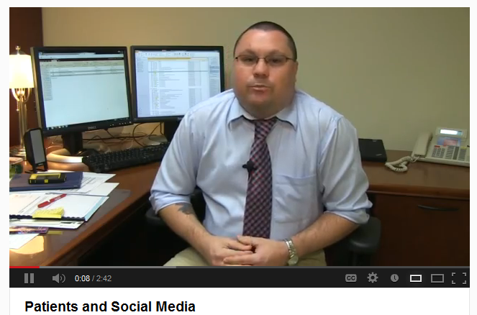
The Power of an Online Community of Patients
http://www.youtube.com/watch?v=BnKqco8G7t4&feature=plcp
Martin Wood, Director of the Maguire Medical Library

Slide 42
Peer-to-peer Healthcare
One in four internet users living with high blood pressure, diabetes, heart conditions, lung conditions, cancer, or some other chronic ailment (23%) say they have gone online to find others with similar health concerns.
By contrast, 15% of internet users who report no chronic conditions have sought such help online.
Fox, Suzannah. Peer-to-peer Healthcare. Pew Internet Survey Results. http://pewinternet.org/Reports/2011/P2PHealthcare.aspx
Notes:
There is evidence from Pew that Patients are looking for people with similar experiences and conditions as themselves.

Slide 43
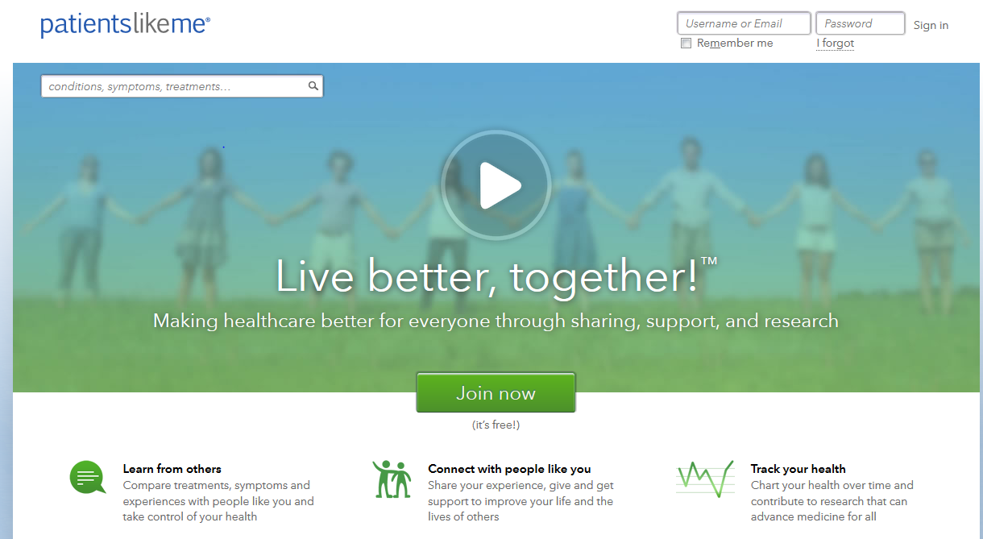
Patients Like Me
https://www.youtube.com/user/PatientsLikeMe2008
Notes:
This site is using Crowd-sourcing surveillance of disease/conditions/drug side effects. This site is for-profit and sells de-identified data to pharma and researchers. However, it is designed to collect and share outcomes data on specific treatment experiences from patients as well as help patients with conditions share their experiences with other patients.

Slide 44
Grief and Community Support
Caring Bridge
Inspire.com
Jacobs, DL. Turning to Social Media in Times of Need. New York Times. May 13, 2015
Notes:
Another example of support groups.

Slide 45
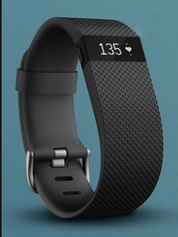
Tracking Health Data
Fitbit sold 4.8 million wearables in the third quarter 2015. Fitbit Community includes help forums, activity groups and discussions.
60% of U.S. adults track weight, diet, or exercise routine. (Pew)
21% use some form of technology to track their health data
46% of trackers say that this activity has changed their overall approach to maintaining their health or the health of someone for whom they provide care.
Notes:
Another consideration is the acceleration of available "mobile health (mHealth)" devices such as wearables, apps and social media platforms for tracking both personal health and allowing healthcare practitioners to track patients remotely. This ability to track personal health, check in remotely with your physician, and partake in competitive fitness and health regimes could lead to a re-imagination of how we experience our personal health daily ("have to get those 10,000 steps in!"), also creating predictive and preventative monitoring programs for outpatient care. Other examples include Weight Watchers with online communities that support weight loss. CGIs that talk to smartphones that can report dangerous blood sugars to friends or physician.

Slide 46
How to Find Communities
Google a condition and “social media communities”, “Blog” etc.
Go to a major social media site and search on a disease/condition
Check out
www.Inspire.com - communities
www.BensFriends.org, Patient Support Communities – look under Community List
Notes:
If you have a patient who is looking for others with the same conditions to connect with or sites with good information about their condition that allow 2 way communication, here are the ways to find them.

Slide 47
Health Information Online
80% of internet users gather health information online (Pew)
Educate patients to find good information online
List reliable sites on your clinic web site
Social media provides physicians opportunities to contribute to good information online
In your Twitter posts, FB page, or Blog
Recommend sites, good articles, good blogs on topics you see often or questions you answer often
Notes:
Patients approval improves
Reviews improve
Payment requirements, patient satisfaction

Slide 48
As a patient, have you used social media to address a health question?
Yes
No
Notes:
Such as watched a YouTube video on a procedure you are scheduled to undergo, or watch a talk on a condition you have.
How did you use it?

Slide 49
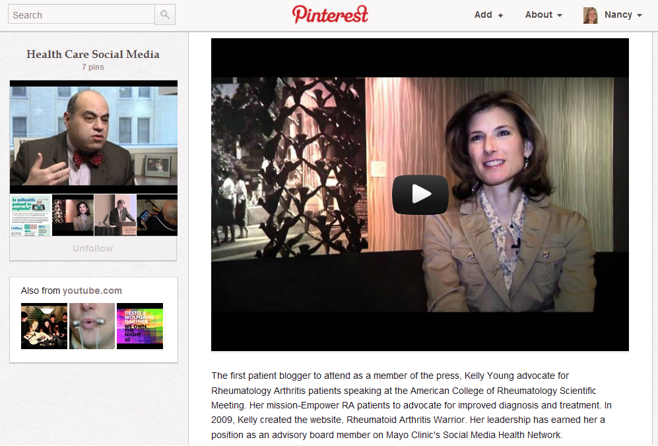
Rheumatoid Arthritis
http://bit.ly/MgNS8t
Notes:
Here is a video of a doctor who suffers from and treats patients with RA, who created a social networking web site for patients with RA. (show about 1 minute of this).

Slide 50
Enter Question Text
For which of the following reasons might you recommend a social media site to a patients?
Patient education
Caregiver support
Peer-to-peer support
Healthy lifestyle support
Find community health resources
Other
Nothing
Pick up to 6
Notes:
Let group discuss this. Ask what those that selected Other had in mind to share to the group.

Slide 51
Manage your Reputation
https://www.youtube.com/watch?v=-XhH1-NMPHI

Slide 52
Your Online Reputation
Multiple sites contain physician demographics, certifications, credentials, actions…
Allow patient reviews
Physician Experience
Ease of scheduling appt.
Wait times
Staff friendliness
Would they recommend to friend
Healthgrades.com
AngiesList.com
Google Plus Local (maps)
Vitals.com
Zocdoc.com
…and many more
Establishing, Managing, and Protecting Your Online Reputation: A Social Media Guide for Physicians and Medical Practices
by Kevin Pho M.D., Susan Gay

Slide 53
Patients Share Experiences
Patient reviews mostly positive……
Encourage your good patients to post review
“You have no control over what other people say about you, but you have total control of the content you create about yourself and your practice.” Kevin Pho
Notes:
Patients are very likely to share information about their hospital stay, medications, medical insurance company, and their doctors.

Slide 54
Dealing with Patient Reviews
Monitor patient comments about you
Respond to comments in compassionate, thoughtful way
Calmly and thoughtfully suggest alternative points of view
Consider opinions -- not dismiss them as irrelevant/incorrect
Avoid online confrontation – let administrator contact patient to deal with concerns
Campbell, KR. Doctors: Social media strategies to manage our identity online. August 2012. www.kevinmd.com/blog/2012/08/doctors-social-media-strategies-manage-identity-online.html
Notes:
1. Start with a professional website. The website should serve as the hub of all of your online activities. It should be professionally designed with your specific clientele in mind. The site should link to your other online activities such as your Twitter feed, your LinkedIn profile, your blog and your professional Facebook page. The website should highlight what you want your patients and potential customers to know about you. My website is a good example.
2. Respond to comments. If comments are left on a blog or on a MD review website, try to respond in a compassionate thoughtful way. Suggest alternative points of view and possible solutions in a respectful, calm and thoughtful manner. Always take other opinions into consideration and do not just dismiss them as incorrect or irrelevant. Your responses give you a chance to present another side of the story without confrontation. If you are dealing with a patient complaint, try to identify the patient and have your practice administrator contact them through the practice privately in order to deal with their concerns. Often, patients and customers who do complain want recognition and to know that they matter and that we care.
3. Remain diverse and don’t get stale. When developing and managing an online reputation, diversity is key. Don’t just focus on one outlet such as Twitter or Facebook. Search engines such as Google are constantly updating how they “hit” and by spreading your presence over several social media networking outlets and frequently updating your website and blog you increase your visibility. Make sure you have an active presence on several different types of sites. Frequent updates are critical to success.
4. Engage in online communities. Participation in websites that are “patient communities” is very important. Your involvement in patient led forums and groups keeps you grounded and allows you to better understand what is important to patients with a particular disorder or disease. For me, involvement and participation in the “ICD Users Group” has been a wonderful learning experience and has helped me improve the way I approach ICD patients in my practice. In addition, participation in professional online communities can help to boost your online reputation and increase your recognition as an expert.

Slide 55
What is Astroturfing?
The practice of masking the sponsors of a message or organization (e.g., political, advertising, religious or public relations) to make it appear as though it originates from and is supported by grassroots participant(s).
In medicine, posting fake positive reviews.
Prosecutions have resulted: Lifestyle Lift and San Francisco Plastic Surgical Center.

Slide 56
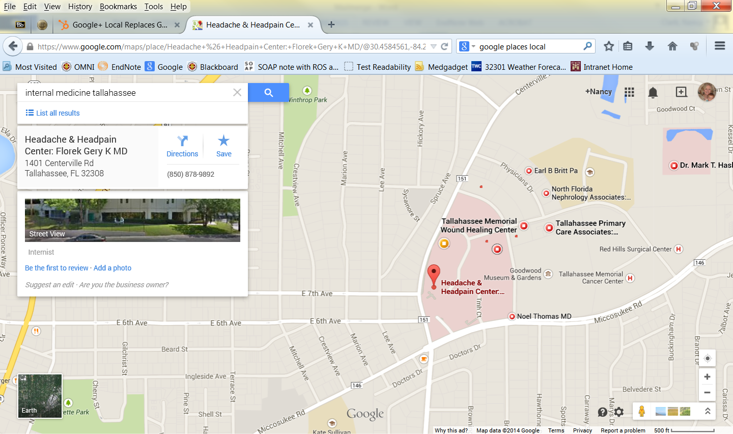
Google Plus Local
Notes:
Google Maps are now most people’s white pages. Phone books are becoming things of the past. This is the white pages business section. One of the most valuable, free resources to marketing any practice is Google Maps/Places. When the information on a business comes up, it is not there by accident. Businesses manage what comes up in Google Places. You can market and at the same time, manage reviews.
Though it’s important to optimize your listings on every review site with a description of your business and a link to your website, perhaps the most beneficial review source of all is Google Places.
Google Local(the section of Google search results that lists local business and a corresponding map) not only combines all your reviews in one place, but it also allows you to directly respond to those reviews from Google users and plays a major part in your organic search results.
Amanda Kanaan is a healthcare marketing author, speaker, and consultant. She blogs at WhiteCoat Designs and can be reached on Twitter @whitecoatdesign.

Slide 57
Manage Your Google Rep
Claim your listing. Search Google Places by your telephone number, then claim your listing(s). Need Google account (Gmail). Delete duplicate listings. Do not use the same phone number for multiple locations.
Complete your listing. Fill out profile completely. Add link to website and practice description. Use keywords that relate to practice or specialty. Google Places shows your profile completion rate. 100% most effective.
Update: Reviews in Google+ Local. No longer anonymous. Good for businesses, bad for healthcare.
Google recognizes up to date profile and active participation in listing and uses this when calculating rank.
Establishing, Managing, and Protecting Your Online Reputation: A Social Media Guide for Physicians and Medical Practices
Notes:
Claim your listing. Start by searching Google Places by your telephone number and then claim your listing(s) if you haven’t already. All you need for this is a Google account (simply sign up for a free Gmail account if you don’t already have one). Delete any duplicate listings as this may harm your rankings and do not use the same phone number for multiple locations.
Complete your listing. Fill out your profile as completely as possible. Add a link to your website and a description of your practice. Be sure to use keywords that relate to your practice or specialty. Your Google Places page will show your profile completion rate. Make sure it reaches 100 percent to be most effective.
Manage reviews. Google used to allow you to respond to reviews but no longer does. Reviews are now required to show name of reviewer, who must have a Google+ account. Business owners are not allowed to respond to reviews.

Slide 58
Hire a Reputation Mgmt Firm
To insure consistent and factual information about you and your practice
Remove any unwanted information from online resources
Suggestions for selecting a firm:
Verify their credibility
Get a referral
Check out their work
Know what you are paying for
Kevin Pho

Slide 59
Physician Use of SM
Market practice and recruit patients
Identifying services patients desire
Connect with other doctors
Connect with patients
Keep up to date with health news, technology’s impact on health and the delivery of healthcare
Recruit research subjects
Notes:
It mostly boils down professionally to these five-six practical uses of social media.
We will talk about each of these, one at a time.

Slide 60
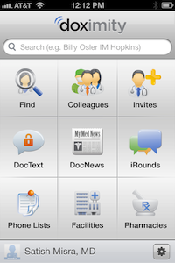
Connecting with other doctors
http://www.youtube.com/watch?v=xL85FlmbI_4
doximity.com The Private Network for Physicians. Med Students. Convenient & HIPAA-compliant. Free for doctors on iPhone, Android and web. Alumni groups. Secure patient information, eFaxing, messaging. Consults. Recruiting.
https://www.youtube.com/watch?v=bEmwyxaY6hw
http://33charts.com/2013/08/12-things-about-doximity.html
Notes:
Doximity.com: site only for doctors, Article: http://www.imedicalapps.com/2012/06/doximity-physician-social-networ/
1. Doximity is as much platform as network. While Doximity is often thought of as just a social network, it serves a variety of functions including rolodex, professional profile page, CME tool, email/fax/text service, news portal, and digital doctors lounge for curbsides and conversation. It’s emerging as a platform for doctors to get things done.
2. Doximity was founded by Jeff Tangney, co-founder of Epocrates. Jeff knows doctors and he knows how to build the things they use. This explains why he’s super-involved in the experience of the Doximity user. He regularly takes email from Doximity users at jeff at doximity dot com (I’d recommend joining first).
3. 1 in 4 U.S. physicians is on Doximity. And a recent survey by the American College of Physicians listed Doximity as a top 5 app most used by the members of ACP.
4. Doximity is doctor-driven. The majority of product decisions come from Doximity’s member groups – Medical Advisory Board, Fellows, Panelists & Ambassadors. (For example, my input was instrumental in selection of the current ‘wifi d’ logo that you see up and to the right). The co-founder of Doximity, Nate Gross, is a physician.
5. You can earn CME credits like you’re eating potato chips. I just started doing this and here’s my process: Read | Learn | hit button. It’s like eating potato chips, only better for your brain. The program is powered by the Cleveland Clinic and supported by the content of a load of major journals. Doximity will track your credits and, most impressively, they’ve hired elves to personally integrate your CME credits onto your Doximity transcript. Email them at CME@doximity.com
6. Doximity users love to fax. One of the most frequently used Doximity features is its HIPAA compliant fax tool. Since I’m not a fax user at all, this has always been a surprise to me. As a registered Doximity user, you are assigned a lifetime fax number that allows you to send and receive secure fax messages between offices or to pharmacies.
7. Physician profiles are public facing. Many members don’t know this, but your profile is searchable and viewable to the public at your discretion. Controlling your digital footprint is a new professional responsibility for doctors. And if you don’t tell your story, someone else will. All the more reason to have a complete and compelling profile.
8. Adding a profile photo doubles the chances of someone finding you. Doximity profiles with pictures get preferential search ranking. So upload your mug and be found.
9. Med students rule. Doximity supports the next generation of physician from day one of medical school through their inclusion in the network. Med students sign up just like doctors. They’ve been a Doximity priority since their earliest days.
10. Public content can convert to doctor-only dialog. Sensitive to the fact that some docs are bashful about their commentary, Doximity has designed elements to pull dialog started in public into the professionally private realm. On Twitter, for example, tag your tweet with #dox and your post will make its way into iRound, Doximity’s chatter stream. They’ve got a nifty Doximity share button that, when punched, opens a comment box and then, when saved, pulls the link of that article along into Doximity iRounds. If you go to the bottom of this post and hit the Doximity share button, you can see it in action. For best effect, sign in to Doximity first.
11. Doximity search is perhaps its most underutilize power-feature. This is helpful when looking for doctors of a particular breed. For instance, if you needed a French speaking knee surgeon in Atlanta, you could type “ortho knee french Atlanta” and find that perfect referral. I’m not kidding, try this.
12. The co-founder of LinkedIn, Konstantin Guericke, sits on Doximity’s Advisory Board. Tells you a little about where Doximity sees itself heading.

Slide 61
Connecting with Patients
Start with a professional Website
Use Facebook account for clinic linked to Website
Remind patients of Great American Smokeout, flu shots
Cosmetics post success stories from patients
TwitterDoctors.net – doctors who Tweet
Share articles, sites, news
Tweet while attending conferences
Tweet when running late
“…consider being on Twitter to extend your reach and impact. If however, you are concerned and hesitant about it, I would suggest a gentle progression from Twitter anonymity to community.” Levi, E. This surgeon learned the power of Twitter. KevinMD.com; June 12, 2015.
Notes:
Here are some suggestions for using Facebook and Twitter for your practice or professionally.

Slide 62
Incentives
Patient satisfaction increases (https://cahps.ahrq.gov/)
Support meaningful use efforts: Stage 2
Communicating health information to patients, electronic copy of health information upon request
View and download relevant information via web-based portal within 36 hrs – use mobile apps?
Integral aspect of the Patient-Centered Medical Home (PCMH) model
Standards will need to be developed to do this securely
HCSM and the Patient Centered Medical Home. Ben Miller. March 2012.
http://smhcop.wordpress.com/2011/03/16/hcsm-and-the-patient-centered-medical-home/
Notes:
HCSM and the Patient Centered Medical Home. Ben Miller. May 2012.
http://smhcop.wordpress.com/2011/03/16/hcsm-and-the-patient-centered-medical-home/

Slide 63
Strategies for Putting SM into Practice
Set up Google Alerts for your name
http://www.google.com/alerts
Define your goals
Manage online reputation, increase patient load, improve office efficiency, engage patients…
Establish guidelines
Determine time commitment
Define your role, role of staff members
Determine your message
Pick a core site for presence
Hire a communications professional (reputation.com)
Notes:
Set your goal(s)
Having a deep online presence is literally the only means to manage your online reputation; the best defensive is a great offense; drive positive, accurate content to counteract the inevitable negative comments that will arise on sites such as HealthGrades, Vitals, and Yelp.
Set up a Google alert for your name.
This is one easy way to be on “patrol” for when your name or practice is mentioned on the web. Simply visit http://www.google.com/alerts.
The most meaningful reason to establish a presence is that patients can find you and perhaps learn a bit more about your perspective, approach and rapport with your patient base.
Second would be your ability to replicate the content that you share with forty or more patients every day in your office
Needs to tie in with overall marketing objectives.
Establish a set a clearly articulated guidelines, Communicate to staff.
Determine how much time you plan on committing to SM, How much time you want your office manager to commit?
A personal commitment of an hour or two a week is usually all that’s necessary.
Know your role(s) Who is going to monitor the various platforms? How will you “frame” your message?
You need to define your message, develop your message, and know how to articulate your message — and most important, you need to stay on message.
Establish a foundation Given the multitude of platforms and tools available today, your core presence can be a website, a blog, a Facebook Page, or a robust profile page on one of the many Q&A based sites appearing these days. Always give attention to your main website!
Consider adding a blog to your main site.

Slide 64
What would be your goal of using Social Media professionally?
Market Practice
Improve patient satisfaction and outcomes
Influence health policy
Protect reputation
Mentor students/residents
Promote healthy lifestyle
Other
Pick your top 3
Notes:
If you were to use it….What are the others?

Slide 65
Social Media Guidelines and Policies
If part of larger organization, review their policy
If not, develop one for your practice
Make sure everyone knows the policy
Contact the FSU College of Medicine Communications Office before you use social media to promote anything related to FSU College of Medicine
Doug Carlson doug.carlson@med.fsu.edu or (850) 645-1255

Slide 66
Does your practice/clinic have a social media policy?
Yes
No
Don’t know

Slide 67
Guidelines on Social Media Use
Federation of State Medical Boards – Guidelines for Appropriate Use of Social Media… (April 2012)
Connecting with patients - Do Not…interact with current or past patients on personal social media. Professional only.
Connecting with other physicians – secure, HIPAA compliant sites like Doximity.com
Privacy/confidentiality – HIPAA – written authorization from patients
Disclosure – reveal any conflicts of interest
Content
Professionalism…
Federation of State Medical Boards. Model policy guidelines for the appropriate use of social media and social networking in medical practice. April 2012.
http://www.fsmb.org/Media/Default/PDF/FSMB/Advocacy/pub-social-media-guidelines.pdf
Notes:
Professionalism
To use social media and social networking sites professionally, physicians should also strive to adhere to the following general suggestions:
• Use separate personal and professional social networking sites. For example, use a personal rather than professional e-mail address for logging on to social networking websites for personal use. Others who view a professional e-mail attached to an online profile may misinterpret the physician’s actions as representing the medical profession or a particular institution.
• Report any unprofessional behavior that is witnessed to supervisory and/or regulatory authorities.
• Always adhere to the same principles of professionalism online as they would offline.
• Cyber-bullying by a physician towards any individual is inappropriate and unprofessional.
• Refer, as appropriate, to an employer’s social media or social networking policy for direction on the proper use of social media and social networking in relation to their employment.

Slide 68
Resources
FSU CoM Social Media Guidelines
http://med.fsu.edu/index.cfm?page=COMaboutUs.socialmediaguide
Mayo Clinic Center for Social Media
http://socialmedia.mayoclinic.org/
Curriculum on Social Media - SMUG http://social-media-university-global.org/
AMA Policy: Professionalism in use of Social Media
http://www.ama-assn.org/ama/pub/physician-resources/medical-ethics/code-medical-ethics/opinion9124.page
CDC Health Communicator’s Toolkit
http://1.usa.gov/amOmMI
Establishing, Managing, and Protecting Your Online Reputation: A Social Media Guide for Physicians and Medical Practices. By Kevin Pho M.D., Susan Gay. Greenbranch Publishing. 2012. http://www.kevinmd.com/blog/reputation

Slide 69
In Summary
The cat is out of the bag…
Critical message: Rules of offline behavior apply to online behavior where there is much wider audience
Errors will occur: Develop a social media policy -provide orientation and training. View mistakes as learning opportunities.
There is great power in the conversation. Know the risks and behave accordingly. Do not be so risk averse that you do not participate.
Dr. Farris Timimi, Medical Director of the Mayo Clinic Center for Social Media
http://socialmedia.mayoclinic.org/2012/04/05/a-twelve-word-social-media-policy/
Notes:
“The cat is out of the bag. Even if you wanted to avoid social media entirely, it is simply too late to attempt to do so. Even if your practice or institution does not have an active social media presence, it is likely that others are already discussing you on line. It is important to set up a social media monitoring program right away, if you do not already have one in place, so that you may respond in the real world to issues flagged in cyberspace.
You can become an active participant in health care social media and stay on the right side of the law, and these days it is becoming more and more imperative to use this toolset for marketing, patient communication and care management.”

