Slide 1
Prescribing medical Apps to Patients
Nancy B. Clark, M.Ed. Director of Medical Informatics Education
Cynthia Samra, M.D. Informatics Curriculum Director, Sarasota Regional Campus
FSU College of Medicine
Notes:
Links to videos are meant to allow this PowerPoint to be used as a stand alone tutorial, not to be used in the workshop, with the exception of the Mount Sinai and Doctor’s office of the future videos.
Additional contributors: Terri Johnson, Informatics Librarian. Mark Strickland.

Slide 2
Disclaimer
No financial connection to any of the products and services listed in this presentation.
Dr. Eric Topol on NBC's Rock Center
Notes:
In 2013, I saw a long interview of Eric Topol by Nancy Sniderman on NBC and in the middle of it, I heard this comment and was curious as to how this was going to affect healthcare. This workshop is the result of that. It just took 4 years to put together.

Slide 3
Objectives
Identify current medical uses of apps in practice
Describe the FDA oversight of medical apps and devices that communicate with smartphone apps
Identify reasons for prescribing apps to patients
Describe a process for prescribing apps to patients
List security considerations for smartphone app usage by patients
Describe ways EMRs are developing apps for patients and integrate data from other apps
How this technology will evolve healthcare?
Notes:
This is an informational workshop. We won’t be able to give you any skills, and you won’t walk away changed. This is just a snapshot in time. This is one of those workshops that will change each time it is given. You will hopefully have a lot of knowledge about what is happening out there in the evolution of Health technology and how it may change the way medicine is practiced in the future when our students are in practice.
Identify current medical uses of apps in addition to medical reference to include healthy lifestyle, disease monitoring, measurement of adherence, disease management, research, and data collection.
Identify reasons for prescribing apps to patients, including the benefits and barriers to prescribing apps to patients
Describe a process for prescribing apps to patients
Describe the FDA oversight of medical apps and devices that communicate with smartphone apps
List HIPAA considerations for smartphone app usage by patients
Identify obstacles to EMR/App integration, and which EMRs have apps for patients.

Slide 4
Handouts
PowerPoint
InfoGraphic: 5 Kinds of mHealth Users
List of medical apps, devices, videos and resources mentioned in presentation
Evaluations

Slide 5
Popularity and adoption of smartphones
How many here have smartphones?
Use apps for health reasons yourself?
Use wearables or have other devices that talk to smartphone?
Patients asking you to recommend an app to help manage their disease or help them exercise and lose weight?
Notes:
These are just questions to throw out to the audience to get them started talking and see where they are coming from, why they are here. You could get attendees to address one of these questions as they introduce themselves.

Slide 6
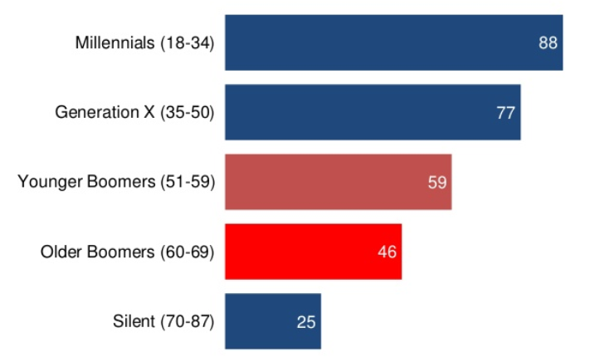
Smartphone users Percentage by age group
Rainie, L and Perrin, A. Technology Adoption by Baby Boomers (and everybody else). Pew Research Center. March 22, 2016.
Notes:
This illustrates a current problem which may get better or worse. Those patient who would benefit the most from the use of these apps do not have access to the technology, either lacking a smartphone, cell coverage, or the knowledge to use the apps.

Slide 7
Survey: use of mobile tech
58% of people with smartphone shared information with medical professional using mobile or wearable device
40% comfortable using AI like Siri
25% have emailed or texted a photo of a medical issue to a doctor
25% say health and fitness tracking apps have made them feel bad
9% would use an AI therapist
N = 2000 smartphone owners
Ketchum mHealth Monitor. 2016 https://www.ketchum.com/mhealth-monitor
Notes:
HIDDEN SLIDE. About the Ketchum mHealth Monitor Ketchum Global Research & Analytics conducted an online survey of 2,000 respondents who own a smartphone in the United States in April 2016. The global margin of error is +/-2.1 percent. The research explored respondents’ attitudes and behavior regarding the use of mobile technology to manage health. All data collection was handled by Survey Sampling International.
Results:
Nearly a quarter (24 percent) of Americans said health and fitness tracking apps have made them feel bad, and 21 percent have stopped using certain apps.
Although the majority of Americans said they have used technology to interact with a medical professional, most (63 percent) said they still prefer face-to-face interaction with their healthcare providers.
Nearly one-third (32 percent) said they are likely to use an A.I. search tool and 31 percent an A.I. health tracker, but they aren’t too convinced about using an A.I. medical adviser (18 percent) or an artificially intelligent therapist (9 percent).
There’s an opportunity to educate: Just over half (51 percent) — across all ages — feel they have a lot to learn about how mHealth can benefit their health.

Slide 8
5 Kinds of mhealth Users
Discerning Digitals: 16% super users, love being constantly connected, advocates of mHealth, still like face-to-face contact with medical professionals
Swayable Seekers: 21% want to expand their smartphone repertoire, feel confident about managing their health and get medical info online. Have lot to learn about using mobile tech for their health
Health Tech Hesitators: 21% don’t manage health very well and aren’t happy with physical well-being, and not exactly comfortable sharing information online either
App-athetic Agnostics: 22% love mobile technology; don’t use any type of mHealth, nor do they care to in next year
Low-tech Lifers: 18% don’t think mHealth has had a positive impact on their lives, nor do they foresee it having a positive impact in the future.
Ketchum mHealth Monitor. 2016 https://www.ketchum.com/mhealth-monitor
Notes:
mHealth stands for mobile health. Look over this list of kinds of mHealth users. See where you fit. This also defines a problem, because many of our clinicians are in the bottom two categories and either do not use any type of mHealth app other than references, or think it has a positive impact on their lives or the lives of their patients.
Note comparison to Diffusion of innovations
Innovators 2.5%
Early adopters 13.5%
Early Majority 34%
Late Majority 34%
Laggards 16%

Slide 9
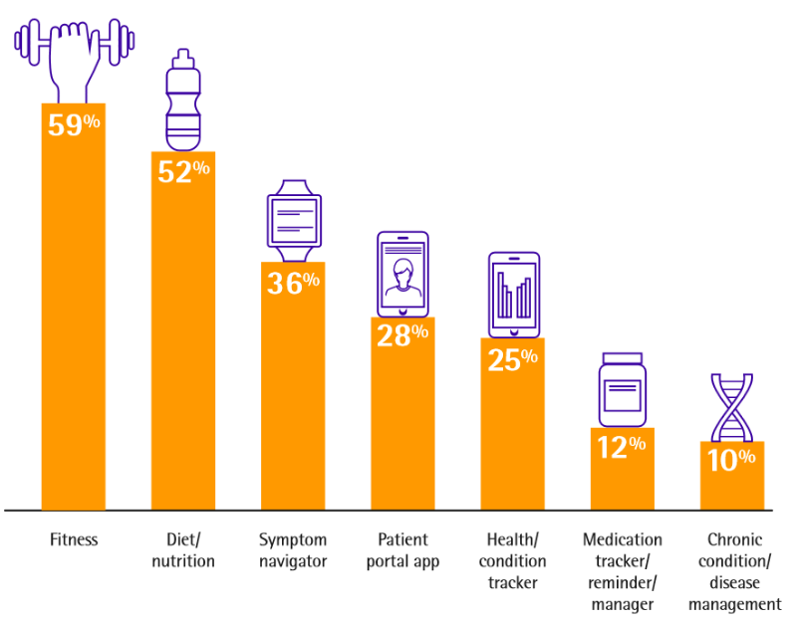
Patients Use Apps for Health Reasons
2016 Survey:
Use of health apps doubles since 2014 from 16% to 33% in 2016
Use of wearable technology up from 9% in 2014 to 21% in 2016
200K↑ Medical Apps
Accenture 2016 Consumer Survey on Patient Engagement
Notes:
There are currently over 200,000 medical/health apps in the iTunes App Store and Google Play
This is the current distribution of health/medical uses of those apps from a 2016 survey.
https://www.accenture.com/t20160629T045303__w__/us-en/_acnmedia/PDF-6/Accenture-Patients-Want-A-Heavy-Dose-of-Digital-Research.pdf#zoom=50

Slide 10
Fitness Revolution
Notes:
Since the number 1 use is fitness, let’s look at the current state of fitness apps and devices.

Slide 11
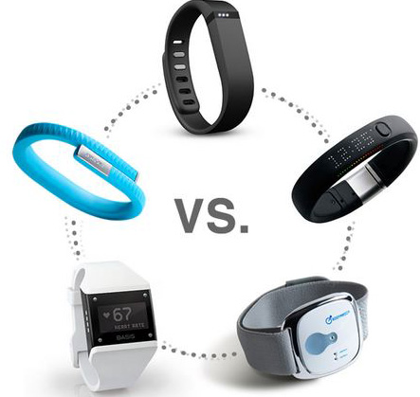
Fitness -- Wearables
Activity and sleep trackers are TNTM
Still growth market – 112M by 2018
Fitbit wins in sales 2016
Various styles – features – prices
Heartrate monitor
Sleep monitor
Stairs climbed
Calories burned
Time/date display
Swim monitor
Smartwatches have some of the above and are competitive
Notes:
The greatest use of apps and devices is for fitness. There are huge numbers of devices and accompanying apps. PROJECTED: Consumers will sport almost 112 million wearables by 2018.
The Vitality Group conducted a five-year study of more than 300,000 patients, it found
63% of those who monitored their health and exercise via smartphone were overweight or obese.
Almost 24% were 45 to 54 years old and about 9% were aged 55 to 64,.
At the end of the study, hospital costs dropped 6% for those who were inactive and became active.
Hospital costs fell 16% for participants who were active throughout the five years, compared with people who remained inactive.
Video – Top 5 Best Fitness Trackers 2017 by The Product Labs 8:47 min https://www.youtube.com/watch?v=q-A7IOpjfnY
NOTE:
Not all of these talk to the Apple Health app, Here is an article to get the wearable apps to sync with Apple Health:
https//www.iphonelife.com/content/how-connect-health-or-fitness-tracking-device-your-health-app

Slide 12
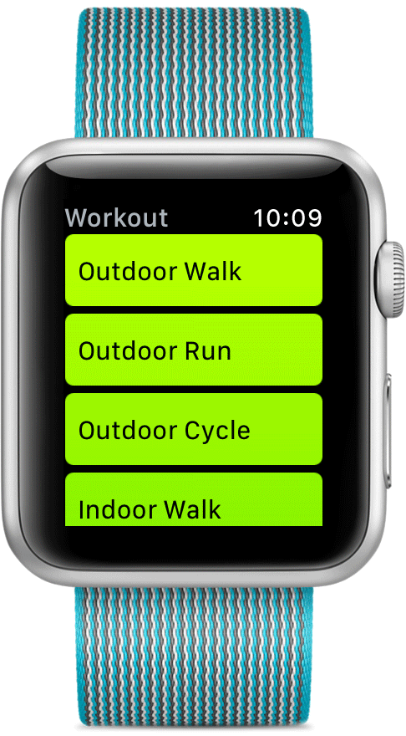
Smartwatches
Advantages over wristbands:
Answer phone
Receive and send texts
Emergency SOS button
Get alerts from programs on your phone like calendar alerts, pill reminders
Track odd exercises, get exercise progress reports
Basal energy expenditure more accurate
Disadvantage: expensive
May be >60% of wearable market by 2021
Notes:
Shcherbina et al from Stanford University developed a wearable sensor evaluation framework to test the accuracy of heart rate and energy expenditure estimates from seven commercially available wearable devices. Current wearable devices provide relatively accurate measurements on heart rate but not energy expenditure, with the Apple Watch providing the greatest accuracy compared with 6 other devices
Smartwatches are still growing in popularity but the current cost is keeping them from taking over the wearable market. One projection by says that by 2021, they will be the largest share (64%) of the wearable market: 64% -- Watch, 24% -- Wristband, 9% -- smart Clothing, 2% -- Smart Eyewear
REFERENCE:
Martin, C. Wearables Market Growth Shifting to Smartwatches. IOT Daily. 3/21/2017. http://www.mediapost.com/publications/article/297478/wearables-market-growth-shifting-to-smartwatches.html
REFERENCE: http://www.businessinsider.com/smartwatch-and-wearables-research-forecasts-trends-market-use-cases-2016-9
http://www.mediapost.com/publications/article/297478/wearables-market-growth-shifting-to-smartwatches.html
Video: TOP 5: Best Smartwatch 2017, from The Product Lab. 9:24 min
https://www.youtube.com/watch?v=rcxIokcFLE8

Slide 13
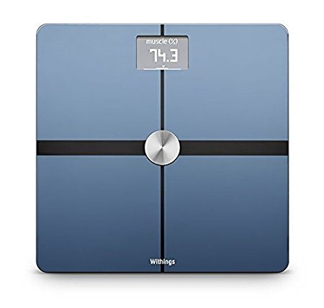
Fitness - Smart Scales
Several brands available: Withings/Nokia, Fitbit, Garmin, Polar Balance, iHealth, Under Armour…
Some work with wearables to add weight to fitness tracking, calculate BMI
Work with their own app or others like MyFitnessPal
$25 - $400
Withings (Nokia) Body - Body Composition Wi-Fi Scale, Black, $125 at Amazon. Works with MyFitnessPal
Notes:
6/20/17, Nokia bought Withings and is rebranding all their products under the Nokia name.
The scale has value for patients with diabetes, asthma, and other respiratory ailments. "It's also useful for patients with congestive heart failure, where weight gain is the primary parameter you follow," notes Dr Scher. "A patient with congestive heart failure can gain 3 lb in a day owing to fluid retention.“
Video: Top 5 BEST Wireless Smart Scales 2017! From Riznos, Feb 2016. 8:55 min https://www.youtube.com/watch?v=3IRyHuEmnsA

Slide 14
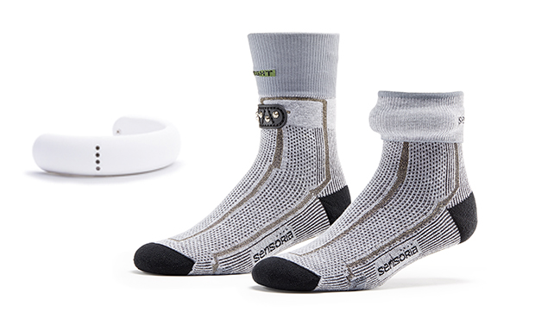
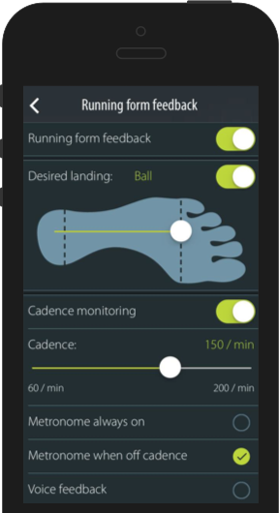
Wearables - Smart Tops, Socks and App
Monitor Running/walking form, heart
Alert when corrections needed
Works with sports tops that monitor breathing and heart rate
www.sensoriafitness.com
Notes:
And for the serious fitness addict, there are the these.

Slide 15
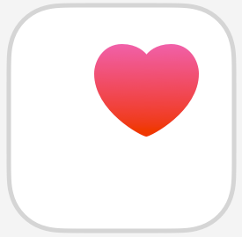
Health and Fitness Dashboards
Smartphone proprietary apps
Apple Health and Google Fit
Uses Geolocation
Steps and stairs
Additional data input from compatible apps
Nutrition – MyFitnessPal’s Calorie Counter and Diet Tracker
Sleep – Sleep Cycle App (sleep with phone)
Running – RunKeeper App
Nield, D. 40 essential fitness apps and devices that work with Apple Health. Feb 2017. https://www.wareable.com/apps/apps-that-work-with-apple-health-kit-compatible
https://www.wareable.com/google/the-best-google-fit-compatible-apps-and-devices
Notes:
When you get an iPhone or Android phone you now get a built in fitness tracker that monitors your steps and stair climbing using geolocation as long as you carry it on your body. You can add apps that will talk to the phone Health app. Without a wearable, that means you have to sleep and run with your phone. I do not recommend swimming with the phone unless it is marketed with that capability. Or wearable for that matter.
There are reams of devices/apps already able to pair with Health thanks to Apple's HealthKit API. And Google Fit
For example, every time you use a Withings Smart Body Analyzer scale, Wireless Blood Pressure Monitor or Aura Smart Sleep System that information is reported sent back to the Withings Health Mate app via Bluetooth or Wi-Fi. If you want this data to be fed to Apple Health, you'll need to enable it as a source.
MORE INFORMATION:
https://www.wareable.com/apps/apps-that-work-with-apple-health-kit-compatible This article lists the best ones.
Here are the ones that work with Google Fit
https://www.wareable.com/google/the-best-google-fit-compatible-apps-and-devices

Slide 16
FDA Oversight
Which apps need FDA approval?
How are they approved?
How do phony apps get around this?
Do we need to teach patients to be smart consumers of apps?

Slide 17
Mobile Medical App Oversight
Food and Drug Administration (FDA) must approve mobile apps that are:
1. An extension of one or more medical devices which controls the device or monitors patient or analyzes medical device data
2. Transform the mobile platform into a regulated medical device by using attachments
3. Performing patient-specific analysis and providing patient-specific diagnosis, or treatment recommendations.
http://www.fda.gov/downloads/MedicalDevices/.../UCM263366.pdf
Notes:
Let’s take each of these categories and look at some examples of these devices.
[Do not bother reading these categories to the audience.]
Same 5 step process as for drug or standard medical device

Slide 18
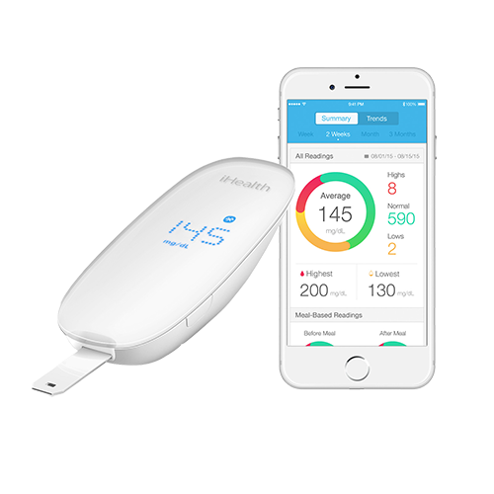
Apps/Devices FDA Regulatory Oversight ( Next 9 Slides Refer To #1)
Mobile apps that are an extension medical devices for purposes of:
controlling the device(s)
active patient monitoring
analyzing medical device data
iHealthlabs.com Smart Glucometer
Food and Drug Administration. Mobile Medical Applications: Guidance for Industry and Food and Drug Administration Staff. Document issued on February 9, 2015. http://www.fda.gov/downloads/MedicalDevices/.../UCM263366.pdf
Notes:
Mobile medical apps of this type are considered an accessory to the connected device and are required to comply with the controls applicable to that connected device. As a result, the mobile medical app would be required to comply with the regulations applicable to the connected medical device in order to address any associated risk, like a glucose monitor that talks to a smartphone app via Bluetooth and collects data. This is the iHealth glucometer with Bluetooth and an app.
FDA VERBAGE: These are the Subset of mobile apps that are the focus of FDA’s regulatory oversight
Mobile apps that are an extension of one or more medical devices by connecting to such device(s) for purposes of controlling the device(s) or for use in active patient monitoring or analyzing medical device data.
Examples of displays of patient-specific medical device data include: display of medical images directly from a Picture Archiving and Communication System (PACS) server and remote display of data from bedside monitors (note that mobile medical apps that display medical device data to perform active patient monitoring such as bedside monitors are subject to regulations associated with such devices) ..Examples of mobile apps that control medical devices include: apps that provide the ability to control inflation and deflation of a blood pressure cuff through a mobile platform and mobile apps that control the delivery of insulin on an insulin pump by transmitting control signals to the pumps from the mobile platform.

Slide 19
Digital Glucose Fingerstick Monitors
Plug into phone with adaptor, USB or wire: Dario
Several FDA approved now have Bluetooth connection to phone app/web app
Accu-Chek Aviva Connect
iHealth
Beyer Contour Next One
One Touch Reveal
One Drop
Apps have progress tracking, hypoglycemia alerts with GPS locator, carb counting
Notes:
Many medical devices with apps are in the support of diabetes, either type 1 or 2. A lot of the examples we are going to see are diabetic apps and devices. Here is a list of Bluetooth connected glucometers with associated apps.

Slide 20
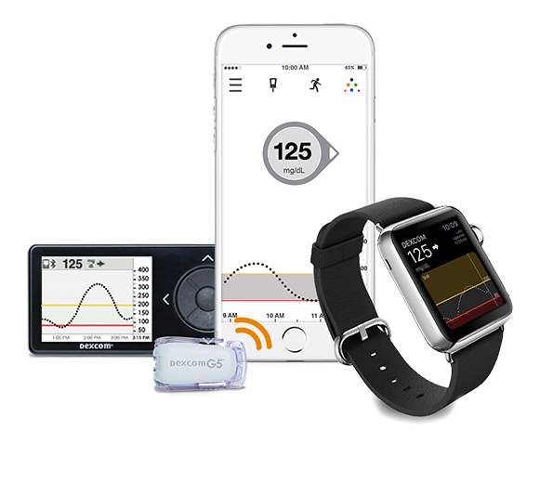
Continuous Glucose Monitors (CGMs)
Dexcom (also Medtronic)
Talks to phone, Apple watch
Share with up to 5 others
Alerts high or low
Dexcom.com G5 CGM
Notes:
In January 2017, the Centers for Medicare and Medicaid Services announced that it would cover continuous glucose monitoring for the first time; specifically it would cover therapeutic CGMs, of which the only one currently recognized is the Dexcom G5. That coverage officially kicks in today, 3/24/17, now that CMS has issued the billing codes providers can use to get reimbursed.
“This is a new era and a huge win for people with diabetes on Medicare who can benefit from therapeutic CGM,” Dexcom president and CEO Kevin Sayer said in a statement. “This decision supports the emerging consensus that CGM is the standard of care for any patient on intensive insulin therapy, regardless of age.”
Apple is investing heavily in the R&D of noninvasive BG monitoring using sensors possibly in Apple Watch. Hired several big names in glucose monitoring to work for them.
Video: What is a Continuous Glucose Monitor from Dexcom. 3:17 min
https://www.youtube.com/watch?v=nSuGeN7Ko7Q

Slide 21
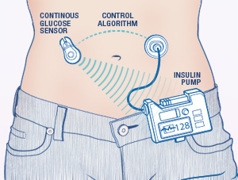
Artificial Pancreas
CGM and Insulin pump communicate
Medtronic first to gain FDA approval
Several more in clinical trials
© Healthline 2012
Notes:
Video is: Artificial Pancreas System Explained, from Diabetes Care Center. 3:24 min
https://www.youtube.com/watch?v=_dEPDutcySE
Link is to https://www.fda.gov/MedicalDevices/ProductsandMedicalProcedures/HomeHealthandConsumer/ConsumerProducts/ArtificialPancreas/default.htm
Patients can join clinical trials to help test new devices.
Three types of artificial pancreas devices
Threshold Suspend Device System
The goal of a threshold suspend device system is to help reverse a dangerous drop in blood glucose level (hypoglycemia) or reduce its severity by temporarily suspending insulin delivery when the glucose level falls to or approaches a low glucose threshold. These are sometimes referred to as "low glucose suspend systems." This kind of system serves as a potential back-up when a patient is unable to respond to a low blood sugar (hypoglycemic) event. Patients using this system will still need to be active partners in managing their blood glucose levels by periodically checking their blood glucose levels and by giving themselves insulin or eating.
Insulin-Only System
An insulin-only system achieves a target glucose level by automatically increasing or decreasing the amount of insulin infused based on the CGM values. These systems could be hybrid systems that only automatically adjust basal insulin with the user manually delivering bolus insulin to cover meals, or could be fully closed loop systems, where the system can automatically adjust basal insulin and provide insulin for meals.
Bi-Hormonal Control System
A bi-hormonal control system achieves a target glucose level by using two algorithms to instruct an infusion pump to deliver two different hormones – one hormone (insulin) to lower glucose levels and another (such as glucagon) to increase blood glucose levels. The bi-hormonal system mimics the glucose-regulating function of a healthy pancreas more closely than an insulin-only system.

Slide 22
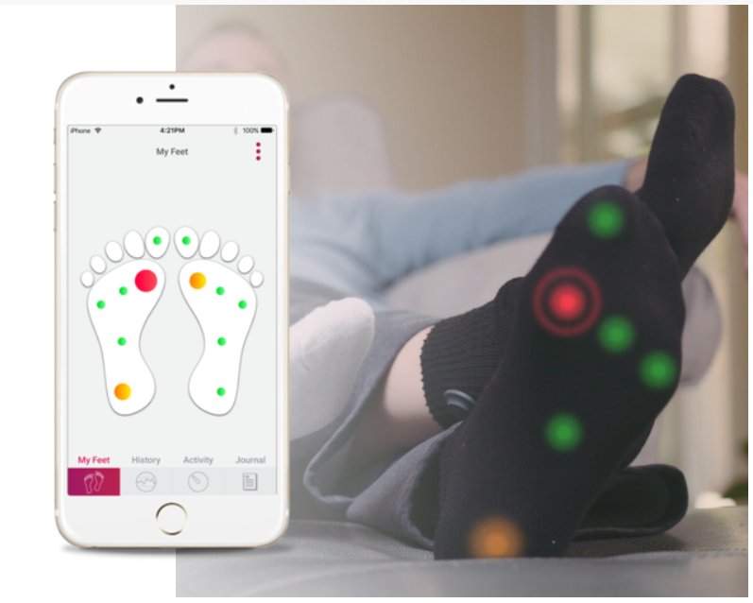
Smart Socks for Diabetic Foot Mgmt
Siren Care – subscription
Monitor foot temperature
Catch infections before becoming ulcers
Available spring 2017
29M diabetics in US
1.5M foot ulcers/yr
25% don’t heal
100K foot amputations/yr
https://siren.care/
Notes:
Cost $120 for 7 washable/reusable socks that should last 6 months. So about $240 per year.
29.1M people in US with Diabetes. 1.5M will develop foot ulcers every year, 25% don’t heal. 100,000 foot amputations per year.

Slide 23
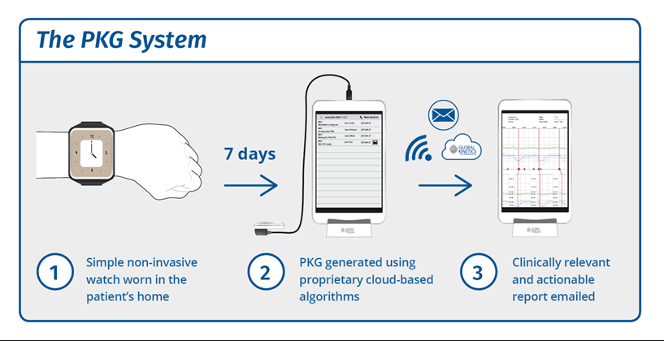
Parkinson’s Monitor
Global Kinetics: Personal KinetiGraphTM (PKG) smartwatch
Medication alarms, movement tracking
FDA approved
http://www.globalkineticscorporation.com.au/
Notes:
The PKG™ (Personal KinetiGraph™) provides continuous, objective, ambulatory assessment of the treatable and disabling symptoms of Parkinson’s disease including tremor, bradykinesia and dyskinesia. The PKG™ also provides an assessment of daytime somnolence and an indication of propensity for impulsive behaviors.
The PKG™ system consists of a wrist-worn movement recording device known as the PKG™-Watch, proprietary algorithms and a data-driven report known as the PKG™. Developed by Global Kinetics Corporation in Australia, has FSU approval.
Video is Fall 2015: Monitoring Parkinsonian Hand Tremor Using Smartwatch – how they developed the app 2:00 min
https://www.youtube.com/watch?v=3N5T6TV-AZA

Slide 24
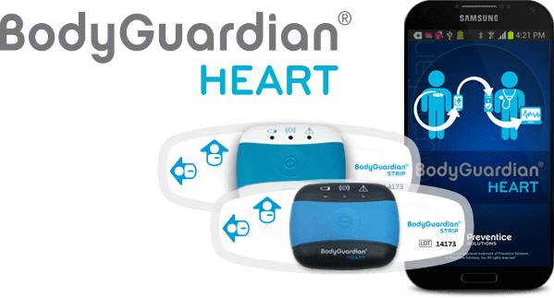
Remote Monitoring Devices
Bodyguardian Heart (Zio, Medtronic, others)
Developed with Mayo and ST Microelectronics
Rhythm monitoring
Set intervals for recording
Patient portal
Care team monitoring
http://www.preventicesolutions.com/technologies/body-guardian-heart.html
Notes:
Video: BodyGuardian Heart Instructional Video from Preventive Solutions. 10:00 min
https://www.youtube.com/watch?v=CWuv-LFKng8
The Medtronic's Seeq™ Mobile Cardiac Telemetry System, including a wearable peel-and-stick sensor and a wireless transmitter, is designed for patients with frequent symptoms that require short-term cardiac monitoring for up to 30 days. At a Medicare-certified diagnostic testing facility, cardiographic technicians review incoming data from the transmitter 24/7 and notify monitoring providers of clinically relevant events.
Evidence for Remote Patient Monitoring:
Vegesna A, Tran M, Angelaccio M, Arcona S. Remote Patient Monitoring via Non-Invasive Digital Technologies: A Systematic Review. Telemed J E Health. 2017;23(1):3-17.
Systematic Review Results: Of 347 articles identified, 62 met the selection criteria. Most studies were randomized control trials with older adult populations, small sample sizes, and limited follow-up. There was a trend toward multicomponent interventions (n =26), followed by smart-phones/PDAs (n=12), wearables (n=11), biosensor devices(n=7), and computerized systems (n=6). Another key trend was the monitoring of chronic conditions, including respiratory (23%), weight management (17%), metabolic (18%), and cardiovascular diseases (16%). Although substantial diversity in health-related outcomes was noted, studies predominantly reported positive findings.
Conclusions: This review will help decision makers develop a better understanding of the current landscape of peer-reviewed literature,

Slide 25
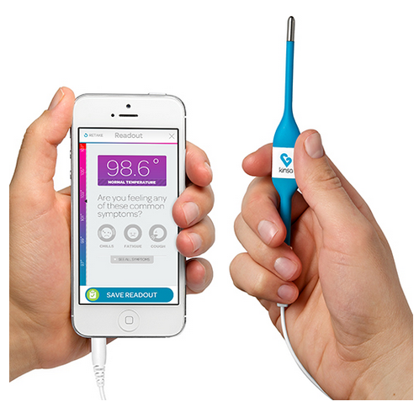
Home Health - Smart Thermometers
Some need wire (Kenza) and others use Bluetooth (Withings) to talk to app
Apps let you track symptoms
Define multiple users
$15 - $100
Notes:
Just as an FYI: Withings is a part of Nokia and produces a fitness smartwatch, pulse ox, scales, thermometer, BP, all that talk to Apple Health.
Video is a review of the Withings Thermo Smart Thermometer https://www.youtube.com/watch?v=A9nrl6SZjyg
From Booredatwork.com 3:28 min

Slide 26
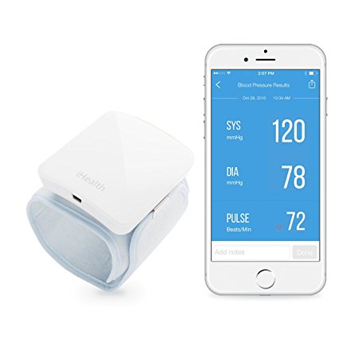
Home Blood Pressure Monitors
Cuff or wrist models
Bluetooth to app
iHealth, Withings, Omron 10
Check for FDA approved
Pulse Oximeter also available
Example:
iHealthLabs.com Wireless Blood Pressure Wrist Monitor and MyVitals App. $79.00
http://www.ihealthlabs.com/blood-pressure-monitors/wireless-blood-pressure-wrist-monitor/
Notes:
iHealth has a portal that collects data from multiple devices (scales, temp, BP, Pulse ox) and provides one patient health display. See http://ihealthnext.com
Video is 10 Best Blood Pressure Monitors. From Ezvid Wiki. 4:44 min
https://www.youtube.com/watch?v=O7HcZAQlvV0

Slide 27
Lab-in-a-Box Health Tracking
Cue systems
Samples blood, saliva, mucous
Monitor Vitamin D, inflammation, influenza, testosterone, fertility
Sends results to app
https://cue.me/#inflammation
Notes:
Video is the Cue promotional video. 2:16 min https://www.youtube.com/watch?v=32YwVuiAgEg

Slide 28
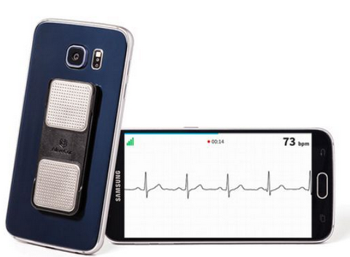
Apps/Devices FDA Regulatory Oversight
Mobile apps that use attachments, display screens, sensors or other such similar components to transform a mobile platform into a regulated medical device.
Example:
Kardia Mobile ECG-AliveCor.com
http://www.fda.gov/downloads/MedicalDevices/.../UCM263366.pdf
Notes:
Video is a Review of the AliveCor device by Cardiologist. 5:00 min.
https://www.youtube.com/watch?v=HCyR4wYptWM
Any attachment with an app, that attaches to the smartphone that turns the smartphone into a regulated medical device, like a EKG (shown), stethoscope, and ultrasound attachment, Most of these are used in the physician’s office, by physicians, but could theoretically be used in telemedicine visits.
FDA VERBAGE: Mobile apps that transform the mobile platform into a regulated medical device by using attachments, display screens, or sensors or by including functionalities similar to those of currently regulated medical devices. Mobile apps that use attachments, display screens, sensors or other such similar components to transform a mobile platform into a regulated medical device are required to comply with the device classification associated with the transformed platform.
Examples of these types of mobile apps include: a mobile app that uses a mobile platform for medical device functions, such as attachment of a blood glucose strip reader to a mobile platform to function as a glucose meter; or attachment of electrocardiograph (ECG) electrodes to a mobile platform to measure, store, and display ECG signals; a mobile app that uses the built-in accelerometer on a mobile platform to collect motion information for monitoring sleep apnea; a mobile app that uses sensors (internal or external) on a mobile platform for creating electronic stethoscope function is considered to transform the mobile platform into an electronic stethoscope; manufacturers of such a mobile app are required to follow the requirements of 21 CFR 870.1875(b) (Electronic Stethoscope); and similarly a mobile app that displays radiological images for diagnosis transforms the mobile platform into a class II Picture Archiving and Communications System (PACS) under 21 CFR 892.2050.

Slide 29
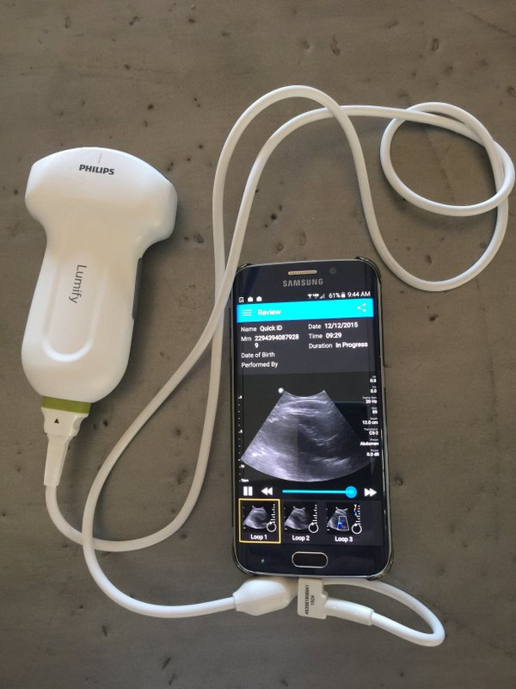
Other Smartphone Attachments
Ultrasound (Philips)
Stethoscope (Eko)
Pulse Oximeter (iHealth)
Otoscope (Welch Allyn)
Ophthalmoscope (WA)
Etc.
Some have AI assisted diagnostics in app
Philips Lumify Ultrasound
Notes:
Video: Philips Lumify ultrasound demo. 1:26 min https://www.youtube.com/watch?v=76a2B7ti5hY
The fact that some of these attachments are accompanied by intelligent apps that assist in identification of problems, diagnosis and such leads us to the next category which is….

Slide 30
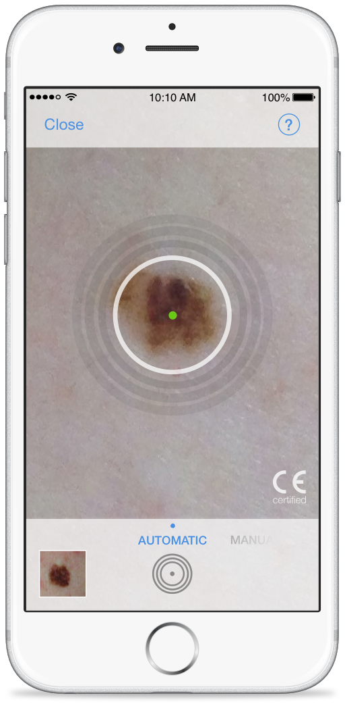
Apps/Devices FDA Oversight
Mobile apps that become a regulated medical device by performing patient-specific analysis and providing patient-specific diagnosis, or treatment recommendations.
Example: Mole Analysis (not approved yet because of problems)
SkinVision.com
http://www.fda.gov/downloads/MedicalDevices/.../UCM263366.pdf
Notes:
3. Apps that performing patient-specific analysis. Example is the app that lets you take a picture of your mole, it analyses it for possible melanoma, lets you track it over time, and allows a physician to pull up the pictures online and look at them. It is NOT FDA approved and has been cited as missing a lot of melanomas. However, a Watson based AI analysis of images is being tested.
FDA VERBAGE: “Examples of mobile apps that perform sophisticated analysis or interpret data (electronically collected or manually entered) from another medical device include: apps that use patient-specific parameters and calculate dosage or create a dosage plan for radiation therapy; Computer Aided Detection software (CAD) image processing software; and radiation therapy treatment planning software. We believe that these types of software present the same level of risk to patients regardless of the platform on which they run.“

Slide 31
FDA Oversight Discretion They may decide to regulate apps that:
Facilitate behavioral change or coach patients
Organize and track patients health information
Find information about patient’s condition (reference)
Perform calculations (calculators)
Document, show, or communicate to providers potential medical conditions
Interact with the PHR or EHR systems
Are medical device data systems
Will not certify fitness devices and apps
Notes:
The FDA has grouped these apps into 7 categories. [Do not read these categories out loud] Now we are going to look at each of these categories one at a time and give examples of apps that might be prescribed or recommended to patients in each category.

Slide 32
FDA Oversight Discretion
May choose to regulate additional apps
Currently do not
Quality = variable
Safety, effectiveness, ease of use: must be assessed by other means
Curating efforts
Research
Experience
Notes:
Now let’s talk about apps that the FDA has chosen not to regulate. The following slides contain mobile apps for which the FDA intends to exercise enforcement discretion: in other words, they may choose to regulate them, but for now, for the most part, do not.
As a result, these are highly variable. There needs to be external assessment of their safety, effectiveness and ease of use thru some kind of curating effort, research and shared experience between clinicians.

Slide 33
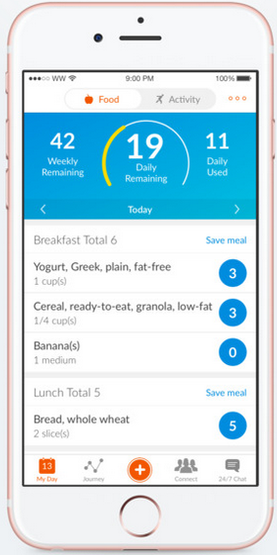
FDA Oversight Discretion (Next 8 Slides Refer To Category #1)
Apps that supplement care by facilitating behavioral change or coaching patients with diseases or conditions in their daily environment.
Medication Reminders
Coaching apps
Maintain weight/nutrition
Fitness apps
WeightWatchers.com
Notes:
The first of these are apps that facilitate behavioral change or coaching. Examples is the highly popular and very successful WeightWatchers app. As well as the fitness apps we have mentioned previously. Medication reminders also are included in this group. Lets look at several of these types of apps.
FDA VERBAGE: 1. These are apps that supplement professional clinical care by facilitating behavioral change or coaching patients with specific diseases or identifiable health conditions in their daily environment. Examples include:
Apps that coach patients with conditions such as cardiovascular disease, hypertension, diabetes or obesity, and promote strategies for maintaining a healthy weight, getting optimal nutrition, exercising and staying fit, managing salt intake, or adhering to pre-determined medication dosing schedules by simple prompting.

Slide 34
Medication Adherence
Economic burden of nonadherence:
$100-$300 billion per year
Medication Adherence Clinical Reference. American College of Preventive Medicine. 2011. http://www.acpm.org/?MedAdherTT_ClinRef#Statistics
Notes:
Speaking of medication reminders…. Nonadherence results in an economic burden of $100 to $300 billion per year. Annually, nonadherence costs $2,000 per patient in physician visits.
People with chronic conditions only take about half of their prescribed medicine. Adherence to treatment regimens for high blood pressures is estimated to be between 50 and 70 percent.
The rate of nonadherence is expected to increase as the burden of chronic disease increases.
Nonadherence accounts for 10% to 25% of hospital and nursing home admissions .
Recent research has found medication nonadherence to result in:
5.4 times increased risk of hospitalization, rehospitalization, or premature death for patients with high blood pressure
2.5 times increased risk of hospitalization for patients with diabetes
More than 40 percent of nursing home admissions

Slide 35
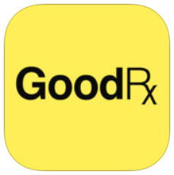
Filling Prescriptions
GoodRx - free
Uses location to find best prices for prescription drugs
Coupons, prices and saving tips
Pharmacy Apps - free
CVS, Walgreens, etc.
Scan bar code on bottle, refill prescriptions, refill reminders, alerts when ready
Medication reminders
Notes:
Let’s take this opportunity to look at medication reminders and the whole medication app picture.
As one of the predictors of medication nonadherence is the cost of medications or copay for medications, one of the best apps you can suggest a patient use is GoodRx. It lets patients find the cheapest price on their medicines in their vicinity and provides coupons to help pay for medications.
The pharmacies have developed apps to help patients manage their medicines, get refills, and some ALSO include medication reminders which let the patient choose from their prescriptions list to set the reminder. You can also get your pictures printed out directly from your phone ☺.

Slide 36
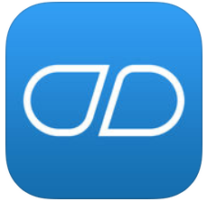
Med Reminder Apps
Medisafe Pill Reminder -Free
Medication tracker
Smartphone (iOS and Android) Apple Watch
Manage numerous people
Collaborating with Epic and Cerner EMR
Other free and highly recommended
AlarMed, Round Health, DoseCast, Pill Monitor Free, RemindMe Prescription/Medication
iMedicalApps. Study finds the best medication adherence medical apps. Jan, 2017.
Notes:
One of the most highly recommended pill reminder is Medisafe. Medication reminders.
Nice article at iMedicapApps on the best medication reminder apps. http://www.imedicalapps.com/2017/01/study-best-medication-adherence-medical-apps/
Video is MediSafe Meds & Pill Reminder | Health-e-Apps | Improve Your Health In A Mobile Minute https://www.youtube.com/watch?v=mWqkBjfU3sE 2.10 min

Slide 37
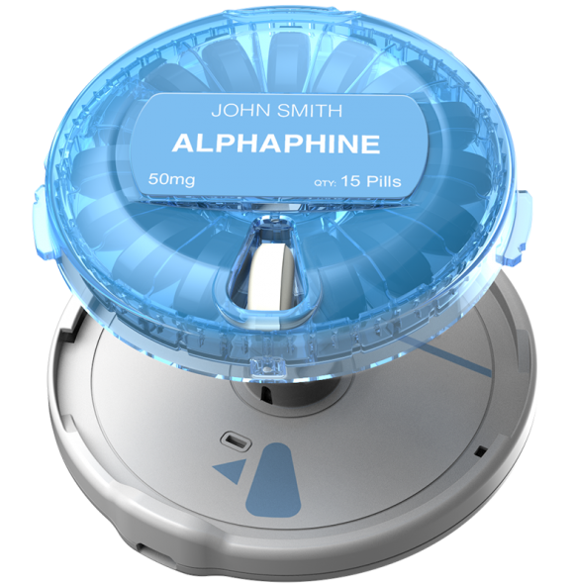
DoseSmart App and Dispenser
Medication reminders
Vibrating dispenser
Or Smart Pill Bottle
Bluetooth
Alternative: Smart wireless pill bottles adheretech.com
Monitor adherence
Mydosesmart.com
Notes:
Video is a Prototype smart pill dispenser from Kent State University. 2:36 min https://www.youtube.com/watch?v=rn-VCEv5N7I

Slide 38
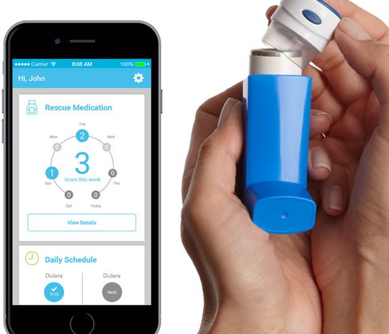
Monitoring Adherence
Asthma/COPD Smart Inhaler
Device that fits onto an inhaler, Bluetooth spirometers
Wirelessly syncs with app
Record trending data
Shared with physician
https://www.propellerhealth.com/
Notes:
Monitoring medication adherence is made easier with devices that will track when a patient takes a pill or uses their inhaler. Smart inhalers like ones that work with rescue bronchodilators will also tell you how well controlled an asthmatic is, allowing the clinician to adjust their overall management.
Video is cute promotional for the 3M Intelligent Control system. 1:45 min. https://www.youtube.com/watch?v=5Ye44s0pToQ

Slide 39
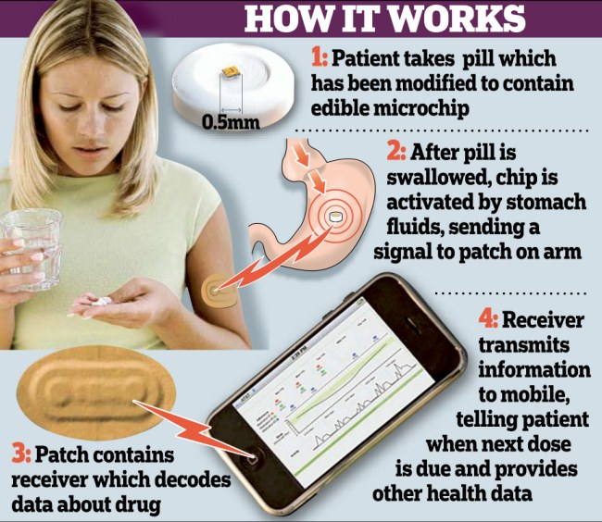
Monitor Adherence
Smart pills FDA approved
Proteus.com
Patients may find intrusive
Useful for clinical trials
Invasive for patients
Cha, A.E. “Smart pills” with chips, cameras and robotic parts raise legal, ethical questions. Washington Post. May 24, 2014.
Notes:
The smart pill is likely only going to catch on with researchers to insure people involved in clinical trials are compliant. Courts could use for chemical castration orders.

Slide 40
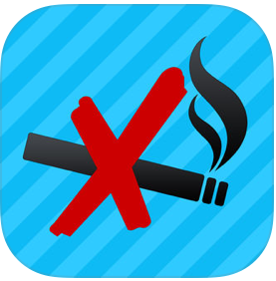
Coaching Apps Smoking Cessation
Quit It – Stop Smoking Today
$.99 - Lite version free
Motivational program
Support and encouragement to stop
Track #cigarettes not smoked
Track $$ saved
Other highly recommended
Quit Smoking Now HD, QuitGuide from NCI, SmartQuit
Notes:
Here is an example of a coaching app. Apps that support smoking cessation have shown positive and negative results.
http://www.imedicalapps.com/2016/08/quitguide-smoking-cessation-app-review/#
http://www.imedicalapps.com/2016/07/smartquit-app-smoking-cessation-app-free/#
health.usnews.com/health-news/health-wellness/articles/2014/07/09/how-to-use-your-smartphone-to-quit-smoking

Slide 41
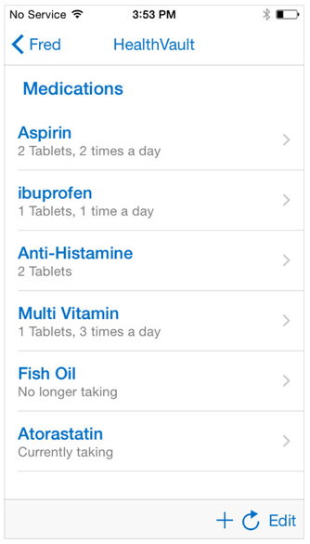
FDA Oversight Discretion
Apps that provide patients simple tools to organize and track their health information.
Personal health record
Fitness tracker
Symptom tracker
Microsoft HealthVault
Notes:
Mobile apps that provide patients with simple tools to organize and track their health information – These are apps that provide patients with tools to organize and track health information without providing recommendations to alter or change a previously prescribed treatment or therapy. Examples include:
Apps that provide simple tools for patients with specific conditions or chronic disease (e.g., obesity, anorexia, arthritis, diabetes, heart disease) to log, track, or trend their events or measurements (e.g., blood pressure measurements, drug intake times, diet, daily routine or emotional state) and share this information with their health care provider as part of a disease-management plan.
Example given is Microsoft Health Vault. Been around a long time. (2012) Has online web site and well as app. Linked to https://www.healthvault.com/en-us/ Patient takes responsibility to enter their data, plus it does input from Bluetooth scales and devices, Patient can grant access to online information to their family members, physician, etc.

Slide 42
Symptom Tracking Apps
There is a patient log app for any chronic condition. Examples:
GI- myIBS, GI Buddy, Poop Time Pain – My Pain Diary Fertility - Period Tracker Neuro - Migraine Buddy Rheum – myRA
Diabetes –
mySugr, BG Monitor Diabetes, Glucose Buddy
Notes:
There are literally thousands of apps that fit this category. For almost every chronic disease there are dozens of apps that allow patients to put their logs of symptoms and such into an app, and share them with friends, family and/or their physician. The problem is to consolidate all that info into a usable interface. If you have 30 patients with one chronic condition, but each is using a different app, that can be a problem for you.
Diabetes BG tracking apps have been around for a long time. Here are some of the better ones. The advent of Bluetooth glucometers have made these archaic, but still handy for people with old equipment.
Searching Google for “apps for patients with…” gives you some idea of the vast numbers of apps for a condition. For example: here is an article on the best apps for patients with psoriatic disease: https://www.psoriasis.org/blog/best-apps-psoriatic-disease

Slide 43
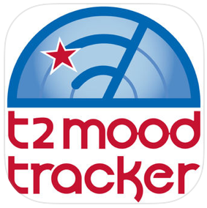
Mental Health Apps
T2 Mood Tracker
Monitor moods on 6 scales (anxiety, stress, depression, brain injury, PTS, wellbeing)
From National Center for Telehealth and Technology
Other highly recommended:
MoodPanda –Moon Diary & tracker
Live OCD Free
ADHD Angel
PTSD Coach (VA)
Breathe2Relax
mTBI Pocket Guide
Notes:
For the psychiatrists in the room, there are large numbers of apps that both coach, track and education patients with mental health issues. The national center for telehealth and technology has several nice apps which are combinations of tracking, coaching apps: T2 Mood Tracker, Breathe2Relax, mTBI Pocket Guide (mild traumatic brain injury). Some of these also contain patient education.
Live OCD claims to reduce OCD by 34% in 8 weeks. Has video tutorials as a nice user guide. PTSD Coach has some research to back up success. Live OCD Free Tutorial Video: https://www.youtube.com/watch?v=5T63lNyjFb0 5 min
PTSD Coach Mobile App Video from the VA https://www.youtube.com/watch?v=yQuEVOPeDrM 3.5 min.

Slide 44
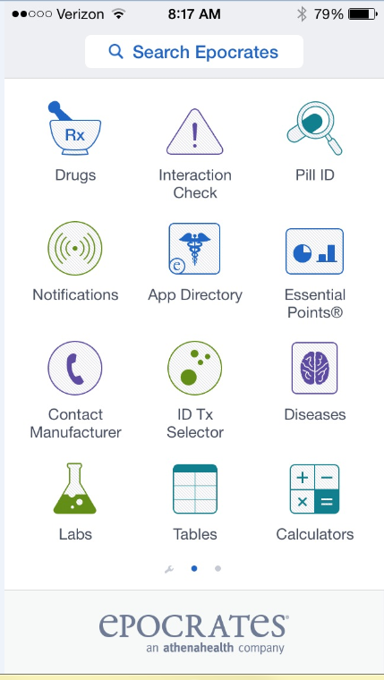
FDA Oversight Discretion
Apps that provide access to information related to patients’ health conditions or treatments (reference)
Perform simple calculations routinely used in practice.
Epocrates
QxMD Calculate
Epocrates.com
Notes:
We have several workshops that cover these, no not going to spend any time on these. There are a number of apps that are free like Epocrates Rx, Medscape, WebMD, and such that patients can download for education purposes. Many of the previously mentioned apps Dx tracking apps have educational components built in.
FDA VERBAGE: 3. Apps that provide easy access to information related to patients’ health conditions or treatments (beyond providing an electronic “copy” of a medical reference) – These are apps that provide contextually-relevant information to users by matching patient-specific information (e.g., diagnosis, treatments, allergies, signs or symptoms) to reference information routinely used in clinical practice. The type of information provided in these apps is from authoritative medical sources, as recognized by the field or discipline that is the subject of the app. (e.g., practice guidelines) to facilitate a user’s assessment of a specific patient. Examples include:
Apps that use a patient’s diagnosis to provide a clinician with best practice treatment guidelines for common illnesses or conditions such as influenza;
Apps that are drug-drug interaction or drug-allergy look-up tools.
4. Mobile apps that perform simple calculations routinely used in clinical practice – These are apps that are intended to provide a convenient way for clinicians to perform various simple medical calculations taught in medical schools30 and are routinely used in clinical practice. These apps are generally tailored for clinical use, but retain functionality that is similar to simple general purpose tools such as paper charts, spread sheets, timers or generic mathematical calculators. Examples of such general purpose tools include medical calculators for:
Body Mass Index (BMI)
Total Body Water / Urea Volume of Distribution
Mean arterial pressure
Glascow Coma Scale score
APGAR score
NIH Stroke Scale
Delivery date estimator

Slide 45
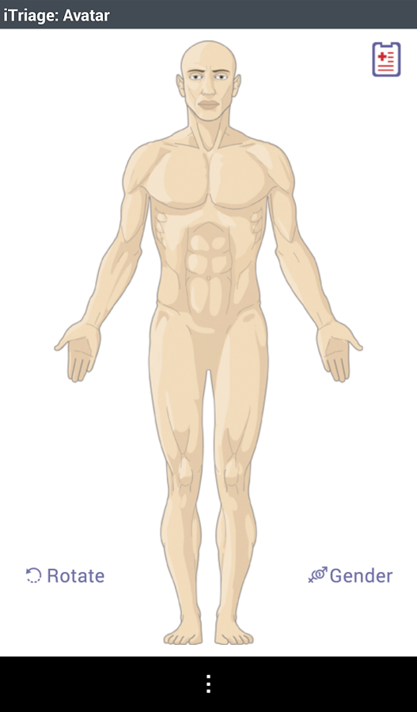
Patient self-Education
Apps designed for patients
iTriage
WebMD
Symptom checker
Procedure information
Condition information
Medication information
Allergy information
AskMD
KidsDoc
Notes:
Video is Demo of iTriage symptom checker. 1:14 min https://www.youtube.com/watch?v=ynaq__WRntQ
AskMD -- Sharecare's AskMD app offers users a symptom checker that allows patients to choose which symptoms they are feeling and then see which potential health issues they might have. The app then walks the user through a ‘consultation’ in which the app will ask the user a series of questions to identify more specifically what the symptom feels like, when it started, and if there are any other symptoms accompanying it. AskMD will integrate data from Apple Health so that the app will have snapshots of the user's health.
The KidsDoc app, an app made by the American Academy of Pediatrics, is designed to be a resource for parents who are seeking medical guidance for their sick or injured child. The description of the app says that it is specifically designed for moments when parents have medical questions after hours or when it would otherwise be difficult to reach their primary care physician. Amazon Echo has incorporated the KidsDoc app into their system so that a parent can ask Echo (Alexa) questions http://www.imedicalapps.com/2016/05/amazon-echo-kidsmd-app/

Slide 46
What is out there for your patients?
Activity: Using Google, search for “best apps for patients with _____” using a condition common in your practice
Look for articles listing coaching, tracking and/or educational apps
Good sites with reviews include: iMedicalApps.com, MobiHealthNews.com, Medscape, Healthline.com, EverydayHealth.com, specialty blogs
Check dates. Look for current or past year.
Notes:
We have talked about coaching, tracking and patient ed apps. If you want to use the computers, you can take 5 min and let the audience search and report what they find. If not, this can be homework. NIH.nlm sites would be journal articles.
You can go to http://healthline.com and search for apps to see reviews.

Slide 47
Searching App Stores
Google Play play.google.com/store/apps
Pick category or search and filter ratings 4+, price, but not category
iTunes App Store lacks functionality
Try https://theappstore.org
Filter by last updated, ratings, category, price, age
Notes:
Basically, the official app stores for Android and Apple lack functionality. Using theappstore.org to find an app works much better. Demo these with audience input or let them try these on the computer. There are still too many good apps to pick one, but this narrows it down considerably. We will talk about curation efforts later.

Slide 48
FDA Oversight Discretion
Apps that help patients document, show, or communicate to providers potential medical conditions.
Telemedicine platforms
eVisit.com
TouchCare
TeleProviders
DoctorOnDemand.com
HealthTap.com
LiveHealth Online
TouchCare.com
Duffy, J. 10 apps that are changing healthcare. PC Magazine. 2/11/15. http://www.pcmag.com/article2/0,2817,2476623,00.asp
Notes:
Video is eVisit Video. 1:39 min https://www.youtube.com/watch?v=KwNz7tYcbFE
Touchcare and eVisit can be licensed by clinician, group or institution and used for telemedicine visits with patients. They allow scheduling of visits to set up a time, patient downloads app, clinician can use computer or app and have a secure video conference.
Touchare can be licensed by any providers to use in their practice. Patients make appointments (video) and visits use an app to set up the appointment, and use the built in camera in the phone for the visit. Platform is HIPAA compliant. eVisit is also a telemedicine platform that can be licensed by providers.
Doctor’s on Demand and Healthtap hire their own physicians who provide remote medical care. Patients pay $75 per visit for DOD. Labs are ordered thru Labcorp or Quest Diagnostics, and prescriptions are sent to pharmacy.MDLiveis another app or online based 24/7 clinic for $49 per visit
FDA VERBAGE: 5. Apps that are specifically marketed to help patients document, show, or communicate to providers potential medical conditions – These are apps that in their labeling or promotional materials are not promoted for medical uses but which, by virtue of other circumstances surrounding their distribution, may meet the definition of a medical device. These products either pose little or no risk, or are the sole responsibility of the health care providers who have used them in medical applications. Examples include:
Apps that serve as videoconferencing portals [TouchCare] specifically intended for medical use and to enhance communications between patients, healthcare providers, and caregivers;
Apps specifically intended for medical uses that utilize the mobile device’s built- in camera or a connected camera for purposes of documenting or transmitting pictures (e.g., photos of a patient’s skin lesions or wounds) to supplement or augment what would otherwise be a verbal description in a consultation between healthcare providers or between healthcare providers and patients/caregivers.

Slide 49
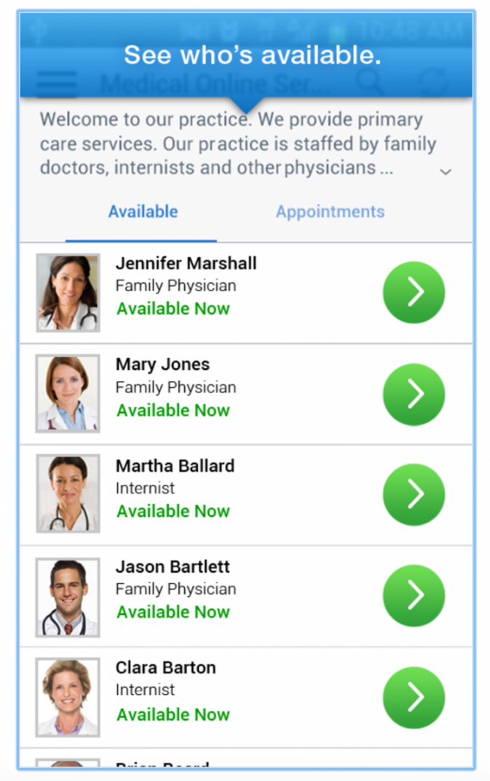
24/7 App Based Visits
Univ Pittsburg announced March 2017
All citizens of Pennsylvania
6 minute wait - $10-$49 per visit
3,600 docs in system
UPMC Health Plan members and non-members
Mack, H. UPMC Health Plan launches app-based video visits to all Pennsylvania residents. MobiHealthNews. 3/17
http://www.mobihealthnews.com/content/upmc-health-plan-launches-app-based-video-visits-all-pennsylvania-residents
Notes:
Here is how one institution is using app based telemedicine. The University of Pittsburgh Medical Center (UPMC) Health Plan has launched an app-based, 24/7 telemedicine service to offer patients across Pennsylvania video visits from UPMC emergency room nurses and clinicians. Initially launched on desktop in November 2016 to UPMC Health Plan employees, the app version of AnywhereCare is now available to all patients within the state.
Even though emergency room professionals are providing the service, the AnywhereCare app is actually intended for non-emergency ailments that nonetheless require urgent care, such as sore throats and respiratory illnesses. Powered by American Well and whitelabeled under UPMC, the video visit app is available for free on smartphones, tablets or desktop computers, and users can expect to wait a little over six minutes, on average, to see a clinician.
UPMC is one of the largest health systems and insurers in the state, counting 3,600 physicians across 25 hospitals and 600 offices and outpatient clinics. There are more than 3 million members under UPMC Health Plan, but AnywhereCare is available to anyone in the state regardless of their plan. Depending on coverage, the video consultations range from $10 for health plan members to $49 per visit for nonmenters. Healthcare professionals conducting a visit can also send prescriptions directly to the patient’s pharmacy, if need be, saving the patient even more time.
"AnywhereCare also helps to free the backlog in doctor's offices, urgent care facilities, and hospital emergency rooms and allows doctors to spend more time with patients who suffer from chronic conditions. Nearly 90 percent of patient issues are resolved during the AnywhereCare virtual visit and do not require follow-up care."
.

Slide 50
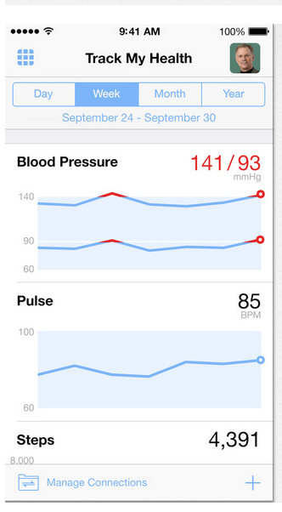
FDA Oversight Discretion
Apps that enable individuals to interact with personal health record systems or EHR systems.
Epic: MyChart
Allscripts – FollowMyHealth App
Mostly read only
drchrono - onPatient Personal Health Record
Epic.com MyChart
Notes:
Drchrono has taken it a step farther, with an app that allows a patient to enter their own information into an app
Onpatient PHR which then talks to and feeds into the drchrono EMR. onPatient PHR is part of the drchrono EMR system which is gaining in the market for small physician offices. Drchrono now let patients integrate HealthKit data into their personal health record.
Video is a promotional video from a clinic to tell their patient how to use Epic MyChart. 1:00 min https://www.youtube.com/watch?v=T4ds-rtjD_U
FDA VERBAGE: 6. Apps that enable individuals to interact with PHR systems or EHR systems -- These are apps that provide patients and providers with mobile access to health record systems or enables them to gain electronic access to health information stored within a PHR system or EHR system. Applications that only allow individuals to view or download EHR data are also included in this category. These mobile apps are generally meant to facilitate general patient health information management and health record-keeping activities.

Slide 51
EMR Companies Developing Apps
Epic: MyChart
Partnering with existing apps like Apple’s HealthKit, Fitbit to collect data from multiple apps and devices
AthenaHealth: athenaWell Care Management
owns Epocrates
Allscripts: FollowMyHealth
Cerner: HealtheLife

Slide 52
FDA Oversight Discretion
Apps that meet the definition of Medical Device Data Systems.
Example Apple’s Health
Consolidates data from multiple sources: Apple Watch or Fitbit, iHealth devices, MyFitnessPal, RunKeeper….
Transform data into diagnostic tools
HealthKit, ResearchKit and CareKit developer kits for connectivity
Pai, A. 38 more health and wellness apps that connect to Apples HealthKit. 10/16/14. http://www.mobihealthnews.com/37340/38-more-health-and-wellness-apps-that-connect-to-apples-healthkit and http://www.mobihealthnews.com/36870/23-health-and-wellness-apps-that-connect-to-apples-healthkit/#comment-1613689779
Notes:
Video is What Can Apple's HealthKit Do? From Bloomberg News. 2016. 3:47 min https://www.youtube.com/watch?v=Q2PpQy5RFfE
Pubmed studies using Apple ResearchKit https://www.ncbi.nlm.nih.gov/pubmed/?term=researchkit
The Apple HealthKit was created to allow developers of fitness apps, wearables and devices to consolidate all fitness data collected into one app for the patient to monitor. EMR companies and institutions are able to tap into this data if working with Apple. Links are to lists of apps and devices that now talk to Apple’s HealthKit. List is growing.
In March of 2015, Apple attracted a great deal of attention when it launched ResearchKit, an open source framework that lets developers create medical apps designed to engage patients in research studies. About a year later, the company released CareKit to help people actively manage their own disorders. CareKit, to be released in April 2017, is intended to help “enable people to actively manage their own medical conditions. iPhone apps using CareKit make it easier for individuals to keep track of care plans and monitor symptoms and medication; providing insights that help people better understand their own health. It consolidates data from multiple monitoring devices and apps.
FDA VERBAGE: 7. apps that meet the definition of Medical Device Data Systems – These are apps that are intended to transfer, store, convert format, and display medical device data, without controlling or altering the functions or parameters of any connected medical device, as defined in the MDDS classification regulation (21 CFR 880.6310). These mobile apps include those that are used as a secondary display to a regulated medical device when these apps are not intended to provide primary diagnosis, treatment decisions, or to be used in connection with active patient monitoring (i.e., mobile apps that meet the MDDS definition).
Two articles linked list apps and devices that are connected to Apple HealthKit as of 10/14. There are a lot more now.

Slide 53
Model for Health Data Collection
A dashboard is needed.
Cloud collection point for multiple devices:
BP, BG, vitals, etc.
Proprietary to device manufacturer
Shared with popular health/fitness app like Apple Health or MyFitnessPal
Will EMR import?
Notes:
Apple’s Health app is a model of what is needed to make all these apps useful in the clinical setting to clinicians. What is needed is a dashboard built into the EMR that collects all this disparate date and displays it in a usable format. (would that the rest of the EMR was like that)
Video is the first 90 sec of a 38 minute panel discussion: Supporting Digital Health Solutions/Services: What is the Market & What does the Customer Need? 38 min https://www.youtube.com/watch?v=Uteelo8nQVA
Panel discussion: USC Center for Body Computing
Oct 12, 2016
Daniel Kraft, MD - Singularity University Maneesh Juneja - MJ Analytics Bakul Patel - Food & Drug Administration Michael Krupnick - AppScript, IMS Health Michelle Longmire, MD - CEO, Medable Inc. Stuart Karten - Karten Design

Slide 54
Duke Using Dashboard
Duke: Integrate Apple’s HealthKit mobile platform with Epic EMR.
Pilot with patients CHF
Monitor BP, weight, activity at home
Duke provides devices
Clinicians opt to turn on data stream, notifications, alerts
Ritterband, V. Apps for physicians and patients: The next frontier for EHRs? 2015 http://www.massmed.org/News-and-Publications/Vital-Signs/Apps-For-Physicians-and-Patients--The-Next-Frontier-for-EHRs-/#.WNVjyGe1uvF
Notes:
Zubin Eapen, MD, Medical Director, Duke Heart Failure Same Day Access, Duke University Medical Center
Recorded at the 3rd Annual mHealth@Duke Conference on April 15, 2015 https://www.youtube.com/watch?v=MEh9murD_wk
Note to speaker: I highly recommend reading the article referenced on the slide.

Slide 55
AMA Guidelines for Health App Usage
Main concerns;
Support patient-physician relationship
Integrate into clinical workflow
Reimbursement models
Ensure patient safety, quality care and positive health outcomes
Abide by state laws and licensure
American Medical Association. AMA Adopts Principles to Promote Safe, Effective mHealth Applications. Press release. Nov 16, 2016. https://www.ama-assn.org/ama-adopts-principles-promote-safe-effective-mhealth-applications
Notes:
According to the AMA statement, these principles will guide future advocacy and efforts in promoting the use of health apps and other digital health tools. In addition to supporting development, a unique focus of the AMA’s efforts seems to be on integration of these tools into clinical workflows, patient-physician relationships, and reimbursement models.
These guidelines were released with the knowledge that more research must be done to show the “accuracy, effectiveness, safety and security” of health apps. It will be interesting to see what specific actions the AMA takes going forward to push the digital health industry towards these principles.
Specifically, they will aim to support health apps & digital health tools that:
Support the establishment or continuation of a valid patient-physician relationship
Have a clinical evidence base to support their use in order to ensure mHealth app safety and effectiveness
Follow evidence-based practice guidelines, to the degree they are available, to ensure patient safety, quality of care and positive health outcomes
Support care delivery that is patient-centered, promotes care coordination and facilitates team-based communication
Support data portability and interoperability in order to promote care coordination through medical home and accountable care models
Abide by state licensure laws and state medical practice laws and requirements in the state in which the patient receives services facilitated by the app
Require that physicians and other health practitioners delivering services through the app be licensed in the state where the patient receives services, or be providing these services as otherwise authorized by that state’s medical board
Ensure that the delivery of any services via the app be consistent with state scope of practice laws.

Slide 56
Apps Make False Claims
Snake Oil Apps
Apps without attachments that claim to measure BP, pulse ox, or temp.
Look for “for entertainment purposes only” in description
Look for FDA approved on any devices or app to manage a Dx. Example: Insulin dose calculator
Watch for healthcare systems to certify apps and create their own that integrate with information systems
Misra, D. App claims to measure oxygen saturation with only a smartphone. Medpages Today, June 2015. http://www.medpagetoday.com/Blogs/IltifatHusain/51888
Notes:
Phones may add sensors in the future, but standard iPhone 7 does not have the necessary sensors to measure BP, pulse ox or temperature. Some heartrate apps work well enough for fitness, but have been shown to be incorrect. The one that uses the finger over the camera works much better than the one that looks at the face. Apple has announced that they are going to take a hard look at medical apps, whatever that means: http://www.emrandhipaa.com/katherine/2016/09/13/apple-app-store-toughens-guidelines-for-health-apps/ Apple App store toughens guidelines for health apps.
Insulin dosage calculators fall into this category as well. A 2015 study found 46 such apps on iOS and Android stores and reported that "none of the apps included in this study appear to have FDA approval.” Recently the FDA approved (2017) insulin dosage calculator is My Dose Coach from Sanofi who make Lantus insulin. Eli Lilly (Go Dose) and Roche also have recently received FDA approval similar apps.
NEWS: AmalgamRx, a newly unstealthed company founded by WellDoc founders Ryan Sysko and Dr. Suzanne Clough, has received FDA clearance for iSage, an insulin titration algorithm. Sage is a prescription-only patient-facing iOS and Android app that works in conjunction with a web portal used by the doctor.

Slide 57
HIPAA Considerations
HIPAA was written before smartphones
Only clinicians covered by HIPAA
DHHS has issued new guidance for health app developers. : http://hipaaqsportal.hhs.gov/
ONC has site with tutorials on mobile device use for providers: https://www.healthit.gov/providers-professionals/your-mobile-device-and-health-information-privacy-and-security
Notes:
We forget that only healthcare providers are covered by HIPAA. Any data a patient chooses to enter into an app is not covered by HIPAA. So developers are given some guidance by the DHHS site. ONC (Office of the National Coordinator) is mostly concerned by the use of mobile devices by providers to access EMRs and other PHI and suggests we password protect everything, encrypt, do not use your own phone number to text a patient, instead use a HIPAA compliant texting service, not share a device with others, etc. There is a series of nice videos on the ONC site above for providers.

Slide 58
HIPAA Caution
No texting with patient using personal account:
If patient initiates, caution in responding.
No emailing patient using personal account:
Use patient portal instead.
Use HIPAA compliant services
HIPAA compliant texting services
TigerText, qliqsoft, pMD, PingMD
Notes:
Multiple surveys have shown that Patient portals are not convenient to patients who want to use their own email or text. The industry needs to find a better way. The portal app may be easier for patients if they can use it like the Facebook messenger app on their phone.
http://www.thedoctors.com/KnowledgeCenter/PatientSafety/articles/To-Text-or-Not-to-Text
Texting Precautions
Consider the following steps to safeguard your practice:
Enable encryption on your mobile device.
Have a texting policy that outlines the acceptable types of text communications and specifies situations when a phone call is warranted.
Report to the practice’s privacy officer any incidents of lost devices or data breaches.
Install autolock and remote wiping programs to prevent lost devices from becoming data breaches.
Know your recipient, and double check the “To” field to prevent sending confidential information to the wrong person.
Avoid identifying patient details in texts.
Assume that your text can be viewed by anyone in close proximity to you.
Ensure the metadata retention policy of the device is consistent with the medical record retention policy and/or that it is in accordance with a legal preservation order.
Ensure that your system has a secure method to verify provider authorization.
When conducting your HIPAA risk analysis, include text message content and capability.
Consider Nicole Bentz’ example - say a patient texts you "I have a cold and don't think I need to see you right now. Viral. But can I take cold medication?" You respond "Lots of viral respiratory things going around. Rest and fluids. But, with your heart condition, high blood pressure and history of min-stroke, do not take cold meds with pseudoephrine. Come in if you feel worse" This is great patient education and appropriate by phone or in office, but you just disclosed a bunch of medical history with an innocent text. Just saying "no" to the cold medication would not give the patient proper guidance. Answering this message via the EMR portal (encrypted, password protected) or calling the patient is safer.

Slide 59
Information Collected by Apps
Survey of 184 mHealth apps
Password Req
Privacy Policy
Personal Health Information
Contact Info
Name, DOB & Gender
Grindrod K, Boersema J, Waked K, Smith V, Yang J, Gebotys C. Locking it down: The privacy and security of mobile medication apps. Canadian Pharmacists Journal : CPJ. 2017;150(1):60-66. http://journals.sagepub.com/doi/abs/10.1177/1715163516680226
Notes:
What kind of data is collected by apps?
2017 study. Survey, (Grindrod) of the 184 apps evaluated,
70.1% had no password protection or sign-in system.
Personal information, including name, date of birth and gender, was requested by 41.8% (77/184) of apps.
Contact information, such as address, phone number and email, was requested by 25% (46/184) of apps.
Finally, personal health information, other than medication name, was requested by 89.1% (164/184) of apps.
Only 34.2% (63/184) of apps had a privacy policy in place
Encourage patients not to enter personal information like name, contact info, DOB, SSN, health insurance information in apps without privacy policies. And to turn on biometric or passcode protection on their phones.
Even without activating an app, your phone is collecting information about your activity, steps, sleep, etc.

Slide 60
Apps and Security of Health Data
Apple more secure than Android
Free apps are more prone to security violations
Look for a Privacy Policy on apps that contain PHI
Patients and providers should enable security on their mobile device
Brüggemann, Thomas, et al. "An Information Privacy Risk Index for mHealth Apps." Annual Privacy Forum. Springer International Publishing, 2016. http://link.springer.com/chapter/10.1007/978-3-319-44760-5_12
Notes:
Hackers have discovered that there is a black market for health data, usually a patient’s medical record from a healthcare institution or insurance company. They can sell it for as much as $500 per complete record to identity thieves or to people who make false health insurance claims. Apps usually don’t contain that kind of data. Apple apps are more secure than Android apps. Image is from the iTunes app store showing the link to the Privacy Policy and user agreement on a medical app Microsoft HealthVault.
Future of Privacy Forum. FPF Mobile Apps Study. August 2016. This report looks the most popular apps and whether they have a privacy policy either in the app or on their website. Fitbit, MyFitnessPal, Headspace, LoseIt!, MapMyRun, and PeriodTracker (top 6) all do have privacy policies. https://fpf.org/wp-content/uploads/2016/08/2016-FPF-Mobile-Apps-Study_final.pdf
Video is https://www.youtube.com/watch?v=Ca9FbEUxSkY Bloomberg, How secure is your health data with Apple. 4:48 min
https://www.youtube.com/watch?v=Ca9FbEUxSkY
REFERENCES:
1. Brüggemann, Thomas, et al. "An Information Privacy Risk Index for mHealth Apps." Annual Privacy Forum. Springer International Publishing, 2016. http://link.springer.com/chapter/10.1007/978-3-319-44760-5_12
3. Singh, Karandeep, et al. "Many Mobile Health Apps Target High-Need, High-Cost Populations, But Gaps Remain." Health Affairs 35.12 (2016): 2310-2318. http://content.healthaffairs.org/content/35/12/2310.short
GOOD ARTICLE: https://securityintelligence.com/2016-state-of-application-security-top-health-care-apps-in-critical-condition/

Slide 61
How and why prescribe an app
Notes:
Video is When the Doctor Prescribes an App, news from WSJ. 5.22 min
https://www.youtube.com/watch?v=2pCF1fGTqxo
Interview with oncologist about a cancer pain app.
Pretty good one. Might consider showing this one to the audience.

Slide 62
Benefits of Prescribing apps
Improve physician/patient relationship
Promote self and shared health management
Assist caregivers in following instructions
Providing data to patient to self monitor and physician monitoring uncontrolled chronic condition
Scher, DL. The big problem with mobile health apps. Medscape. 2015. http://www.medscape.com/viewarticle/840335
Notes:
Benefits for use of this technology has been reported to include
improving the patient/physician relationship by promoting shared health management;
connecting patients with peer and support communities online to more actively engage them in their own care;
assisting caregivers in following your instructions;
and providing useful patient data to both the patient who is self-monitoring (as, for example, some diabetic patients are now doing) and the physician who may be monitoring patients with uncontrolled chronic conditions.

Slide 63
More Benefits
Patients more likely to use app: monitor symptoms, medication adherence, if they collaborate with their physician, care coordination team
Outcomes based reimbursement is an incentive
Cost savings to patients
Oscar, R. Mobile apps improve medication adherence, reduce costs. ModernMedicine Network. 2016. http://managedhealthcareexecutive.modernmedicine.com/managed-healthcare-executive/news/mobile-apps-improve-medication-adherence-reduce-costs
Notes:
The AAPM study mentioned earlier also noted that while overall satisfaction of care is not typically a factor in medication adherence, the level of adherence does drop when there are long lapses between appointments or communication with their healthcare professional. Another study found that 90% of people said that they would use an app if their physician prescribed it to be used in their care and demonstrated that the data was being used by the physician in the care of the patient. http://www.pmlive.com/pharma_intelligence/mhealth_patients_open_to_app_prescriptions_486119
Benefits of mobile and messaging applications include:
Improved patient satisfaction by providing easy access to personalized medication histories in an easy to understand format;
Patient cost savings through access to comparisons of drug prices and their potential out-of-pocket costs for specific pharmacy benefit options;
Improved patient satisfaction due to personalized cost-savings and healthcare messages relevant to their healthcare needs;
More empowered patients through tools that help them prepare questions in preparation for a physician office visit;
Easier health plan quality reporting through direct and personalized patient condition-specific health risk assessments and patient satisfaction surveys;
Patient and plan cost savings by locating in-network pharmacies and network physicians; and
Patient care management improvements through easier awareness and enrollment in medical management, MTM, and wellness programs.

Slide 64
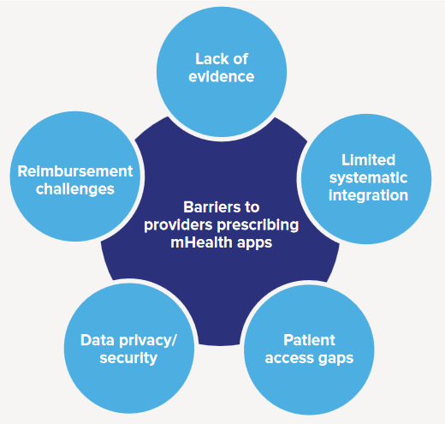
Barriers
Lack of evidence
Limited systematic integration
Patient access gaps
Data privacy and security
Reimbursement challenges
IMS Institute. Patient Adoption of mHealth: Use, Evidence and Remaining Barriers to Mainstream Acceptance. http://www.imshealth.com/files/web/IMSH%20Institute/Reports/Patient%20Adoption%20of%20mHealth/IIHI_Patient_Adoption_of_mHealth.pdf
Notes:
In addition to all the other obstacles we have listed (like security, privacy and the lack of a consolidated dashboard in your EMR for all the data your patients can potentially generate….) are these huge problems:
Research is slowly increasing. The sheer volume of apps hampers definitive research.
Health literacy and digital divide will only be exacerbated over the next few years. As mentioned, those patient who would benefit the most from the use of these apps do not have access to the technology, either lacking a smartphone, cell coverage, or the knowledge to use the apps.
Reimbursement is slow to adapt to the use of new technology along with health insurance coverage for the tech.
We still don’t have EMRs that talk to each other. Now we want to add app data?!?
Workflow in the clinics would have to adapt to this change.

Slide 65
Proactive Insurers
Aetna covers 46.3M people
Announced 9/2016
Will provide Apple Watch free to 50,000 employees who participate in wellness program
Developing integrated health apps with Apple
Will subsidize cost of Apple Watch to large employers
News Release: Aetna to Transform Members’ Consumer Health Experience using iPhone, iPad and Apple Watch. 9/2016. http://investor.aetna.com/phoenix.zhtml?c=110617&p=irol-newsArticle&ID=2206242
Notes:
HARTFORD, Conn.--(BUSINESS WIRE)--Sep. 27, 2016-- Aetna (NYSE:AET) today announced a new initiative to revolutionize members’ consumer health experience by combining the power of iOS apps and the unmatched user experience of Apple products including Apple Watch, iPhone and iPad with Aetna’s analytics-based wellness and care management programs. Beginning this fall, Aetna will make Apple Watch available to select large employers and individual customers during open enrollment season, and Aetna will be the first major health care company to subsidize a significant portion of the Apple Watch cost, offering monthly payroll deductions to make covering the remaining cost easier.
In addition to the customer program, Aetna will provide Apple Watch at no cost to its own nearly 50,000 employees, who will participate in the company’s wellness reimbursement program, to encourage them to live more productive, healthy lives.
Aetna’s iOS-exclusive health apps will aim to simplify the healthcare process through a number of features, including:
Care management and wellness, to help guide consumers through health events like a new diagnosis or prescription medication with user-driven support from nurses and people with similar conditions.
Medication adherence, to help consumers remember to take their medications, easily order refills and connect with their doctor if they need a different treatment through their Apple Watch or iPhone.
Integration with Apple Wallet, allowing consumers to check their deductible and pay a bill.
Personalized health plan on-boarding, information, messaging and decision support to help Aetna members understand and make the most of their benefits.

Slide 66
Proactive Institutions
Ochsner: Setting up their own App Store with apps they recommend to their patients.
Kaiser Permanente: develop certification system for medical apps.
U of Pittsburg Medical Center and Montefiore in NY developing apps for affiliated doctors.
Mount Sinai: RxUniverse, system wide platform to prescribe apps.
Scher, DL. The big problem with mobile health apps. Medscape. 2015. http://www.medscape.com/viewarticle/840335
Notes:
Here are some institutions that are tackling methods to curate and prescribe apps.
Let’s look at how Mount Sinai is doing it.
Another Article http://www.mobihealthnews.com/content/mount-sinai-launches-rxuniverse-system-wide-platform-prescribe-medical-apps/ 11/16

Slide 67
How Mount Sinai did It
Mount Sinai Launches Rx Universe –
Mobile Health Prescription Platform
https://www.youtube.com/watch?v=hNC7QYQP-lM
Notes:
Video is Mount Sinai Launches Rx Universe - Mobile Health Prescription Platform from The Mount Sinai Hospital 2:07 min

Slide 68
RxUniverse
Sinai AppLab has partnered with Mount Sinai Innovation Partners
Plans to launch new company: Responsive Health
License RxUniverse for use by other health systems
Mount Sinai Launches Rx Universe - Mobile Health Prescription Platform
http://www.mountsinai.org/about-us/newsroom/press-releases/mount-sinai-health-system-launches-first-enterprise-wide-platform-to-prescribe-apps-to-patients
Notes:
In response to the enthusiastic reception internally, it was recently announced that the Sinai AppLab has partnered with Mount Sinai Innovation Partners to launch a new startup company, Responsive Health, which will license RxUniverse for use by other health systems.

Slide 69
Resources to Possibly help Rx apps
AppScript.net
iPrescribeApps.com
Happtique and mWellthRx from SocialWellth.com
Xcertia
Notes:
These services seem to be attempting to fill the void left by FDA, which has provided limited oversight and guidance in the mobile medical app space. These attempting to make app prescription services available to independent providers include:
AppScript.net
iMedicalApps: iPrescribeApps (Q3 2017)
SocialWealth.com $ for payers, providers and employers
Let’s look at these individually
You can monitor developments at the following news and review resources:
MobiHealthNews.com
iMedicapApps.com
News release on SocialWellth.com acquisition of Happtique http://www.prweb.com/releases/2016/12/prweb13919855.htm

Slide 70
AppScript.net
From IMS Institute for Healthcare Informatics, now QuintilesIMS
Clinicians look at curated app store online of 60K+ curated apps
Prescribe apps, devices, content to patients’ phone
Currently available?
Pricing model?
Notes:
AppScript -- the cost of which IMS Health says will be on a per-doctor subscription basis, with a volume licensing discount available -- is a clear attempt to arm doctors and providers with a reliable measuring stick so that they can formally recommend certain apps for certain purposes. IMS even envisions a not-too-distant future where apps are prescribed as opposed to simply recommended. Repeated attempts to contact and requests for additional information were not acknowledged.
Developed by IMS Health, AppScript reviews each app's functionality, certifications, relevance, and peer and patient reviews. Physicians can then organize these apps based on the types of patients they see and the types of approaches and treatments they prefer.

Slide 71
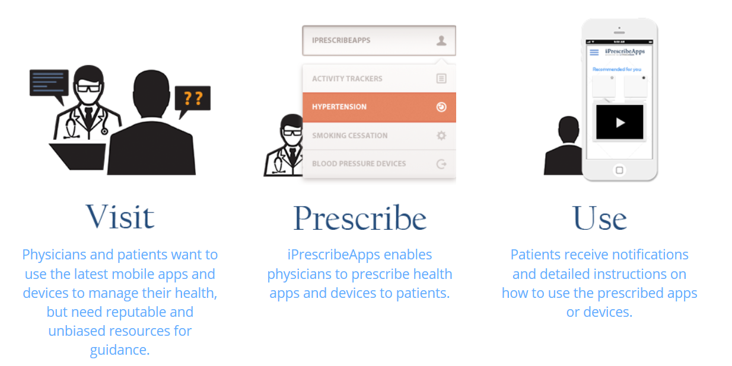
iPrescribeApps.com
From iMedicalApps.com who review medical apps – great RSS feed
Currently in Beta until Q3 2017
Sustainability? Pricing model?
Notes:
Free so far in beta with docs who signed up last year. No idea what the pricing model will be. Considered by Cochrane Collaborative as an evidence based site + considered an expert opinion.

Slide 72
SocialWellth.com
Announced 12/16 at HIMSS
Revived Happtique app curation effort
Creating mWellthRx, advertised to be a boutique of mHealth apps to enable docs to prescribe apps and digital content
mHealthOasis envisioned as consumer base
Vaporware? Pricing model? Sustainability?
Notes:
SocialWellth appears to be clearly targeting large employers, large payers, and large provider groups. But again, no real product has yet appeared. 5/1/17

Slide 73
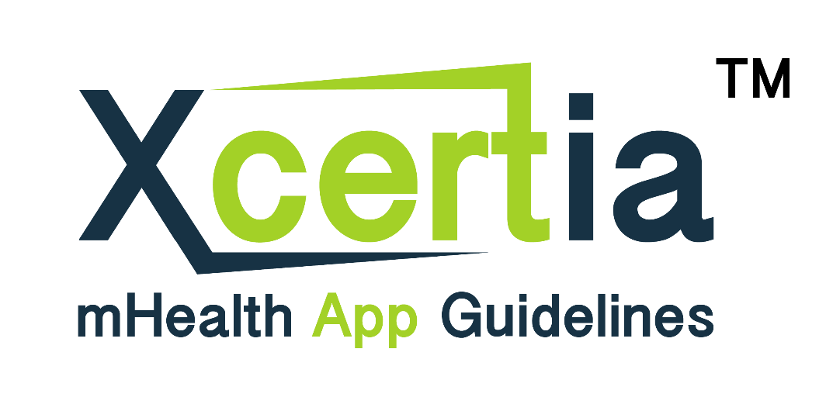
Xcertia.org
Consolidated effort to improve safety of mHealth apps
AMA, AHA, HIMSS and DHX Group.
Notes:
To add to the intrigue, David Vinson is the founder and CEO of SocialWellth and the founder and chairman of DHX Group.
A news release about Xcertia described the vision for the nonprofit’s membership and governing board as “open to representation from consumers, developers, payers, clinicians, academia and others with an interest in the development of guidelines for mobile health apps.” Their original intent was to curate medical apps, but have given that up and intend just to put out guidelines.

Slide 74
A starting point
When patient needs to track symptoms, treatments, medications….
Assess their technology adoption and suggest they find an app or suggest one you or staff are familiar with
Have them bring printout of data from online?
What works for you?
Notes:
If you don’t happen to be employed by Duke or Mount Sinai, who have their own app review and prescribing services, then you can try some of the following. We see advise to use your experience, your staff and colleagues’s experience with apps, talk to patients and see what has worked and not worked for them. Appscript may be your only option for a while. Investigate what your EMR developer is offering in data integration.
Advocate for parent org like TMH, CHP, Patient’s First…to get on board and license a service.
What have some of you tried?
Consider prescribing the same app to all people with the same condition so you are not having to accommodate multiple apps that do the same thing.

Slide 75
Evolution of Healthcare
In Person
Reactive
Broke - Fix
In Home
Connected
Semi-Reactive
Prevented
Predicted
Monitored
Zubin Eapen, MD, Epic and iHealth App: My Data, Your Data, Our Data: Using Apple’s HealthKit and ResearchKit to Improve Care Delivery and Clinical Research. Duke Global Health Institute. Video. May 2015. https://www.youtube.com/watch?v=MEh9murD_wk
Notes:
GREAT Video is 30 min. Duke Global Health Institute the talk is 20 minutes followed by audience questions.
Epic and iHealth App: My Data, Your Data, Our Data: Using Apple’s HealthKit and ResearchKit to Improve Care Delivery and Clinical Research 30 min. https://www.youtube.com/watch?v=MEh9murD_wk
Smart connected technology offers the possibility of moving from our current, expensive and inefficient status of healthcare being episodic, in person, reactive, and ‘fix when it breaks’ to a brighter future.

Slide 76
What will healthcare look like in 20 Years?
The Doctor's Office of the Future
Bloomberg Technology
January 18, 2017
.Nicholson, D. and Jeffries, A. The doctors office of the future. Bloomberg News . 1/18/17. https://www.bloomberg.com/news/videos/2017-01-18/the-doctor-s-office-of-the-future-video
Notes:
https://www.bloomberg.com/news/videos/2017-01-18/the-doctor-s-office-of-the-future-video 4:19 min

