Slide 1
Learning Styles and Approaches
How is this a predictor of your success in medical school and long- term as a physician?
Nancy B. Clark, M.Ed.
Director of Medical Informatics Education

Slide 2
Learning Styles and Approaches
What are your characteristics?
What do those scores mean?
How can you leverage knowing your characteristics to….
  Study efficiently and effectively
  Form the most effective study group
  Prep for the boards
  Select the right specialty
Notes:
There are hundreds of different learning styles inventories and personality trait tests that you can take. Many medical schools require them prior to admission, or administer them during orientation as team building exercises. I have linked to several of these on my web site. I picked out free ones, because we have spent all our money on technology!!! But seriously, these are mainly interesting from an individual’s perspective, and not predictive of academic success in medical school. We are going to spend the session learning about your traits. I will share the results of the classes learning styles inventories with the faculty in hopes that they consider your traits as they design their presentations.

Slide 3
Goals of Understanding LS
Short Term
  Self aware
  Succeed in med school
  Form cohesive, productive study groups
  Adapt to new learning situations
  Maintain Sanity
Long Term
  Life long learning
  Select right specialty
  Work well with healthcare team
  Teach students
  Educate patients
  Clinical competence
Notes:
My goals for you knowing your learning style are both short term and long term.

Slide 4
Development -- Piaget
Toddler
Adult
Notes:
Let’s start with developmental level as researched by Piaget and others. (Erikson, Kolberg) The arrow represents a continuum along which our learner may lie. This body of research shows us that children pass through predictable progressions of development which influence their perspectives and ability to learn at any given point in time.
To be effective, instruction must be responsive to the developmental levels and should reflect awareness of the general patterns of physical, emotional, cognitive and social development. Once an adult, new issues emerge, as researched by Crow and Knowles.
Each developmental level is so significant, that we have developed separate areas of Educational specialty--pre-school, elementary, secondary, higher and adult education.

Slide 5
Adult Learning Theory
Adult Learners
  Build on their experiences
  Accept responsibility for their own learning
  Self-directed; typically not dependent on others for direction
Learning takes place
  in context of a problem to be solved
  when questions are answered
  the issues are applicable to work/career
  when it doesn’t take too much time
http://www.qotfc.edu.au/resource/?page=65375
Notes:
Cross (1981) presents the Characteristics of Adults as Learners (CAL) model in the context of her analysis of lifelong learning programs. The model attempts to integrate other theoretical frameworks for adult learning such as andragogy ( Knowles ), experiential learning ( Rogers ), and lifespan psychology.
The CAL model consists of two classes of variables: personal characteristics and situational characteristics. Personal characteristics include: aging, life phases, and developmental stages. These three dimensions have different characteristics as far as lifelong learning is concerned. Aging results in the deterioration of certain sensory-motor abilities (e.g., eyesight, hearing, reaction time) while intelligence abilities (e.g., decision-making skills, reasoning, vocabulary) tend to improve. Life phases and developmental stages (e.g., marriage, job changes, retirement) involve a series of plateaus and transitions which may or may not be directly related to age.
Situational characteristics consist of part-time versus full-time learning, and voluntary versus compulsory learning. The administration of learning (i.e., schedules, locations, procedures) is strongly affected by the first variable; the second pertains to the self-directed, problem-centered nature of most adult learning.
Example:
Consider three adults: a nursing student, a new parent, and a middle-aged social worker about to take a course on child development. Each of these individuals differs in age (20,30,40) and life/developmental phases (adolescent/searching, young/striving, mature/stable). They also differ in terms of situational characteristics: for the nursing student, the course is full-time and compulsory, for the parent, it is part-time and optional; for the social worker it is part-time but required. According to the CA L model, a different learning program might be necessary for these three individuals to accomodate the differences in personal and situational characteristics.
Principles:
1. Adult learning programs should capitalize on the experience of participants.
2. Adult learning programs should adapt to the aging limitations of the participants.
3. Adults should be challenged to move to increasingly advanced stages of personal development.
4. Adults should have as much choice as possible in the availability and organization of learning programs.
References:
Cross, K.P. (1981). Adults as Learners. San Francisco: Jossey-Bass.

Slide 6
Transfer of Learner Control
Faculty
High
Doctor
Control of Learning
Low
Faculty
Student
Time
Medical School
Residency
Notes:
As a first year medical student, your learning is typically mostly controlled by the course directors and the content of each course. As you progress through medical school and on into residency and practice, you will find yourself increasingly self-directed on the content and depth of your learning, as the faculty will have less and less to do with guiding you, until the point where they are no longer there. This is why it is vital that you learn to be an independent, self-directed, lifelong learner.

Slide 7
Inventory of Learning Styles
Felder-Silverman Model
Decision
Active
Reflective
Perception
Sensing
Intuitive
Sensory Reception
Visual
Verbal
Organization
Sequential
Global
Weak 1-3 Moderate 5-7 Strong 9-11
Notes:
After taking the Inventory of Learning Styles, you will receive scores over 4 domains: decision making, perception, sensory reception, and organization.
A score of 1 or 3 shows a weak preference. These people will be the most flexible when it comes to adapting to a different style and a tendency to use either style.
A score of 5 or 7 shows a moderate preference for this style.
A score of 9 or 11 shows a Strong preference for this style, and an inflexibility to adapt to presentation of materials in an opposite style.
We will look at these individually.

Slide 8
Active vs Reflective
Tend to retain and understand information best by doing something with it—discussing, applying or explaining it to others.
"Let's try it out and see how it works"
Like to work in group
Sitting through lectures hard
Usually Extroverts
Prefer to think about it quietly first
"Let's think it through first" is reflective learner's response.
Reflective learners prefer studying alone
Are quiet in group learning situations
Usually Introverts
Notes:
How can active learners help themselves?
If you are an active learner in a class that allows little or no class time for discussion or problem-solving activities, you should try to compensate for these lacks when you study. Study in a group in which the members take turns explaining different topics to each other. Work with others to guess what you will be asked on the next test and figure out how you will answer. You will always retain information better if you find ways to do something with it.
How can reflective learners help themselves?
If you are a reflective learner in a class that allows little or no class time for thinking about new information, you should try to compensate for this lack when you study. Don't simply read or memorize the material; stop periodically to review what you have read and to think of possible questions or applications. You might find it helpful to write short summaries of readings or class notes in your own words. Doing so may take extra time but will enable you to retain the material more effectively.

Slide 9
Active vs Reflective
The majority of undergraduate students are Active
83% of college student leaders were active
65% of Phi Beta Kappas were reflective
Around 62% med students are Active
Majority of university professors are Reflective

Slide 10
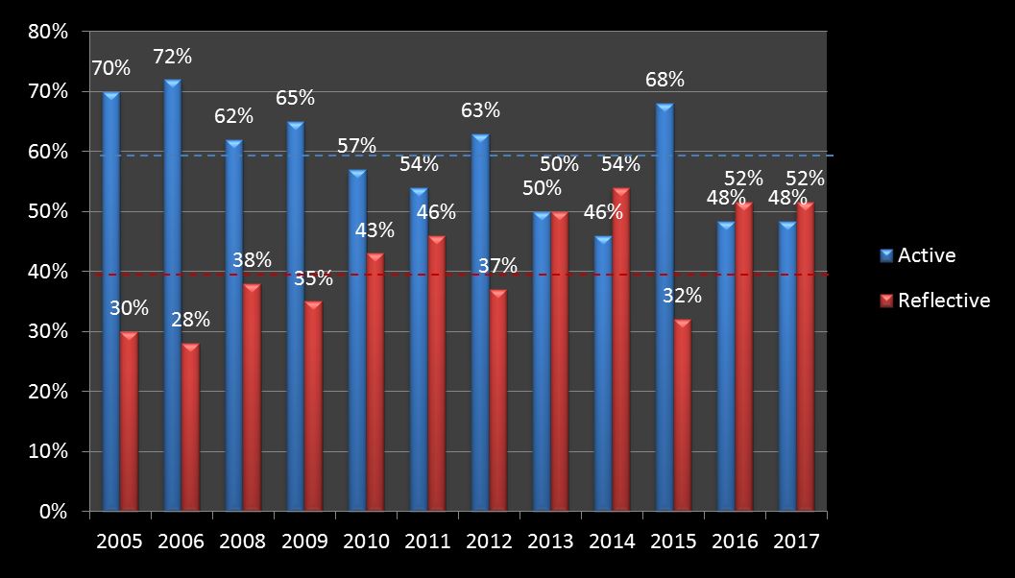
Classes to Date

Slide 11
Sensing vs Intuitive
like learning facts
like solving problems by well-established methods (logical)
dislike complications and surprises
want step-by-step instructions (linear)
patient with details (detailed)
Like memorizing facts and doing hands-on (procedures) work
more practical and careful than intuitors
don't like courses with no apparent connection to real world (concrete)
Notes:
Sensing and Intuitive is the only part of this inventory that is predictive of success in medical school and passing Step1 of the USMLE.
Intuitive is the most desirable approach.
Sensing students resent being tested on material that has not been explicitly covered in class

Slide 12
Sensing vs Intuitive
prefer discovering possibilities and relationships
like innovation and dislike repetition
may be better at grasping new concepts
often more comfortable than sensors with abstractions (abstract)
tend to work faster and to be more innovative than sensors
don't like "plug-and-chug" courses that involve memorization and routine calculations
Notes:
Intuitives see the connections between different subjects, topics, etc.

Slide 13

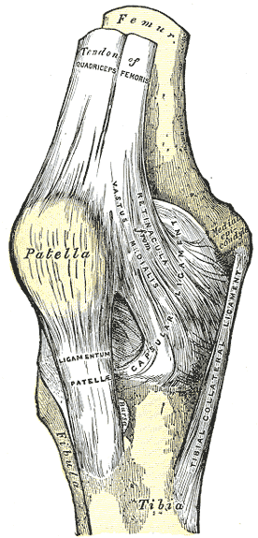

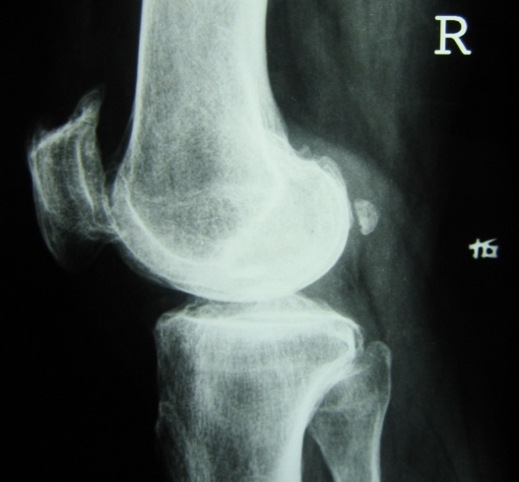
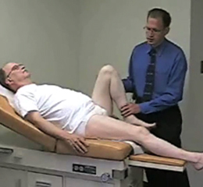
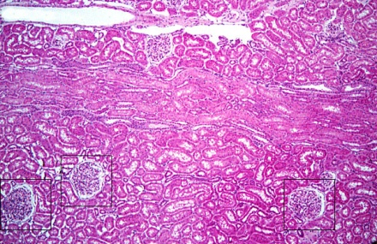
See the linkages in knowledge…
Notes:
This illustrates how vital it is to link prior knowledge and new knowledge with that learned in another area. While taking anatomy, you are learning to do the physical exams and take histories on the same areas of the body, and look at that area in different ways like radiology. As you progress thru the first two years into microbiology, genetics, histology and so forth, you should correlate the new learning with the old--see the connections--so that you will understand and commit to long term memory more easily. Do not think of any subject in medical school as a factoid in isolation.

Slide 14
Sensing vs Intuitive
The majority of undergraduates are Sensing
56% -72% college freshmen Sensing
83% of national merit scholarship finalists were Intuitive
92% of Rhodes Scholars were Intuitive
75% of first year medical students are Sensing*
Predictive of Passing Boards
Notes:
*of all students tested at FSU over the last 12 years.
How can sensing learners help themselves?
Sensors remember and understand information best if they can see how it connects to the real world. If you are in a class where most of the material is abstract and theoretical, you may have difficulty. Ask your instructor for specific examples of concepts and procedures, and find out how the concepts apply in practice. If the teacher does not provide enough specifics, try to find some in your course text or other references or by brainstorming with friends or classmates.
How can intuitive learners help themselves?
Many college lecture classes are aimed at intuitors. However, if you are an intuitor and you happen to be in a class that deals primarily with memorization and rote substitution in formulas, you may have trouble with boredom. Ask your instructor for interpretations or theories that link the facts, or try to find the connections yourself. You may also be prone to careless mistakes on test because you are impatient with details and don't like repetition (as in checking your completed solutions). Take time to read the entire question before you start answering and be sure to check your results

Slide 15
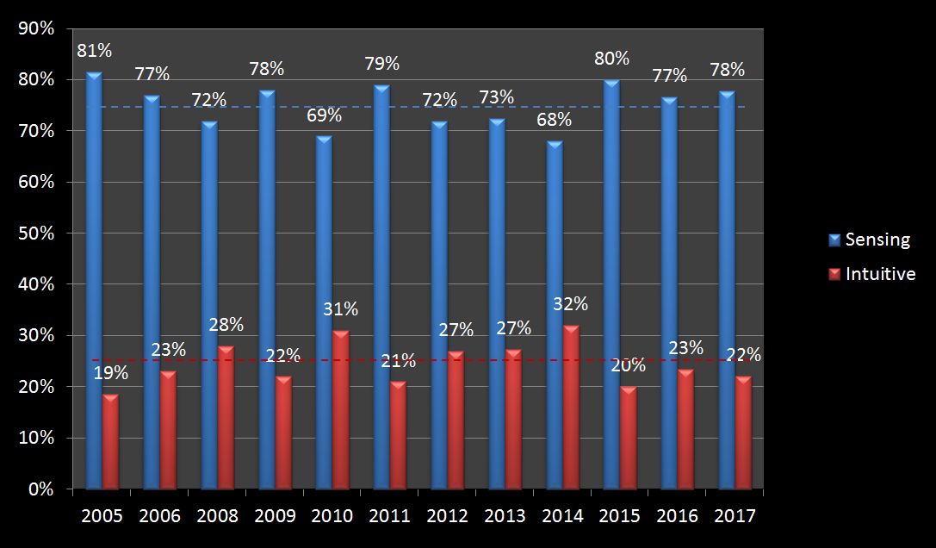
Classes to Date

Slide 16
Visual vs Verbal
Visual learners remember best what they see--pictures, diagrams, flow charts, time lines, films, and demonstrations
80% students are visual
Verbal learners get more out of words--written and spoken explanations
20% are verbal
Notes:
How can visual learners help themselves? If you are a visual learner, try to find diagrams, sketches, schematics, photographs, flow charts, or any other visual representation of course material that is predominantly verbal. Ask your instructor, consult reference books, and see if any videotapes or CD-ROM displays of the course material are available. Prepare a concept map by listing key points, enclosing them in boxes or circles, and drawing lines with arrows between concepts to show connections. Color-code your notes with a highlighter so that everything relating to one topic is the same color.
How can verbal learners help themselves?
Write summaries or outlines of course material in your own words. Working in groups can be particularly effective: you gain understanding of material by hearing classmates' explanations and you learn even more when you do the explaining.

Slide 17
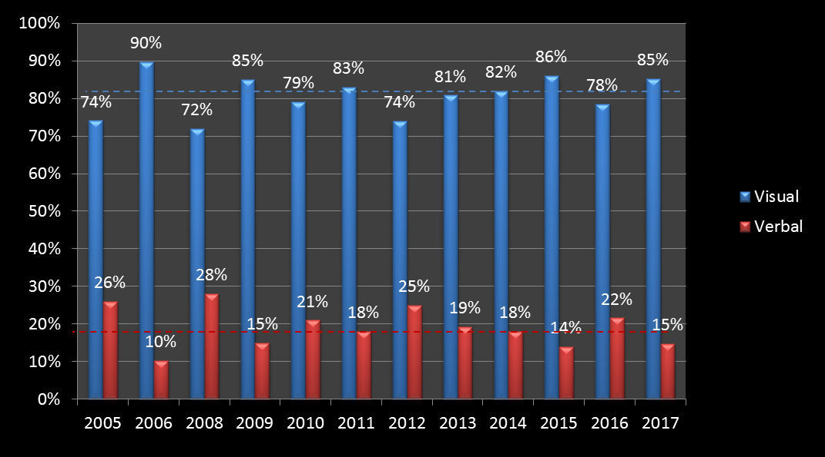
Classes to Date

Slide 18
Sensory Reception Preferences
Auditory
Visual
Reading/Writing
Kinesthetic
Notes:
It was recognized as early as WW2 in military training the importance of providing a variety of stimuli to increase learner retention.
Sensory Preference
Reading/Writing
The more read/write answers you chose, the more likely you learn best through reading or writing. Therefore, read all assignments. Focus on headings and subheadings to help you find the author's organization of information. You might find it useful to reread and rewrite words and notes. Use flashcards, lists, and charts to study.
Listening/Aural
The more aural answers you chose, the more likely you learn best by listening. You might think that you should tape your lectures, but that won't help you separate and organize important lecture ideas. Instead, try converting written lecture notes to audio tapes. To do so, you first review and edit your notes to identify the main ideas and important details. Then read your notes aloud into a tape recorder, leaving brief amounts of time between main ideas and questions. This gives you time to think and study. Participation in study groups and class discussions also provide ways to learn from what you hear.
Interactive/Kinesthetic
The more kinesthetic answers you chose, the more likely you learn by direct experience. When you learn from direct experience, you learn by touch or by physical movement. The more you do, the more you learn. Highlighting, underlining, labeling information, and writing add movement to learning. Mapping, charting, or creating other graphics also are ways to learn by doing. Role-plays, models, and experiments also help you learn actively. Participation in study groups or tutoring others provide additional ways to become an active learner.
Visual/Sight
The more visual answers you chose, the more likely you learn visually. Visual learners prefer flash charts, visual outlines or maps, and graphics. Adding meaningful symbols, colors, and graphics to notes also provide visual cues. Try to visualize how information appears on a page. In study groups or discussions, focus on how people look when they speak.

Slide 19
Organization-- Wertheimer
Gestalt Theory
Step 1
Step 2
Step 3
Step 4
…
Big Picture
Organization
Sequential
Global
Notes:
Individuals show a preference for organization in terms of perception and problem solving. In simple (southern) terms--some people are lumpers and some are splitters.
Learners with a preference for the big picture want to get the global picture first, and usually don’t care if they ever understand the minutia of the structure of the problem or the details. Detail oriented learners are concerned more with structures, step by step process, and can be more concerned with the parts than the whole of a situation.
To accommodate both types, the advanced organizers can be used prior to beginning instruction which is structured from simple to complex. Use analogies, summaries and syntheses.

Slide 20
Sequential vs Global
gain understanding in linear steps, with each step following logically from the previous one
follow logical stepwise paths in finding solutions
Majority of M1s are sequential
Detailed
62%
learn in large jumps, absorbing material almost randomly without seeing connections, and then suddenly "getting it."
to solve complex problems quickly or in novel ways, but have difficulty explaining how they did it.
Want to see Big picture first. Do not like details.
Notes:
How can sequential learners help themselves?
Most college courses are taught in a sequential manner. However, if you are a sequential learner and you have an instructor who jumps around from topic to topic or skips steps, you may have difficulty following and remembering. Ask the instructor to fill in the skipped steps, or fill them in yourself by consulting references. When you are studying, take the time to outline the lecture material for yourself in logical order. In the long run doing so will save you time. You might also try to strengthen your global thinking skills by relating each new topic you study to things you already know. The more you can do so, the deeper your understanding of the topic is likely to be.
How can global learners help themselves?
Before you begin to study the first section of a chapter in a text, skim through the entire chapter to get an overview. Doing so may be time-consuming initially but it may save you from going over and over individual parts later. Instead of spending a short time on every subject every night, you might find it more productive to immerse yourself in individual subjects for large blocks. Try to relate the subject to things you already know, either by asking the instructor to help you see connections or by consulting references. Above all, don't lose faith in yourself; you will eventually understand the new material, and once you do your understanding of how it connects to other topics and disciplines may enable you to apply it in ways that most sequential thinkers would never dream of.

Slide 21
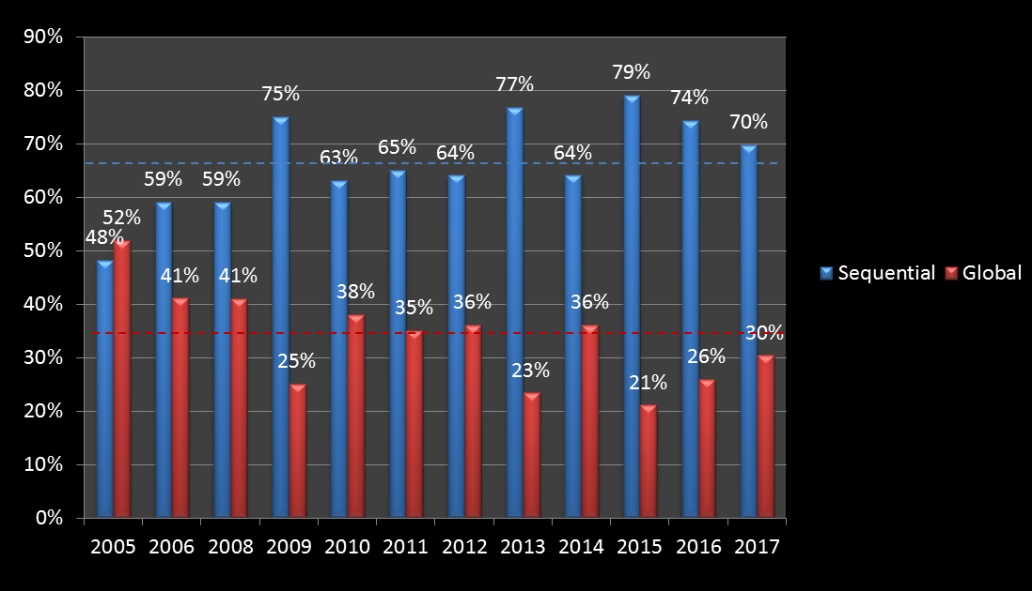
Classes to Date

Slide 22
Personality Inventory -- Jung
Myers-Briggs
Orientation
Extrovert
Introvert
Perception
Sensing
INtuitive
Judgment
Thinking
Feeling
Organization
Judging
Perceiving
ENFP
INTJ
ISTP
Notes:
Personality traits may affect how a person learns. P typing has been widely used in career development and counseling as well as business environments and as a tool for understanding in education. It can also be assessed and used as a basis for decision making about instructional strategies. The MBTI based on Carl Jung’s theory of personality type is the most widely used instrument to test personality.
Jung identified two ways people judge (how they make decisions) Thinking - information is organized and structured in logical, objective ways. Feeling, information is structured in a personal, value-oriented way.
He identified two ways people perceive (what a person pays attention to) Sensing - preference for taking in formation through the five senses, what is real and actual. And Intuition preference for taking in information through a “sixth” sense; what might be.
Jung also identified two orientations (how people interact with the world). Extroverts draw their energy for living from the outside world of people, activities and things. Introverts draw their energy from the internal world of ideas, emotions and impressions.
While Jung believed that the dynamic interaction of these preferences provided the core of our personality from birth, the reliability and validity of the MBI is weak.
Extroversion
Likes to work with others. Relatively short attention span. Learns what instructor wants. Acts quickly, but sometimes without completely thinking the situation through. Prefers variety and active learning opportunities. Prefers many activities or ideas to in-depth treatment of one idea. Becomes impatient when working on long-term tasks.
Introversion
Prefers to work alone. Can concentrate for long periods of time. Sets personal standards. May delay actions to think until too late to complete. Prefers quiet, uninterrupted study site. Prefers in-depth treatment of activities or ideas. Able to follow through until completion of long-term tasks.
Sensing
Prefers a step-by-step approach. Oriented to the present. Likes to refine current skills. Prefers realistic application. Attentive to detail. Patient. Works steadily. Prefers goal-oriented tasks. Prefers direct experience. Prepares well for tests involving practical application. Likes audio-visuals. Prefers to involve senses (underlining, flash cards, recitation). Needs to know rationale for a task before beginning. Prefers to study from old tests.
Intuitive
Tends to use a roundabout approach. Oriented to the future. Becomes bored after mastering a skill. Prefers imaginative application. Attentive to 'big picture'. Restless. Works in bursts of energy. Prefers open-ended assignments. Prefers reading or thinking. Prepares well for tests involving theoretical application. Likes mental visualization and memory activities. Prefers to involve right-brain strategies (mapping, drawing, charting). Comfortable with incomplete understanding of a task; believes task will 'come together' after time.
Thinking
Objective. Task-oriented. Firm. Motivated by desire for achievement. Applies standard criteria for evaluation. Looks for organizational structure.
Feeling
Subjective. Considers personal values. Flexible. Motivated by desire to be appreciated. Applies personal criteria for evaluation. Looks for personal relevancy.
Judging
Goal-oriented. Prefers structure of deadlines. Limits commitment. Prefers to work on one task at a time. Prefers closure in order to make decisions. Persistent. Rigid.
Perceiving
Self-directed. Prefers flexibility in completing tasks. Tends to overcommit. Starts several tasks at once. Delays closure in order to gather more information. Distracted. Flexible.
Average CO 2008 -2012
E 42.41%
I 57.59%
S 72.73%
N 27.27%
T 50.13%
F 49.87%
J 61.12%
P 38.88%

Slide 23
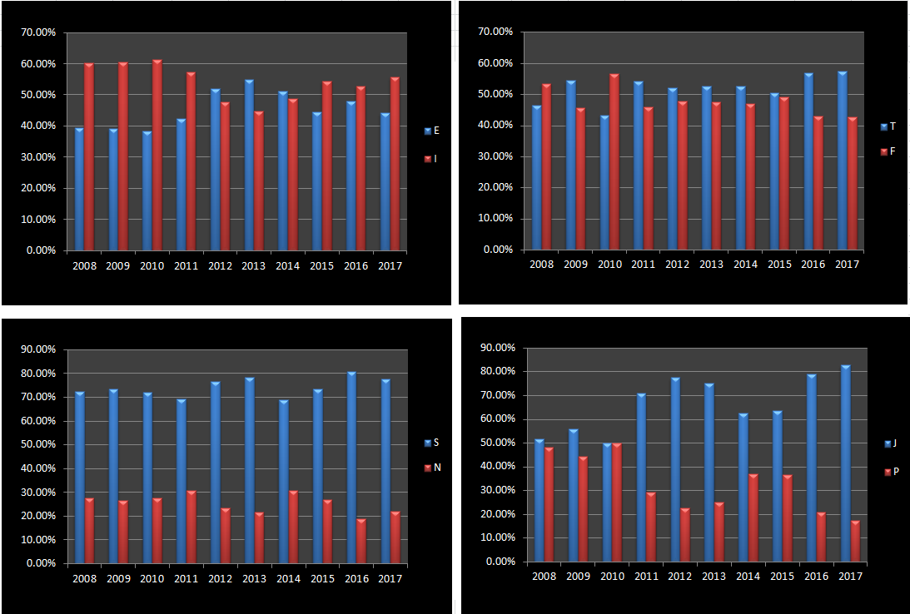
Classes To Date

Slide 24
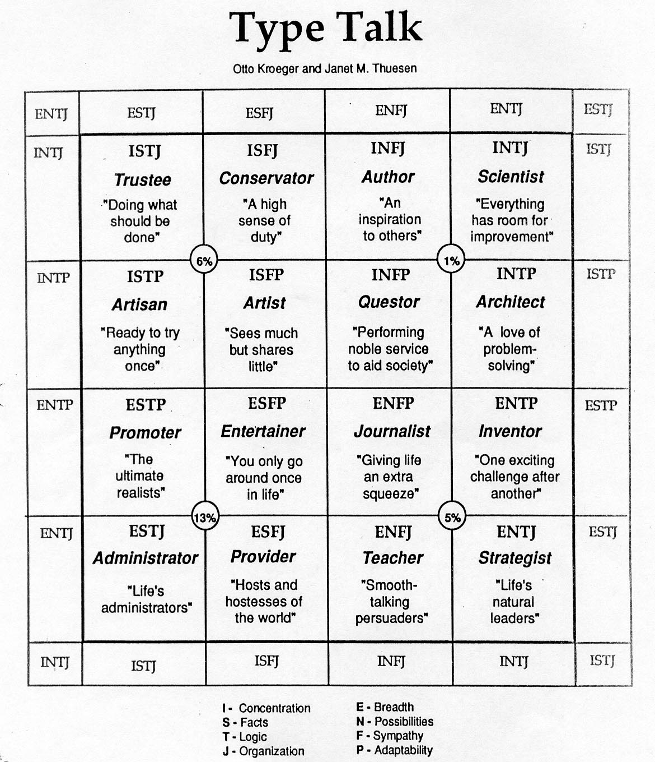

Slide 25

Useful Resource Based on Types
http://www.ttuhsc.edu/som/success/
Notes:
John Pelley is world renown for his resources that use the Myers Briggs Type Indicators to help medical students be successful in both medical school and passing the USMLE step 1 exam. Linked to Pelley’s site. http://www.ttuhsc.edu/SOM/Success/

Slide 26
Considerations for Specialty Selection
Specialty inventories not valid.
Lifestyle: call, free time, $, location...
Interest
Detailed versus global
Amount of patient interaction (E vs I)
Decision making style (active vs reflective)
Seeing results versus long term maintenance
Notes:
These inventories have almost no validity. The do make you start to think about your specialty choice in terms of lifestyle, interests, and preferences.

Slide 27
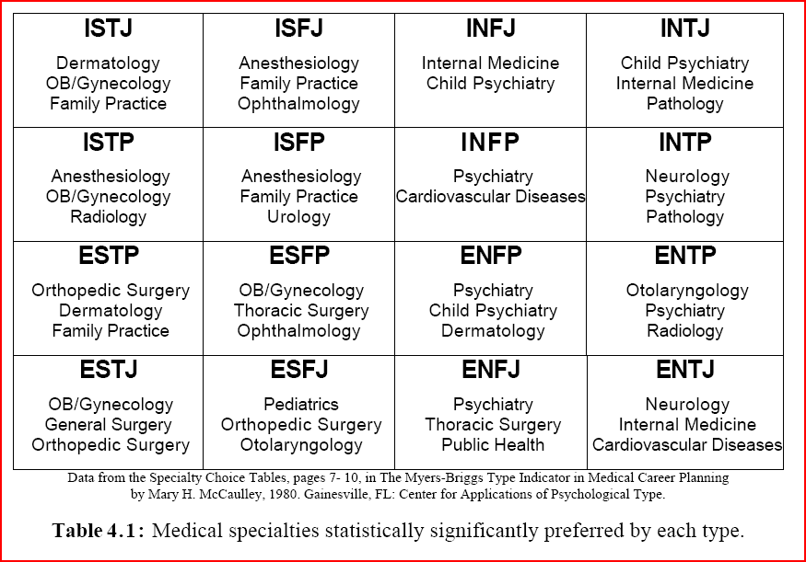
Notes:
Here is one study looking at MBTI types and specialties. All MBTI types are represented in all specialties but the frequency of some are higher than others.

Slide 28
Types and Specialty Selection
Women more likely than men to choose primary care.
Feeling more likely primary care than Thinking.
Intuitive more likely primary care than Sensing.
In non-primary care: more male, extraverts and thinking types in surgical subspecialties.
Stillwell, NA, et al. 2000. Myers-Briggs type and medical specialty choice: a new look at an old question. Teach & Learn Med. 12(1), 14-20.
Notes:
There are a number of research articles published on the relationship of personality types and specialty selection. Your type results should not be used in isolation in regard to specialty selection. You and your advisor should be cautioned against over-valuing type in the career selection process. Although type should never be the determining factor in specialty selection, it may be used to ascertain if the student’s type will be representative of or underrepresented in their chosen specialty.

Slide 29
Hemispheric Dominance
Herrmann
Linear
Sequential
Logical
Verbal
Reality based processing
List makers
Good spellers
Holistic/Global
Random
Intuitive
Nonverbal/visual
Fantasy oriented processing
Creative
Left Brain
Right Brain
Notes:
Correlations exist between Left Brain dominance and preferences for:
Linear
Sequential
Logical
Verbal
Reality based processing
Left brained people are list makers. They enjoy making a master schedule and doing daily planning. Left brained people are usually good spellers.
Correlations exist between Right Brain dominance and preferences for:
Holistic/Global
Random
Intuitive
Nonverbal/visual
Fantasy oriented processing
It is vital that a right brained student read the assigned reading prior to coming to class. To accommodate right brained students, faculty should give an overview before beginning class.

Slide 30

Approach To Learning

Slide 31
Approach to Learning
More predictive of success in medical school than learning styles
Three approaches to learning
  Surface
  Deep
  Strategic
Newble, DI & Entwistle, NJ. (1986) Learning styles and approaches: implications for medical education. Medical Education. (20);162-171.
Notes:
One European inventory classifies students into one of three categories in the way that they approach learning. Extensive studies have proven that this inventory is the most predictive of all the learning styles inventories and personality type indicators at predicting the success of medical students. The three approaches are surface, deep and strategic. Let’s look at these in detail.

Slide 32
Surface Approach
Predominate Motivation
  Passing the course
  Fear of failure
Intention
  Fulfill course requirements by reproduction
  Gorge and regurgitate
Learning Process
  Rote Learning: focus on tasks and pieces of information in isolation
  Uses routine procedures and repetition to memorize facts and ideas
Outcome
  Superficial level of understanding
  Substantial knowledge of factual information
“Is that going to be on the test?”
Notes:
Strongly sensing students who are allowed to indulge their preference, being taught by sensing faculty will fall into this category. When a student asks “Is this going to be on the test?” you know they are indulging in surface learning.

Slide 33
Deep Approach
Predominate Motivation
  Interest in subject matter
  Career relevance
Intention
  Reach personal understanding
Learning Process
  Relates evidence to ideas; details to big picture
  Relate new ideas to previous knowledge
  Read and study beyond the course requirements
Outcomes
  Deep level of understanding
  Integrated principles with facts
  Uses evidence to develop arguments
  Excellent problem solving skills
  Success in medical school
  Excellent physician with honed lifelong learning skills
Notes:
A deep approach can be subverted by adopting either a sequential or global approach to extremes. Here is where a balance of global and sequential characteristics can mean success. Intuitives are much more likely to adopt a Deep approach because they like to see the connections between theory and facts.

Slide 34
Strategic Approach
Predominate Motivation
  Making high grades
  Competing with others
Intention
  To be successful by any means
Learning Process
  Whatever it takes to make good grades
Outcome
  Variable level of understanding
  Shallow, course specific knowledge
  Depth of learning dependent on assessment strategies of courses and course requirements
Notes:
This type of strategy is actually now unnecessary because of our new Pass/Fail grading policy. Highly competitive undergrads need to back off and adopt a much more collegial, deep strategy.

