Slide 1
Finding Health Statistics
Nancy B. Clark, M.Ed.
Director of Medical Informatics Education
FSU College of Medicine

Slide 2
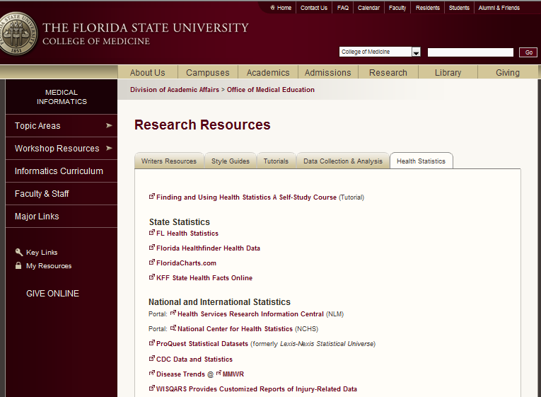
Informatics Resources
Topic Areas > Research
Health Statistics

Slide 3
Types of Health Statistics Questions
Fact lookups [population, demographics]
Research
Presentations
Social and Policy indicators
Notes:
For Fact Lookups, you need to find a table with the answers you need. One should understand the source of the information like the Census bureau or CDC while relating it to the definitions and knowing its limits. Look for a prepared table of digested data in published reports.
When doing research or a presentation you need information to form the bases of comparisons. In this case you will need to consider which population you are talking about and what question you are answering. talking about and what question you are answering. You may need both journal articles and the original data.
For Health and social policy, you need statistical indicators of progress. Uses can include drafting policies or legislation, monitoring success of health care and measuring the impact on society.
Health indicator can include
Quality of life indicators
Public health progress
Quality of care
Evaluation of efforts
You will need literature that summarize results and table that focus on key points.

Slide 4
Strategies for Finding Health Stats
Google Search
Use Portal
Start at Internet site
Start with book or article

Slide 5
Internet Portals of Health Stats
Lists of links that provide starting points for browsing or searching
Keyword search in portal vs Google
General idea what you want
The National Center for Health Statistics portal: http://www.cdc.gov/nchs/
Health Services Research Information Central (NLM)
Notes:
For links to portals, go to Related Health Services Research web sites. The Data Sets and Health Statistics sections are particularly relevant.
Go to the NCHS site and explore the variety of statistical resources available. What parts of this site are useful for fact lookup, research and indicators?

Slide 6
MMWR
Morbidity – illness
Mortality – death
http://www.cdc.gov/mmwr/
Disease Trends
Tables - searchable
Notes:
The morbidity and mortality weekly report is based on data collected by government agencies. Mortality data is based on death certificates at the National Vital Statistics System. Morbidity data is based on surveys and reports of outbreaks that funnel into the CDC. Only reportable diseases are close to accurate. Wellness data is not available because it is not collected.
In the NCSR you can find the whole report on deaths in some year.

Slide 7
Health Care Cost Data
Healthcare Cost and Utilization Project
HCUPnet
Hospital discharges
Ambulatory service
Costs
Amount of care
By diagnosis and procedure
Surveys of hosp, physicians, nursing homes
Notes:
See if you can find the median cost, length of stay and hospital death rate associated with hosp treatment of acute myocardial infarction.

Slide 8
Health Consequences
Costs to society, individuals
Cost from care
Costs of illness
Impact on infrastructure
HCFA➔CMS Health Accounts
http://cms.hhs.gov/
Notes:
Center for Medicare and Medicaid Services (formerly HCFA) site has all this information

Slide 9
Injury Prevention & Control
WISQARS (Web-based Injury Statistics Query and Reporting System) at CDC
Interactive system
Customized Reports
Fatal and nonfatal injury reports by cause
Violent Death report
http://www.cdc.gov/injury/wisqars/
l

Slide 10
State and International Data
FloridaHealthFinder.gov
Floridahealth.gov/reports-and-data/
FloridaCharts.com
KFF State Health Facts Online
United Nations Statistics Division
World Health Organization Research Tools

