Slide 1
Citation Management with EndnoteWeb
Nancy B. Clark, M.Ed.
Director of Medical Informatics Education
FSU College of Medicine
Spring 2014
All recourses are available online in Medical Informatics site
under Topics: Research

Slide 2
My Goal
All faculty and students will correctly cite all copyrighted resources (images, articles, videos, etc.) in their:
Presentations
Posters
Papers –Annotated Bibliography, Health Topic Brief, and Surgery Research Paper

Slide 3
Session Objectives
Attendees will be able to
Use Pubmed to search the medical journals
Find full text peer-reviewed journal articles
Find online health stats
Cite appropriately in a specified style
Use Endnote Web to manage citations and references for papers, posters and presentations

Slide 4
Tutorials Available
Tutorials at Pubmed
Searching PubMed
Using Mesh Terms
Using My NCBI
Tutorials at EndnoteWeb.com

Slide 5
Citations and References
Note: Endnote Web Camtasia Tutorials on Library Tutorials Page

Slide 6
Style Guides
Format of citation on referenced items
AMA Style Guide* (Same as JAMA)
Examples of AMA Citations
Other Style Guides
What do I mean by Style Guides?
Format required for submitting articles to journal
Informatics Resources|Topics|Research|Style Guides

Slide 7
APA Style
Now is the time for all good men to come to the aid of their country.(Alpay & Russell, 2002) Four score and seven years ago our forefathers brought forth a new nation conceived in liberty and dedicated to the proposition that all men are created equal.(Balen & Jewesson, 2004)
References
Alpay, L., & Russell, A. (2002). Information technology training in primary care: the nurses' voice. Comput Inform Nurs, 20(4), 136-142.
Balen, R. M., & Jewesson, P. J. (2004). Pharmacist computer skills and needs assessment survey. J Med Internet Res, 6(1), e11.

Slide 8
JAMA Style
Now is the time for all good men to come to the aid of their country.¹ Four score and seven years ago our forefathers brought forth a new nation conceived in liberty and dedicated to the proposition that all men are created equal.²
References
1. Alpay L, Russell A. Information technology training in primary care: the nurses' voice. Comput Inform Nurs. Jul-Aug 2002;20(4):136-142.
2. Balen RM, Jewesson PJ. Pharmacist computer skills and needs assessment survey. J Med Internet Res. Mar 29 2004;6(1):e11.

Slide 9
EndnoteWeb
Stores your reference citations on the web
Assign to topic groups
Word add-in
Manages Citations
Inserts References in Word
Automatically formats in selected style
Does not store PDF articles. Endnote desktop does.

Slide 10
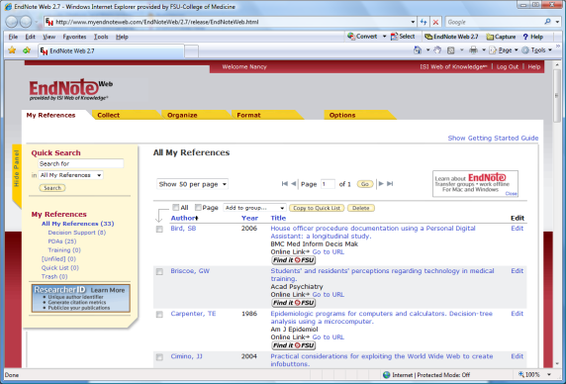
Research Paper
Endnote Library
of References
Now is the time for all good men to come to the aid of their country. (citation)
References
- Bibliographic citation
-
Stack of
References:
Journal articles
Book chapters
Web sites
Monographs
Word Document

Slide 11
First Time You Start Endnote Web
www.myendnoteweb.com
Set up Account
UserID: email
Password (8 character minimum, must have at least 1 letter, 1 number, 1 symbol)

Slide 12
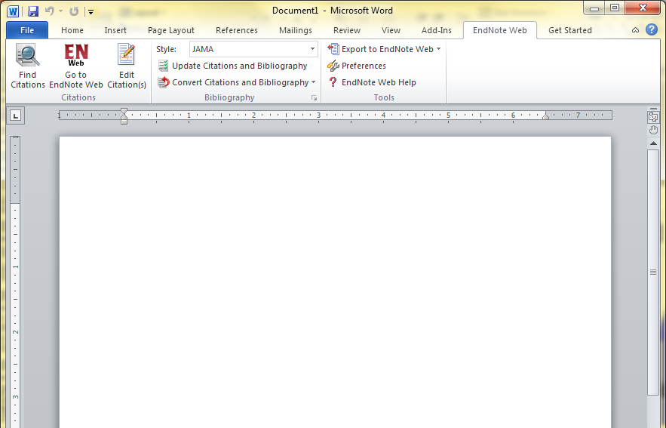
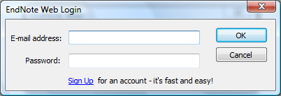
Start Endnote Web in Word 2010
X
Endnote Web Tool Bar on Ribbon
Will ask you to sign in if you have not Set Preferences

Slide 13
Use Endnote Web in Word
Create an Endnote Library online
Add all cited articles, books, websites, etc. to library
Set the Format to JAMA
As you type, Find and insert citation
Pick reference from library
Endnote creates the bibliography

Slide 14
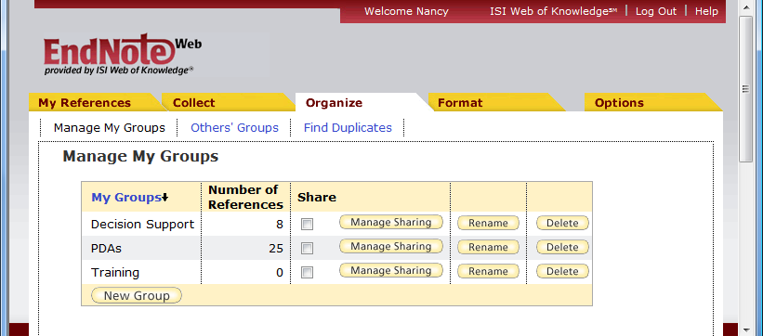
Organize Your References
Create New Group for a project

Slide 15
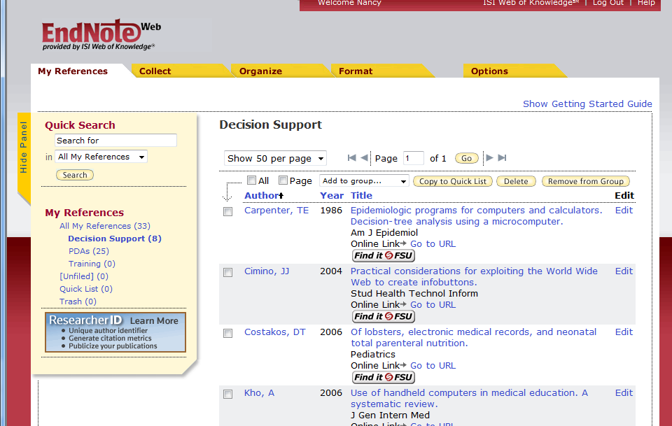
How to Populate the Library - Options
Endnote Web References
Manually enter references
Connect to Pubmed or other database and capture
Search Pubmed or other DB and save results then import (see tutorials on Library website)
In Google Scholar, WOS or OVID, search and export directly to Endnote

Slide 16
Add Citations to Library
Type them in
Book chapters
Images
Newspaper articles
Statistical Reports
Websites
Let Endnote Web grab from PubMed, PsychLit, OVID, etc.
Journal articles

Slide 17
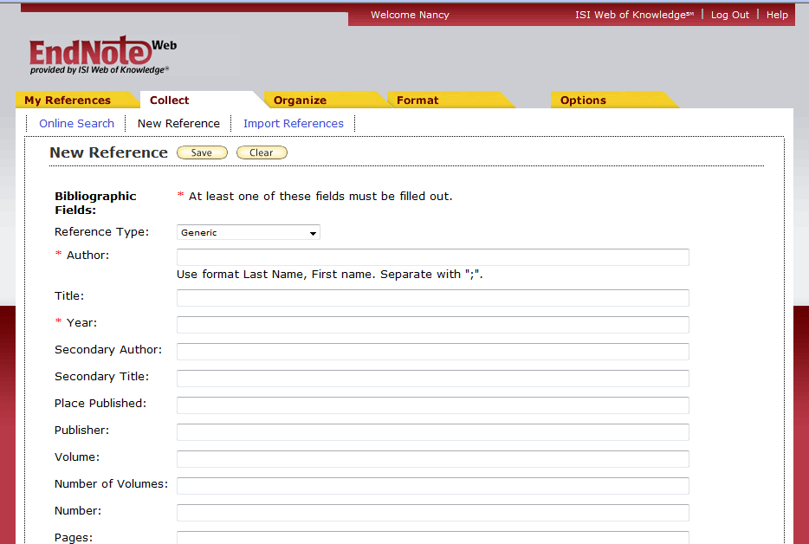
How to Type in Citation
In Endnote Web
Collect Tab
Select New Reference
Pick reference type
Type in fields
Pick Group to save to
Click SAVE

Slide 18
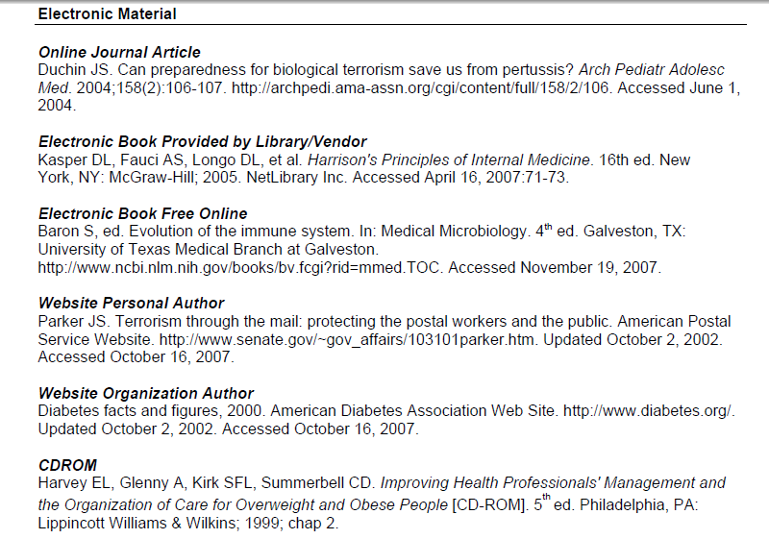
What Fields Do You Need to fill in?
Look at or print our
Examples AMA Citations
Under Style Guides in Research

Slide 19
Citing Images
Use Audiovisual Material: should contain the following information about the image:
Photographer's or artist's name (often not given)
Title of picture or Name of subject
Date of picture (often not given)
Title of website
URL of page in which image found (not of image itself)
Date you accessed the picture.
SAMPLE: Kawasaki, Satoko. Bobby Valentine. October 14, 2005. The Japan Times. www.japantimes.co.jp/ sports/2004bbpreview.htm October 27, 2005.

Slide 20
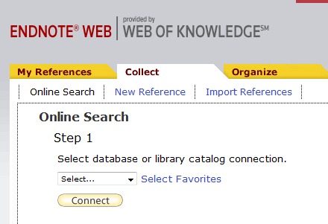
How to Capture References
Collect Tab
Online Search
Pick a source
Pubmed [NLM]
Connect
Select Favorites to limit scrolling

Slide 21
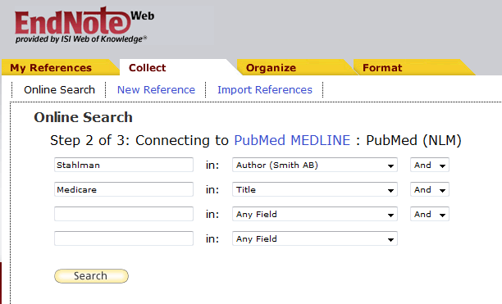
Perform Search
If article known
Use Author and Title word
Search

Slide 22
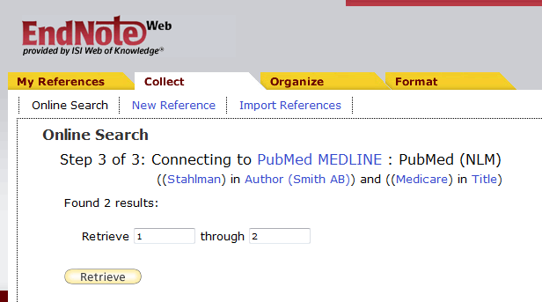
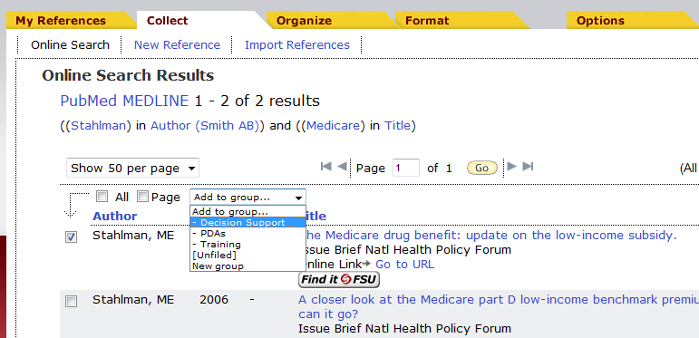
Perform Search
Retrieve Articles found
Pick article(s)
Add to Group
Pick group

Slide 23
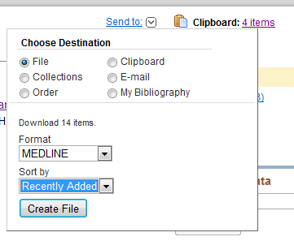
Export References from Pubmed
Collect articles in Clipboard [Check articles as found and Send to Clipboard.]
Open Clipboard and check all articles to export
Send to >> File
Format >> MEDLINE
Save on desktop

Slide 24
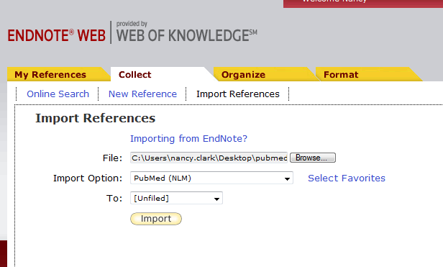
Import file into Endnote Web
Collect Tab >> Import References
Browse to file
Import Options: Pubmed (NLM)
To: >> pick a group
Import button

Slide 25
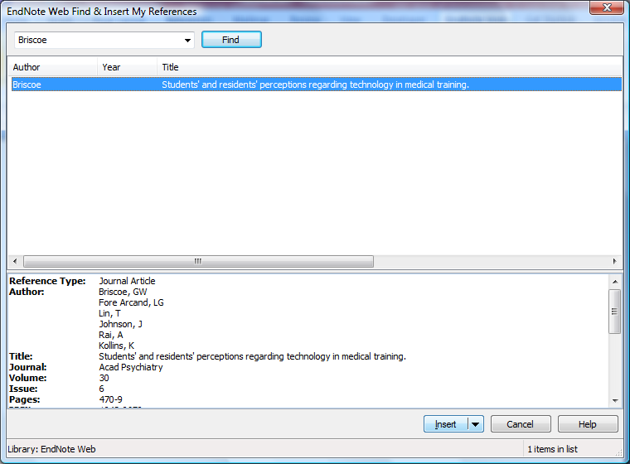
Cite While You Write
In Word
Put Cursor on spot
Endnote Web Ribbon
Find Citation
Type author or distinctive word in title
Click Find
Click citation of choice
Click Insert
Insert

Slide 26
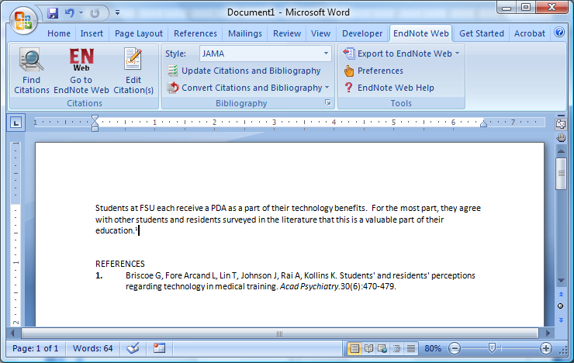
Citation and Reference Appear in Word Document

Slide 27
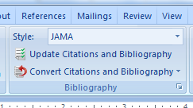
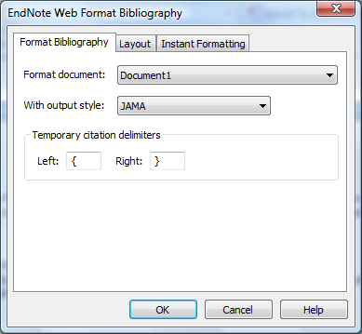
Set JAMA Style
Need to load 1 time
In Endnote Web Ribbon
Style: dropdown
Find JAMA
If not there…
Open Bibliography dialog box
Pick JAMA under output style

Slide 28
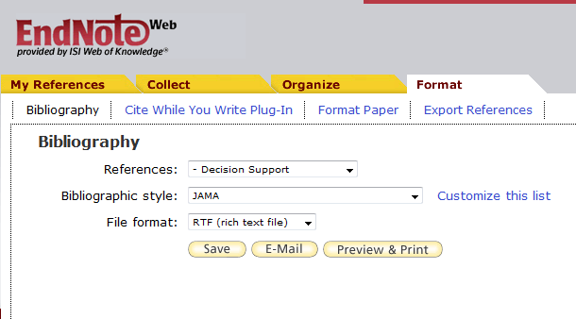
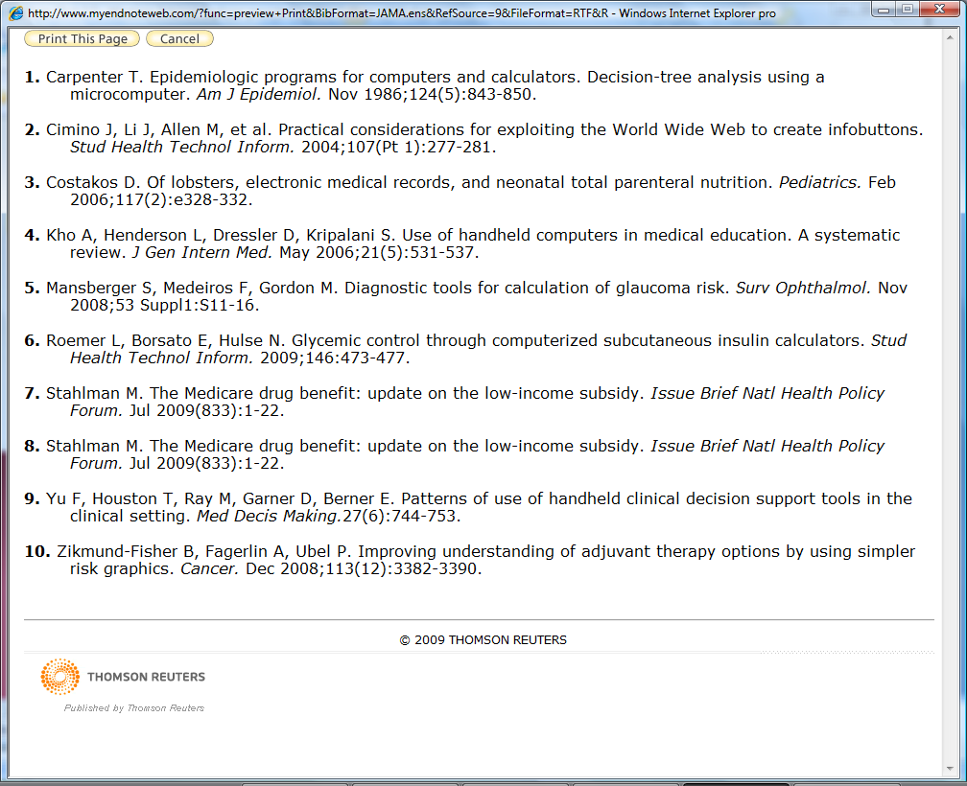
Export References
Citations for posters or presentations
Pick Style
Format >> Bibliography
Save as RTF
Open in Word
Copy and paste in PowerPoint/Publisher

Slide 29
Hands on practice
Do a few on your own.
If you are missing Endnote Web or Stedmans, go by IT office or tell Help Desk and get them installed.

Slide 30
In Summary
Use Pubmed to Search for Articles, My NCBI to manage
Use red FSU button to find articles
If no button: Med eJournals list > FSU eJournals > Interlibrary loan
Any journal article you need, we will get
Use Endnote to manage your citations in your papers, presentations and posters

Slide 31
The End
Practice
Call or e-mail us for individual help
850-644-3883
MedLibrary@med.fsu.edu

